Slide 1
Hands on Banking Experience
Notes:
The Hands on Banking Experience is a “real-world” money management simulation that helps to teach important financial education concepts of budgeting, comparison shopping and evaluating needs, wants, and tradeoffs in a relevant and engaging way. Each of you have received a profile detailing your career, income, and family status. You will use that profile today throughout this activity. Let’s start with a review of your profile and budget worksheet.

Slide 2
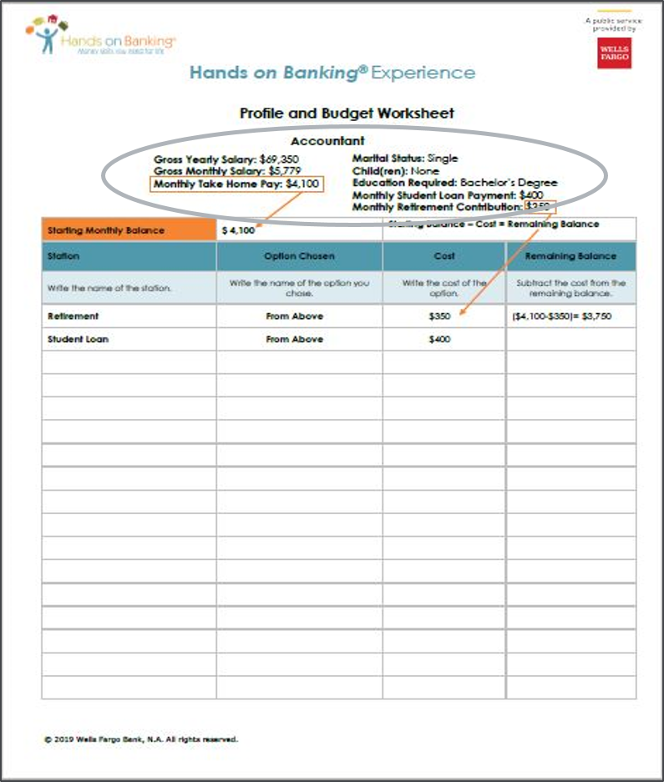
Profile and Budget Worksheet
Notes:
The Profile and Budget Worksheet includes information on your character’s career, income, and family. Did everyone get a profile by email? Make sure that’s open on your computer or that you have a printed copy.
You will use the information on your profile to make some “real world” financial decisions. Your profile indicates your profession and your income.
Let’s look at your income information. It lists your “gross” salary – if that’s a new term for you, that means the amount of money you make before any taxes or other deductions are taken out of your paycheck. Your profile also indicates your monthly take-home pay. That is exactly what it sounds like: the amount of money you get to keep from your paycheck after all taxes and deductions.
Next, look at whether your character is married or single. If you are married, you will see a box on the left side that tells you the profession of your spouse and the amount of their monthly take-home pay.
You will also see information about your level of education, whether you have a student loan payment, and if you have any children.
Next to the orange “starting monthly balance” box, we have totaled up your income (including your spouse’s income if you have one). This is the total amount of income you’re starting with for the month.
Does anyone want to share about your profile for the simulation? What’s your education level? Do you have a student loan payment? Who else is in your family?

Slide 3
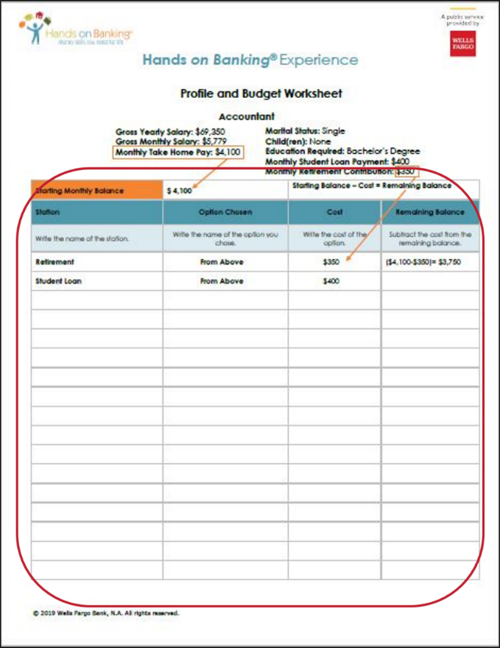
Profile and Budget Worksheet – continued
Notes:
Now let’s take a look at the budget worksheet below the profile. This simulation looks at one “month in the life,” and what your income and expenses might be in that month. If your worksheet is on your computer, you can type answers right on it. Or if you have a printed copy, you can write answers in – we recommend using a pencil, as you might end up wanting to change some choices! You might also want to have a calculator handy.
The first column is Station. In the Station column, you will write the name of the station you are currently visiting.
The second column is Option Chosen. At each station you will choose from several options that have different benefits and costs. In this column, write down the option you chose.
The third column is Expense. In this column, write down the expense associated with the station option you selected. Sometimes you will need to add up costs per person if you have a spouse and/or children to get the total cost for that item.
The final column is your Remaining Balance. This is the running total of money you have left for the month. Each time you make a choice at a station, you will subtract that expense from your balance above, and write your new remaining balance. If this number ever goes below zero you will need to revisit previous stations and make adjustments to your choices.
We also want to show how important it is to save for retirement, even at an early age. If possible, planning for retirement should begin in your first job out of high school or college. In this simulation, everyone saves for retirement. Your profile indicates how much you set aside for retirement each month, and we pre-filled that on your worksheet, and did the math for you to get your new monthly balance.
Next, you might have a student loan entry. Look at your profile to see if you have a student loan payment. If you do, that expense is already recorded for you on the worksheet – you will just need to calculate your new monthly balance. Subtract the loan expense from the previous monthly balance and record your new remaining balance.
If you don’t have any student loans, you don’t have this expense so your monthly balance will remain the same, and you don’t need to do anything right now.
(Ask for virtual “thumbs up” if students are following and ready to move on.)
As we move through the different decisions, remember to refer back to your profile. Some stations will have different costs based on your family size.
[Take a moment and ask students if they have any questions about how to use their profile and budget worksheet.]

Slide 4
Stations
Housing
Furniture
Transportation
Clothing
Communication (cell phone and internet)
Bank (savings)
Health insurance
Groceries
Childcare
Personal care
Entertainment
Eating out
Charitable contributions
Notes:
Here’s a preview of the 13 stations so you’ll have an idea of how many topics you will need money for.

Slide 5

The Experience
Notes:
Now we will play the simulation virtually – starting together with the first station. You will visit 13 stations and will have to make a choice at each station. While making your choices remember that you must stay within your remaining balance of your profile.

Slide 6

Housing
Pick the housing option below that meets your family situation and need.
Suburban | Downtown | Rural
If you choose to live in a suburban area, you can choose public transportation, but you cannot choose walking / biking. | If you choose to live downtown, you can choose public transportation or walking / biking as your transportation. | If you choose to live in a rural area you must have a car.
1 Bedroom Apartment Rent: $1,050 Renters Insurance: $15 Utilities: $135 Total Housing Expense: $1,200 | 1 Bedroom Apartment Rent: $1,550 Renters Insurance: $50 Utilities: $135 Total Housing Expense: $1,735 | 1 Bedroom Apartment Rent: $850 Renters Insurance: $15 Utilities: $90 Total Housing Expense: $975
2 Bedroom Apartment Rent: $1,235 Renters Insurance: $15 Utilities: $165 Total Housing Expense: $1,400 | 2 Bedroom Apartment Rent: $2,050 Renters Insurance: $75 Utilities: $135 Total Housing Expense: $2,260 | 2 Bedroom Apartment Rent: $1,050 Renters Insurance: $15 Utilities: $100 Total Housing Expense: $1,165
3 Bedroom House Mortgage: $2,420 Insurance: $80 Taxes: $300 Utilities: $200 Total Housing Expense: $3,000 | 3 Bedroom Condo Mortgage: $3,050 Insurance: $50 Taxes: $250 Condo Fees: $300 Utilities: $200 Total Housing Expense: $3,850 | 3 Bedroom House Mortgage: $1,150 Insurance: $40 Taxes: $240 Utilities: $185 Total Housing Expense: $1,615
Notes:
First, you’ll choose your housing. Decide whether you’ll live in a downtown, suburban, or rural area, and what size of home you need to fit your family.
You’ll notice that in some of the housing scenarios you are renting, and in some you own the home and pay a mortgage. There are pros and cons to both renting and buying.
Choose one option and write it on your budget worksheet – put “Housing” in the first column, then the name of the option you chose, and then the cost of that option.
While you’re looking at the options, we also want to point out that the housing you choose will impact the transportation options available to you later.
If you choose to live in a rural area, you must choose a car and cannot pick public transportation or walking/biking as an option.
If you choose suburban housing, you can choose a car or public transportation, but not walking/biking.
If you choose downtown housing, you can pick walking/biking.
When you’ve recorded your selection, be sure to do the math to subtract that expense from your balance and record your new remaining balance.
Pause and check for understanding and completion before moving on. Make sure the students have filled out the budget worksheet correctly.

Slide 7

Furniture
Pick one of the options for furniture below.
Thrift Store / Secondhand Furniture $75 | Discount New Furniture $170
Rental Furniture $300 | Designer New Furniture $600
Borrowed / Donated Furniture $0
Notes:
This is the furniture station and you are required to pick one choice for furniture from the options listed at the station. We know that furniture is not usually paid for monthly but we wanted to make sure you understand that furniture is an expense you have to consider when you’re an adult.
Share some of these key ideas:
Think about the type of furniture you realistically want for their family.
Think about the housing option you chose. What furniture makes the most sense for your family?

Slide 8

Transportation
Make a transportation selection. You can pick a new or used vehicle. If you have decided to live Downtown, you can use public transportation or walk / bike if it fits your family needs and budget.
New Vehicles | Cost
New 4 Door Sedan (46 MPG) | Car Payment: $370 Insurance: $120 / Gas: $100 Maintenance: $60 Total Auto Expense: $600
New Hybrid / Electric Car (58 MPG) | Car Payment: $460 Insurance: $115 / Gas: $50 Maintenance: $75 Total Auto Expense: $700
New Luxury Car (29 MPG) | Car Payment: $580 Insurance: $150 / Gas: $170 Maintenance: $100 Total Auto Expense: $1,000
New Minivan, SUV or Pickup Truck (22 MPG) | Car Payment: $420 Insurance: $120 / Gas: $160 Maintenance: $100 Total Auto Expense: $800
Used Vehicles | Cost
Used 4 Door Sedan (46 MPG) | Car Payment: $200 Insurance: $150 / Gas: $100 Maintenance: $100 Total Auto Expense: $500
Used Hybrid / Electric Car (58 MPG) | Car Payment: $305 Insurance: $170 / Gas: $50 Maintenance: $75 Total Auto Expense: $600
Used Luxury Car (29 MPG) | Car Payment: $300 Insurance: $175 / Gas: $185 Maintenance: $140 Total Auto Expense: $800
Used Minivan, SUV or Pickup Truck (22 MPG) | Car Payment: $255 Insurance: $150 / Gas: $170 Maintenance: $125 Total Auto Expense: $700
Public Transportation (regardless of family size) | $200
Walking / Biking | $0
Notes:
Now we have the transportation station. You are required to pick one transportation option from the choices listed at the station. Take a look at your profile and find the housing option you picked earlier and remember the rules from earlier:
If you chose to live in a rural area, you MUST have a car and cannot pick public transportation or walking/biking as an option.
If you chose to live in a suburban area, you can choose public transportation as an option but you cannot pick walking/biking.
You can only use the walking/biking choice if you chose the downtown housing option earlier.
If you get a vehicle, think about how big it needs to be to fit your family.
Share some of these key ideas:
Owning a car can be very expensive. Public transportation is a great way to save money but can be less convenient.
If you live in an area where you have to own a car, consider if it would be cheaper to live in an area where you can use public transportation.
If you buy a car, you might want to consider the gas mileage – Miles Per Gallon (MPG) – as you can save money in the long run by getting more mileage out of the gas you buy.
[Ask for thumbs up when they’re done, and move on when most are ready]

Slide 9
Clothing
Pick your choice for clothing from the options below. Remember all of the prices shown are per adult and per child. Be sure to make a choice for each member of your family.
Yard Sale Per Adult: $30 Per Child: $15 | Thrift Stores Per Adult: $40 Per Child: $20
Discount Stores Per Adult: $60 Per Child: $30 | Department Stores Per Adult: $100 Per Child: $50
Designer Per Adult: $150 Per Child: $75
Notes:
Now we have the clothing station. You are required to pick one of the clothing options listed on the slide.
Important Note: Prices are per adult and per child in their family. Refer back to your profile to help determine the total station cost. Calculate the total cost for clothing for your family and write the choice on your profile sheet.
Share some of these key ideas:
Buying clothes from a thrift store may be a great way to save money. You may even find some cool vintage items!
Many thrift stores only resell items that are in good shape.

Slide 10

It’s Time for a Chance Card!
There is a hail storm in your area and your window breaks.
Pay $100 to have it fixed.
Notes:
For this activity we wanted to show that unexpected expenses can happen at any time, so we included “chance cards.” These cards mimic real life expenses – while there are a few “good” cards where you gain some money, most are unexpected expenses with some cost associated.
Subtract $100 from your balance.

Slide 11

Communication
Select a mobile phone plan and an internet plan below. Optionally, you may add a cable/streaming plan.
Mobile Phone (must choose one)
Pre-Paid Cell Phone Plan Included: 200 minutes per month and 100 texts per month Cost: $40 (Add $20 for each additional person on the plan)
Basic Cell Phone Plan Included: Unlimited minutes, 100 texts and 1GB of data Cost: $65 (Add $20 for each person on the plan)
Unlimited Cell Phone Plan Included: Unlimited minutes, unlimited texts, unlimited data Cost: $120 (covers all people on the plan)
Internet (must choose one)
Basic Home Internet Cost: $65
High Speed Home Internet Cost: $85
Cable/Streaming (optional)
Basic Cable Basic Channels Cost: $65
Premium Cable Premium Channels Cost: $85
Basic Streaming Online streaming service Cost: $20
Notes:
This is the communication station. You are required to choose a mobile phone plan and an internet plan, because in reality these are both essential to function in the modern world. Optionally, you can add cable or a streaming service as a “nice to have.”
Remember, on your profile, write down the name of the station, what option you picked and the cost, and then come up with your new remaining balance by deducting this expense from your remaining balance.
Share some of these key ideas:
Be sure to think about what you currently have for communication and entertainment.
Do you have a smart phone?
Do you use Wi-Fi at home?
Do you have cable?
Do you use streaming services?
FAQ:
Can we add a cable plan AND streaming service? Sure! (If you feel you have the budget for that!)
Can I get an antenna to just get local TV channels? Sure, you could make a one-time purchase of a digital antenna for about $20 to just get local channels, and then you wouldn’t have a monthly expense. (If that’s your choice, just skip the TV option for this simulation of monthly expenses.)

Slide 12

Bank
Pick at least one of the savings accounts below and deposit a minimum of $10. Consider college savings if you have children.
Savings
$10 | $25 | $50 or more
College Savings
$10 | $25 | $50 or more
Emergency Savings
$10 | $25 | $50 or more
Notes:
At the Bank station, you are required to put a minimum of $10 into one of the savings accounts listed. You can choose any one of the three types of savings accounts, or put money in more than one. The college savings account is an option to consider if you have children.
Share some of these key ideas:
Saving money is like paying yourself first.
Saving is important to reach many of your financial goals. The saving options here can help you get started.
An emergency savings account can help you if you have unforeseen events like an illness or job loss.
Even if you think you don’t have enough money to save, consider starting small… it adds up.

Slide 13
It’s Time for a Chance Card!
It’s your birthday and you get a gift! Add $100 to your account.

Slide 14

Health Insurance
Choose an option for health insurance – medical at minimum, and perhaps also dental and vision.
Type | Cost for 1 Person | Cost for 2 People | Cost for 3+ People
Medical Insurance Only | $100 | $200 | $350
Medical and Dental Insurance Bundle | $150 | $300 | $400
Medical, Dental and Vision Insurance Bundle | $200 | $400 | $700
Notes:
At this station you are required to pick one insurance option from the choices listed. Let’s assume you will obtain the same coverage for everyone in your family – so after you decide which type of plan to get, use the cost corresponding to the number of people in your family (1 for just yourself, 2, or 3+).
Share some of these key ideas:
So why are you paying for insurance? The basic concept is that you pay some money upfront to protect you from bigger costs down the road if something happens, and to cover routine care that can prevent bigger health problems.
Let’s say for example that you break a bone. If you’ve been paying for insurance, you only have to pay a small amount now to get treatment. But without insurance, you will have to pay the full medical bill that’s probably thousands of dollars.
Another example: If you wear glasses, if you choose to buy vision insurance, your insurance plan will cover at least some of the cost when you need to get new glasses. If you don’t have vision insurance, you will pay the full cost for new glasses yourself. (e.g. The cost vs. benefit might depend on how often you usually need to get new glasses.)
Also, the checkups that insurance covers can save you money in the long run by preventing more serious medical, dental, or vision problems.
So, insurance helps protect you again both health and financial risks.
Insurance can be expensive, but paying for medical services out of pocket is generally more expensive.
When you are considering employers and jobs in the future, you may want to ask what benefits they offer, like insurance.

Slide 15

Groceries
Pick one of the grocery plans below.
Type | Cost for 1 Person | Cost for 2 People | Cost for 3 People | Cost for 4+ People
Regular Grocery Plan | $330 | $640 | $740 | $890
Organic Grocery Plan | $400 | $770 | $890 | $1,070
Notes:
Time to go grocery shopping! You are required to pick one of the two grocery plans listed at the station. The costs are listed by how many people you have in your family.
Share some of these key ideas:
Organic groceries may be healthier and more expensive.
Think about the type of groceries you or your guardian currently buy.

Slide 16

It’s Time for a Chance Card!
You have a toothache, and the dentist says it’s a cavity that needs to be filled!
Do you have dental insurance?
  If yes, pay $25 as your portion of the cost.
  If no, pay the full bill of $250.
Notes:
This chance card says you need to have a tooth cavity filled. Here’s an example of the real impact of whether you chose an optional insurance policy, for dental care. If you have insurance, you pay a small fraction of the cost of care and insurance covers the rest. If you don’t have insurance, you need to pay the full bill yourself.

Slide 17

Childcare
If you have children under the age of 14, choose a childcare option corresponding to the age of your child(ren). The nanny cost is for the whole family, and the costs for all other options are per child.
For child(ren) 0-2 years old:
Infant Full-Time Day Care | $1,000 per child
For child(ren) 5-13 years old:
Community After-School Care | $400 per child
Private After-School Care | $600 per child
School-Provided After-School Care | $250 per child
For child(ren) 3-4 years old:
Toddler Full-Time Day Care | $800 per child
For child(ren) of any age:
Nanny | $2,400 (family cost)
Notes:
This is the Childcare station and you need to pick one of the childcare options if you have any children under the age of 14. Check your profile to see what age your children are, and choose an option matching their age, or consider the nanny option for any ages. The cost for each option is per child except for the nanny option. With a nanny, the cost is for your entire family.
(Note: We’re using age 14 as the threshold just for illustration in this exercise. In reality, every family is different.)
Share some of these key ideas:
Some families choose childcare services because of their work schedule.
There are different types of childcare available. Some offer extra services like homework help and even fieldtrips.

Slide 18
Personal Care
Pick one of the options for personal care below.
Choose one:
Low-Cost Personal Care Plan Included: brush, toothbrush, toothpaste, shampoo and cleaning supplies. Cost for Individuals: $30 Cost for Families: $60
Moderate-Cost Personal Care Plan Included: brush, toothbrush, toothpaste, shampoo, cleaning supplies, nail polish and vitamins. Cost for Individuals: $50 Cost for Families: $100
High-Cost Personal Care Plan Included: brush, toothbrush, toothpaste, shampoo, cleaning supplies, nail polish, vitamins, cologne or perfume. Cost for Individuals: $75 Cost for Families: $125
Optional Personal Care Add-Ons:
Salon Visit: $50 Professional Haircut: $20 Manicure / Pedicure: $50 Dry Cleaning: $40 Home Cleaning Service: $90
Notes:
Next we have the Personal Care Station. At this station you need to pick one of the personal care plans listed. The cost is either per person or per family. You can choose as many personal care add-ons as you like. You can also choose the same add-on more than once.
Share some of these key ideas:
Consider how much you currently spend on personal care items.
Certain things at this station are wants and not needs. Which things do you need in a given month, and which would be “nice to have”?
CAN END SIMULATION HERE IF RUNNING OUT OF TIME – SKIP TO SLIDE 21, “REVIEW”

Slide 19

Entertainment
Pick as many of the entertainment options below as you would like. Remember, all costs are per person in your family.
Swimming Cost Per Person - $10 | Recreation Center Membership Cost Per Person - $15 | Museum Cost Per Person - $15
Bowling Cost Per Person - $20 | Camping Cost Per Person - $20 | Skating Cost Per Person - $20
Movies Cost Per Person - $20 | Zoo Cost Per Person - $30 | Amusement Park Cost Per Person - $45
Concert Cost Per Person - $50 | Skiing Cost Per Person - $70 | Family Vacation Cost Per Person - $120
Library Free | Bike Ride Free | Park / Hike Free
Notes:
At the entertainment station you are required to pick at least one option.
The cost for each activity is per person in your family.
Think about what you can realistically afford based on the size of your family.
If you don’t have much money to spend or want to save more money, check out one of the free activities (library, bike ride, or park/hike).
Share some of these key ideas:
The activities on this station are per person, so be realistic when looking at your budget and what you can afford. Also think about how many activities you would do in a given month.
What kinds of activities do you currently do with your family?

Slide 20

Eating Out
Pick at least one of the options below.
 | Once a week (4 times per month) | Twice a week (8 times per month) | Three times a week (12 times per month)
Fast Food | $24 per person | $48 per person | $72 per person
Casual Dining | $120 per person | $240 per person | $360 per person
Fine Dining | $260 per person | $520 per person | $780 per person
Add-ons | Cost per person
Pizza | $20 per pizza
Coffee | $5 per coffee
Smoothie | $6 per smoothie
Notes:
This is the eating out station.
The cost for this activity is per person in your family, and the costs are listed by how any times you would like to eat out each month.
If your budget allows, choose one of the eating-out plans. You can also pick as many add-ons as you would like, but remember the cost is per person.
If you are getting short on money, you have the option to skip eating out at all, or to choose just an add-on, such as one pizza during the month.
Share some of these key ideas:
Currently, how many times per month do you think you eat out now? Be realistic with yourself.
Cutting back on the amount of times you eat out could help you save money.

Slide 21

Charitable Contributions
Donate a minimum of $10 to one or more of the charities listed below and / or select community service.
Type | Donation Amount
Community Organization | Donate $10 or More
Youth Organization | Donate $10 or More
Religious Donation | Donate $10 or More
Community Service | $0 5 hours or more time commitment
Medical Research Charity | Donate $10 or More
Animal Shelter | Donate $10 or More
Homeless Shelter | Donate $10 or More
Notes:
It’s important to give back so we have included this Charitable Giving Station.
You are required to donate a minimum of $10 to at least one of the charities listed at the station but you can choose more.
You may choose the community service option which is no cost to you but there is a time commitment. Consider your profession and family commitments before picking community service.
Share some of these key ideas:
A donation to a charity can help those in need.
Charitable donations of any amount can help your community.

Slide 22
Review
Notes:
Now that we have gone through all of the stations, are there any stations that anyone needs to revisit in order to change their decisions? [Wait for students to answer and go back to any of the stations they request]
Example: If you’re out of money, did you put money in a savings account? That’s why saving is important – so you have a cushion if you need it.

Slide 23
Debrief
Notes:
Now that we have finished the simulation let’s have an open discussion about some of the things that happened during the simulation. [Use these discussion questions to guide your debrief and reinforce lessons taught in the Hands on Banking Experience]
What reactions do you have to this simulation?
What lessons did you learn from this activity?
What considerations were important as you visited each station?
Does anyone want to share your strategy – whether you thought it was successful or not?
Who had money left over? Did anyone run out of money?
Who had children? How did that affect the decisions you made?
Did you return to any station and change your decision? Which one? Why?
Which station was the most challenging to make a choice? The easiest?
How did you handle the unexpected expenses?
You might have noticed an education level on your profile – e.g. high school diploma or different levels of college or graduate degree. What impact do you think that had on your income situation?
Make the point that the amount of education you have correlates to your income level. You might have noticed that a higher education level might have given you a higher income level.
How did that impact the amount of money you had left over?
Make the point that these outcomes aren’t fixed – you can make choices to influence the amount of money you have. Seeking additional knowledge and skills can change your income.
Based on what you learned, what might you do differently in your real life?

Slide 24


Thank you
For additional information email us at hobinfo@wellsfargo.com or visit:
  www.handsonbanking.org
  www.elfuturoentusmanos.org

