Slide 1
Credit Cards
BEFORE PRESENTING THIS MATERIAL:
ADD YOUR NAME TO THE FIRST PAGE
PRACTICE THE PRESENTATION FOR TIMING
REVIEW PRESENTER NOTES TO BECOME FAMILIAR WITH THE INFO / SLIDES
PUT PRESENTATION INTO ‘SLIDE SHOW’ MODE TO CLICK THROUGH THE PRESENTATION AND USE THE INTERACTIVE ELEMENTS.
DELETE THIS MESSAGE BEFORE PRESENTING.
Presenter Name
Notes:
Instructions
Fill out your name in the presentation and save a copy for presenting to the class.
Introduce yourself to the class. Share with them what your role is.
Share with the class what you’ll be covering today:
Today we’re going to talk about credit and interest. Credit is about borrowing money.
We’ll also learn about two different types of credit—credit cards and loans.
Ask the class if they have any questions before we begin?

Slide 2
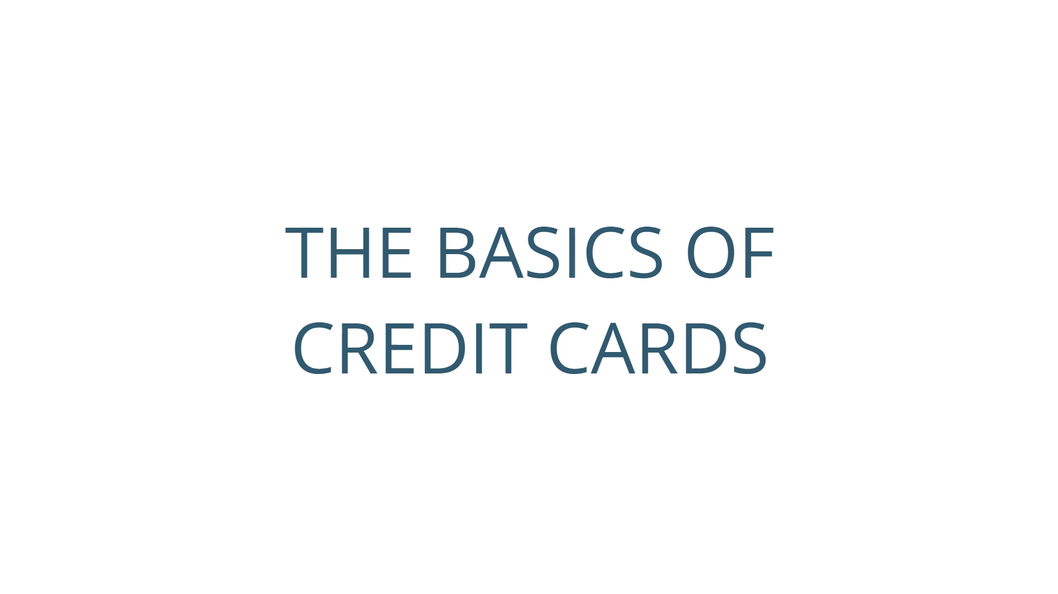
Credit Card Basics
Notes:
Play the ‘Basics of Credit Cards’ video. Ask participants if they have any questions.

Slide 3
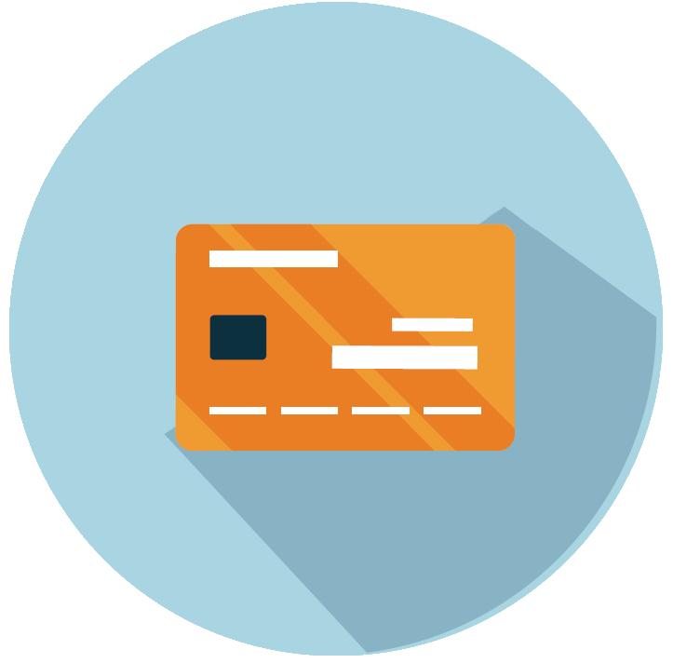
Credit Card Basics
Credit cards can be more convenient than cash
Every time you use your credit card, you are actually borrowing the money
Credit cards are called ‘revolving debt’ because as you pay the money back, your credit becomes available for you to use again
Payment flexibility:
  The amount owed in full
  Pay a partial payment
  Just the minimum payment
Typically, you will not be charged interest on purchases if you pay your entire balance by the due date each month
Notes:
Review the basics of credit cards with participants.

Slide 4

Selecting a Credit Card
All credit cards are not the same! When selecting a card, it pays to shop around.
Compare the following:
Annual percentage rate (APR)
Annual fees and penalties
Credit limit
Card features (e.g. rewards)
Notes:
Let participants know there are many different types of credit cards. They have different features that can benefit them. Go over the options and ask the group if they have any questions.

Slide 5
The Cost of Credit
You just charged $1,000…
SCENARIO 1
Card Balance | $1,000
Interest Rate (APR) | 24%
Minimum Payment | $25
Interest Expense | $2,219
SCENARIO 2
Card Balance | $1,000
Interest Rate (APR) | 14%
Minimum Payment | $25
Interest Expense | $563
183 months of minimum payments, total paid: $3,219
92 months of minimum payments, total paid: $1,563
Notes:
Review the differences in the cost of credit with the participants. The different interest rates and minimum payments can make a HUGE difference in the total payments.

Slide 6
Credit Card Questions
Why should you review it carefully each month?
When was the last time you examined your credit card statement?
Notes:
Ask the two questions on the slide.
Possible responses for question #2: check for errors, helps you be aware of how you are using your card and managing your money each month, look for possible fraudulent activity
5

Slide 7

Keep Your Credit Cards Safe
Deal with loss or theft of a card immediately.
Treat your cards like cash.
Whenever possible, keep your card in sight when using it.
Keep accurate records and monitor your accounts regularly.
Save your bills and receipts.
Don’t lend your credit card to anyone.
Notes:
Go over the ways to keep your credit card safe.

Slide 8
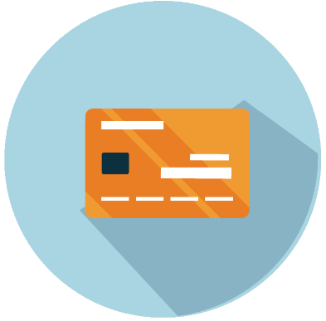
Credit History
Lenders find credit history and scores from the following credit agencies:
  EQUIFAX
  TRANSUNION
  EXPERIAN
Credit Agencies Track
  How much you owe
  Whether you pay your bills on time
  Different types and number of credit accounts you have
  Where you live/work and how long you’ve lived/worked there
Notes:
Tell participants that the three main credit agencies for credit reports are Equifax, Transunion and Experian. Let them know what the companies track.

Slide 9
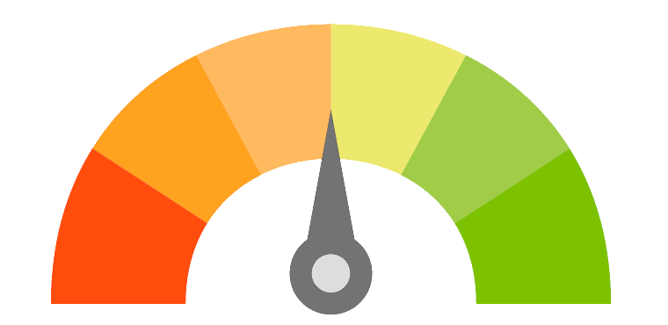
Your Credit Score
Like your credit history, lenders may look at your Credit Score. A Credit Score is a number that indicates how reliable you are at paying your debts.
A program analyzes your credit history and generates a single number score, usually between 300 to 850.
This score helps lenders decide if you are a good credit risk or not.
The higher the credit score, the better.
Lenders may charge lower interest rates to borrowers with higher credit scores.
What goes into your credit score:
Types of Credit
What You Owe
Length of Credit History
Payment Track Record
300
850
Notes:
Review the basics of credit scores with participants.

Slide 10
Quiz Time!
Q1: True or False – When I use my credit card to make a purchase I am borrowing money?
True
True
False
Q2: The term Interest Rate refers to:
a.
Amount of credit I have available on the card.
The interest rate set by the government for credit cards.
My annual fee for having this rewards card.
What is used to compute my finance charge.
b.
c.
d.
d.
Notes:
Presenter Notes/Comments:
Question 1
Ask the participants the first question. Give them time to answer. The correct answer is TRUE. Explain to participants that you are borrowing money from the credit card company when you use your card.
Question 2
The answer is D. This is the interest rate that is used to calculate the amount of interest to be charged on all or part of the balance if the full amount is not paid on or before the due date. The lower the APR means the lower the cost of the loan to you.

Slide 11


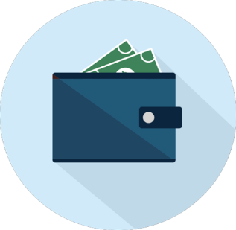
Wrap-up
Be smart about managing your credit
Shop for credit
Keep track of charges
Plan your shopping
Pay on time
Set limit and stick to them!
Get help early if you can’t meet your credit obligations
Be aware of credit trouble signs
  Paying late
  Ignoring savings
  Bouncing checks
  Maxing out credit
  Experiencing stress over finances
  Feeling like you’re paying forever
Notes:
Paying late
You’re frequently late in paying your bills and may be juggling payments to keep creditors satisfied.
Ignoring savings
You don’t have a savings account, or have stopped making deposits to it.
Bouncing checks
Your checking account is frequently overdrawn. You may find yourself racing to deposit your paycheck because you’ve already written checks that require the money in your paycheck to cover them.
Maxing out credit
Your credit accounts are usually at their maximum limits, and you are tempted to apply for more credit cards because you have reached the limit on the ones you have.
Experiencing personal stress over finances
You are always worried about your debts. You may have trouble sleeping or you may begin arguing with your spouse or partner over bills.
Feeling like you’re paying forever
You can make only minimum payments on your revolving charge accounts and you’re still paying off purchases you made a year ago.
Ignoring the phone
You ignore the telephone or mail to avoid dealing with creditors.
If you get into trouble, take action. Here are some tips:
Don’t ignore it! The problem won’t go away on its own.
Talk to your lender right away.
Get help—Your lender may be able to recommend a reputable credit counselor.
Know that credit management is a process—there is no quick fix.

Slide 12
Thank You / Feedback

Slide 13
Thank You and Collect Feedback
Thank you for your support and commitment to providing financial education within our communities! To demonstrate our impact with the work you do, we are collecting volunteer and educator feedback.
Please go to the following page to enter feedback - https://handsonbanking.org/volunteerfeedback/.
Please have your participants go to the following webpage to submit their feedback - https://handsonbanking.org/participant-survey/.
The evaluation does not contain any personal information for participants or you. The evaluation will help us understand participants’ knowledge and confidence about money management topics and will help us better demonstrate the impact of our efforts.
Notes:
After class:
Take a few minutes to ask the teacher or program director how they thought the lesson went. Ask if there are other materials or information you could provide them.
Consider writing a thank you note as a follow-up to your visit.
Submit feedback on your experience at https://handsonbanking.org/employee-volunteer-feedback/
Go to https://wellsfargo.yourcause.com/ and record your volunteer hours.

Slide 14
Handouts

Slide 15
Ten Tips for Credit Card Users
Pay on time. Ask your credit card issuer if it offers automatic payment options or email alerts to remind you when a payment is due.
Read your cardholder agreement—all of it. The agreement spells out fees and finance charges, so make sure you understand the terms. If you have questions, don’t hesitate to ask your card issuer’s customer service agent.
Learn the facts about finance charges. If you don’t pay the entire amount due within the grace period, you will be charged interest on the unpaid amount. Understanding how creditors calculate interest can help you to manage your costs. Make sure you know the Annual Percentage Rate (APR), Periodic Rate, and the method the creditor uses to calculate interest.
Know your credit limit. Monitor your account so you know how much available credit you have. Stay well below your limit in case you need to make an emergency purchase.
Create a budget and stick to it. Budgeting helps you keep control of your finances and resist spending sprees. If you plan ahead, you’ll know whether or not you can afford a particular purchase.
Reduce your debt. Keep your credit card balance low and don’t take on more debt than you can handle. This will also help your credit score.
Limit cash advances. These advances often incur higher fees and finance charges.
Applying for a new account? Think first. When a potential lender requests your credit report, an “inquiry” registers on your report. A high number of inquiries can negatively affect your credit score, so only apply for a new account when you really need it.
Prevent credit card fraud. Closely watch activity in your account. Many companies allow you to check your activity online at any time. Make sure that each transaction was made by you. If you notice suspicious activity, report it to your credit card issuer immediately.
Review your credit report. At www.annualcreditreport.com, you can receive one free copy of your credit report once a year from each of the three largest credit bureaus in the United States.

Slide 16
Credit Card Quiz
How frequently are you entitled to a free copy of your credit report from each of the credit agencies?
  Once a month per agency.
  Once a year per agency.
  Once every two years per agency.
  Never—you always have to pay for it.
The maximum amount you can carry as the balance on your credit card is called:
  Credit Balance
  Revolving Debt
  Credit Limit
  Free Money
Paying on time is important. Missing your payment due date can result in additional finance charges and late fees. To help you make payments on time, you can:
  Monitor your account with online banking.
  Sign up for e-mail alerts.
  Sign up for automatic payments to your credit card.
  All of the above.
Which of the following entities would be interested in knowing your credit score?
  Landlord
  Home mortgage lender
  Car loan lender
  All of the above.
The Annual Percentage Rate (APR) on your credit card refers to:
  The periodic rate, expressed as an annual amount, used to compute the finance charge on an outstanding balance.
  The amount of unused credit you have available.
  The maximum amount you can carry as the balance on your credit card.
  A fee.
Answers
b—Once a year.
c—Maximum amount is known as your credit limit.
d—All of the above.
d—All of the above.
a—The periodic rate, expressed as an annual amount, is used to compute the finance charge on an outstanding balance.

