Slide 1

Spending and saving
Learn about managing your money.
TIPS FOR
Students
Notes:
ATTENTION, SPEAKER!
Please do not change any of the content on the slides!
Please share in Presenter Mode/Slide Show Mode because there are animations and transitions to help emphasize points and help keep your audience engaged.
Practice your presentation in advance to make sure you know how the slide transitions work, especially for the quizzes.
Each slide includes voiceover notes to help you, but reviewing and practicing the entire presentation before sharing it with an audience will help you prepare. We suggest that you customize the voiceover notes to help you speak to your particular audience.
VOICEOVER FOR THIS SLIDE:
This presentation is all about the basics of spending and saving, which are the basic building blocks of learning how to manage your money.
Because the truth is, understanding the basics of managing money can really set you up for success as you get older, when you get your first job, and even when it comes to doing more with the money that you might get as a gift or on a special occasion. This isn’t just about not spending all the money you get. It’s about knowing where your money goes so you can make decisions that help you get ahead.
Another key thing to think about is the role a bank could play in how you manage your spending and saving. Bank accounts like checking and savings accounts can really simplify the process of knowing where your money goes.
But before we go too deep into that subject, let’s talk about spending and saving.

Slide 2
What we’ll talk about
What is a budget?
Spending less than you earn
Wants vs. needs
How banks can help you save
Interest — what it is and why it matters
Notes:
VOICEOVER FOR THIS SLIDE:
Here’s just a quick look at some of the things we’ll talk about today. We’ll start with some basics, which really means understanding what a budget is and how to create one.
We’ll talk about why it’s important to spend less than you earn.
We’ll discuss things like wants vs. needs and what it takes to save for a big purchase.
We’ll also explain a bit about interest — both the good and the not-so-good about interest and how it can impact your ability to save.
And we’ll talk about where you can go to keep learning more about lots of money topics that can help you out in life.

Slide 3
Let’s think about money
When was the last time you got some money?
What did you do with it?
What do you think is the right thing to do with money?
Notes:
VOICEOVER FOR THIS SLIDE:
Before we get into any specifics, think about the last time you received money. Was it as a birthday gift or maybe a weekly allowance? What did you do with the money?
Anyone?
[Presenter: See if you can get a few responses.]
Chances are you spent it or saved it — or a mix of both.
Is there a right thing to do with your money?
While it’s always great to save money, there are many times you need to spend money as well. And that’s OK.
But if you don’t have a plan for what to do with your money, you may end up spending it all every time you get it, which is really not the best way to go.
To help make a plan for your money, you can create something called a budget.

Slide 4

What is a budget?
A budget is a plan for your money.
Budgeting helps you answer these questions:
What do I actually spend money on?
How can I save more money?
How can I make better decisions
about my money?
Are budgets complicated?
No! A budget can be as simple as you need it to be — you can decide what you need!
Notes:
VOICEOVER FOR THIS SLIDE:
A budget is a written plan that helps you decide how you’ll spend your money and gives you something to help you keep track of where your money goes. What makes budgets helpful is when you keep working on them month after month so you can see over time where your money goes and then make plans so that it goes where you want it to go instead of being wasted.
So, a budget can help you see where your money goes each month. It can help you discover where you can save. And it can help you save for bigger expenses.
A budget can be a helpful tool, especially as you start to earn more and spend more, like when you get your first job — a budget can help you make sure your money goes where you want it to, and that it lasts longer. You’ll know where every dollar is going, so you can spend on and save for things that are important to you.
And like I said, it doesn’t need to be complicated. A budget can be as simple as you need it to be — like a simple list that you write on a piece of paper.

Slide 5
Why you should create a budget
A budget will:
Help you reach your money goals.
Keep you from spending too much.
Help you save for things you want.
Prepare you for unexpected expenses
(especially if you’re an adult).
Notes:
VOICEOVER FOR THIS SLIDE:
There is a saying that a budget is telling your money where to go instead of wondering where it went. Sounds pretty good, right?
It’s easy to just keep spending money on things you want until you’re out of money. But if you have a budget, you know how much you should spend, and you can enforce a limit.
Let’s say you love to play online games and have a budget of $20 set aside for your games every month. Once you hit that $20, you stop spending money on gaming. If you don’t have a budget, you might keep clicking to purchase — and spend way more than $20. Then you may not have enough money to cover your next important purchase, like tickets to see a concert you really want to go to.
As you get older, it’s really important to make sure your spending is under control and that you have a healthy savings. This way, if something unexpected happens — like your car breaks down or you break a bone and have a medical bill — you can pay for it.

Slide 6
Let’s talk!
Are you saving money for anything in
particular right now?
Notes:
VOICEOVER FOR THIS SLIDE:
[Ask:]
What’s a money goal you have right now?
Besides keeping you from spending too much, having a budget can help you reach exciting money goals. Everyone has goals for their money — even if you’ve never thought too much about them.
Some examples to start your thinking:
- Buying a new phone
- Paying for a new video game
- Getting a gift for someone else (like your parents, brother or sister, or friends)
- When you’re a little older: buying a car, paying for college, and even saving for retirement!

Slide 7
And another question
What do you think you’ll want to save
money for in the future?
Notes:
VOICEOVER FOR THIS SLIDE:
[Ask:]
What’s a money goal you’ll have in the future?
Whether you’re saving for a car, college, or even movie tickets, having a budget will help you hit big saving goals by keeping your spending under control.

Slide 8

Let’s get a budget going!
Start by keeping track when you receive or spend money. Do you get an allowance or money for your birthday? Keep track of where it goes!
Make a note of every purchase you make for a month to see how much you spend.
How should I keep track?
Keep it simple to start: You can keep track of your spending on paper!
Notes:
VOICEOVER FOR THIS SLIDE:
The first step in creating a budget is to look at how you’re spending money now. And that means writing down when you get money (and how much you get) and every time you spend money (including how much you spend and what you spend it on).
That way, you realistically know what you need to spend on certain things as well as what you buy that you really might not need to buy.
So start by writing down when you receive money and when you spend money.

Slide 9





Let’s get a budget going!
Use that information to help plan next month’s budget.
Your goal should be to have money left over each month for savings.
Possible monthly expenses:
Gas for car $40
Streaming, games, apps $20
Meals out $30
Entertainment, music $50
Cellphone plan $30
Notes:
VOICEOVER FOR THIS SLIDE:
What would it take to create a budget? It can start with something as simple as a list like the one here — one that just highlights how you’re dividing up your money each month.
Your goal is to not spend everything, but to try to have some left for longer-term savings at the end of each month, so you can build that savings account over time.
[Ask:]
What expenses do you pay for each month?
What do you think is part of your family’s monthly budget?
If you were creating a budget, what expenses would you add to this list?

Slide 10


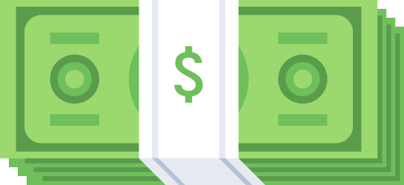
Hands on example:
Building a budget
Lydia is 8 years old and wants to start a budget.
Notes:
VOICEOVER FOR THIS SLIDE:
Let’s go through an example of building a budget with Lydia, who is 8 years old and wants to start a budget so she can help her local pet adoption group.

Slide 11


Hands on example:
Building a budget
Her only income is a weekly allowance of $8.
She decides to divide it three ways.
Notes:
[Presenter: Share the info that’s on the slide.]

Slide 12


Hands on example:
Building a budget
$4 goes to her savings account. $3 goes to her checking account to
spend on things she likes to buy, like a candy bar or a new book.
She sends $1 to her favorite charity for pet adoption and rescue.
Notes:
[Presenter: Share the info that’s on the slide.]

Slide 13

Hands on example:
Building a budget
Lydia’s budget helps her manage her allowance so she
knows where each dollar is going. She’s helping
a cause she loves, and she’s saving for the future.
Notes:
[Presenter: Share the info that’s on the slide.]

Slide 14



Hands on example:
Building a budget
Great job, Lydia!
Notes:
[Presenter: Share the info that’s on the slide; pause for animation]
VOICEOVER FOR THIS SLIDE:
Another good thing about Lydia’s plan: While she’s planning where she wants her money to go, it also gives her something to measure against at the end of the month.
Did her spending go as planned? She can keep track of and make adjustments over time so her budget gets more and more accurate — which also will help her see where she might be able to make changes if she wants to.
Because remember …
[Advance to the next slide.]

Slide 15

Your goal: Don’t spend it all!
Less spending means more saving.
When you spend more than you
earn, you go into debt.
Notes:
VOICEOVER FOR THIS SLIDE:
… less spending means more saving — and your goal is to try to spend less than you earn.
Saving money will allow you to worry less (you will be able to cover unexpected expenses and hit money goals, as we talked about) and give you financial freedom as you get older. Living paycheck to paycheck — with no savings — can be stressful!
It can also lead to debt. Debt occurs when you borrow money — maybe you spent $100 on new clothes with a credit card, but you only have $80 in your account to pay your credit card bill.
In this case, you borrowed money from the credit card company, and now you have to pay it back — with interest.
Instead of just owing $20 the next month, you owe $20 plus the interest on the credit card, which is typically around 24% a year. So on your next bill, you’d owe $20.40. That number keeps growing each month, until you completely pay off your credit card bill.

Slide 16
Let’s talk!
Have you ever spent money on something
and regretted it later?
Notes:
VOICEOVER FOR THIS SLIDE:
[Ask:]
Have you ever spent money on something and regretted it later?
[Presenter: Consider sharing a story about a time when this happened to you.]

Slide 17
5 questions to ask yourself before you buy something
Will I use it? How often?
Did I want this before I walked into the store or saw it in an ad?
Where will I keep it?
Do I already have something like this at home?
Do I really need this?
Notes:
VOICEOVER FOR THIS SLIDE:
It can be really hard not to buy something you really want — something you unexpectedly see and think is just awesome.
But those kinds of impulse purchases, which happen when you make a sudden decision to buy something, can really hurt your ability to save. The thing is, we all face these kinds of struggles where we’re wowed by something in the moment and just want to buy it.
Here’s the thing: To defend against needless spending and to make sure you really need and can use the item that’s calling your name, it can help to ask yourself a few questions.
Will I use it, and how often? Be realistic. Is this really a useful thing? Or are you going to tire of it quickly?
Did you even know about this item before you saw it in an ad or saw it on display in a store?
Do you have a place to keep it, or is it just going to clutter your home?
Do you already have something like this? If so, why aren’t you using that thing?
Do you really need it? This can really be what helps you decide. Sometimes it can help to force yourself to wait a few days before deciding on a big purchase. If it doesn’t feel as important or attractive in a few days, maybe you don’t need to get it.
Running through these questions can help you think carefully about the purchase and hold back if you need to.
[Ask:]
What other questions could you ask yourself if you’re not sure about buying something?

Slide 18


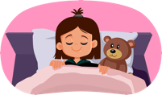
Hands on example:
Need vs. want
Maria is in a store and sees an awesome drink tumbler
in a newly released periwinkle color.
Notes:
VOICEOVER FOR THIS SLIDE:
Let’s go through another hands on example — this one helps show how you can sometimes determine wants vs. needs if you can just give things a little time.
[Presenter: Share the info that’s on the slide.]

Slide 19

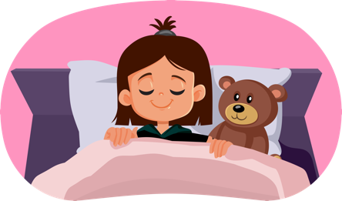

Hands on example:
Need vs. want
She really wants it but decides to wait and see if
she’s still thinking about it by next weekend.
Notes:
[Presenter: Share the info that’s on the slide.]

Slide 20


Hands on example:
Need vs. want
Five days go by, and she’s no longer thinking about the tumbler —
and she realizes her own purple tumbler is pretty close to periwinkle.
Notes:
[Presenter: Share the info that’s on the slide.]

Slide 21

Hands on example:
Need vs. want
Waiting a week helped her to see if she needed the item
rather than just wanting it.
Notes:
[Presenter: Share the info that’s on the slide.]

Slide 22

Hands on example:
Need vs. want
And it saved her $35. Nice work, Maria!
Notes:
[Presenter: Pause for animation.]
VOICEOVER FOR THIS SLIDE:
The good thing about determining if something is a want or a need is that it’s like any other skill: The more you practice, the better you will get at figuring out what is a want and what is a need, and the better you’ll be able to avoid impulse purchases.

Slide 23


Needs vs. wants
Needs: Things you need to have for a safe, healthy, stable life.
Food
Water
Shelter
Clothing
Transportation
Medicine
Notes:
VOICEOVER FOR THIS SLIDE:
As you get older and take on more responsibilities, it will get more and more important for you to know the difference between wants and needs.
Remember, needs are necessary for survival, so you need to spend money on them.
Needs could be food, water, shelter, clothing, and medicine.
[Ask:]
What else would you add to this list of needs?

Slide 24


Needs vs. wants
Wants: Things that are nice to have, but you could get by without them.
Electronics
Fancy cars
Vacations
Toys
Entertainment (music, streaming services, etc.)
Notes:
VOICEOVER FOR THIS SLIDE:
So what are wants?
They’re things that would be nice to have, but they aren’t necessary for survival. You could definitely get by without them.
Wants could be toys, electronics, fancy cars, or vacations.
[Ask:]
What else would you add to this list of possible wants?
Do you think it’s OK to purchase things like this? When would that be OK?

Slide 25
Quiz time!
Want or need?
The lunch you bring to school
The cake pop your mom buys you on her coffee run
Need.
All basic meals are a need.
Want.
Although delicious,
it’s not necessary.
Notes:
VOICEOVER FOR THIS SLIDE:
OK, let’s put some of this into practice and see how well you can spot wants and needs.
Let’s start with this one. Which one is the want, and which is the need?
[Presenter: Click for answer.]

Slide 26
Quiz time!
Want or need?
The shoes you wear to school most days
A smartwatch
Need.
You need clothing to protect
your body.
Want.
You don’t need a smartwatch
to get by.
Notes:
VOICEOVER FOR THIS SLIDE:
And how about this one? Which one is the want, and which is the need?
[Presenter: Click for answer.]

Slide 27
Quiz time!
Want or need?
Your family’s trip to
the beach each year
A place to live while your house
is under construction
Want.
It’s awesome family time, but vacations are a bonus.
Need.
Shelter, or a home, is
always a need.
Notes:
VOICEOVER FOR THIS SLIDE:
Last one! Which one is the want, and which is the need?
[Presenter: Click for answer.]

Slide 28
How bank accounts can help you save
Checking accounts are used for everyday purchases, like buying groceries or paying for items online. This is where your “spending money” would be kept.
Notes:
VOICEOVER FOR THIS SLIDE:
As I mentioned earlier, banks can be very helpful when it comes to keeping track of your money. Bank accounts are safe places to keep your money that still let you get to your money quickly when you want to.
There are two main types of accounts that people who are new to banking should know about: checking accounts and savings accounts.
A checking account is where you would likely keep money for everyday purchases, like groceries or games or snacks. This is also where your general “spending money” would be kept.
Savings accounts are a little different.

Slide 29
How bank accounts can help you save
Savings accounts are not used for daily spending. They are where you deposit money to keep it safe for the future. Savings accounts earn interest.
Special accounts offer different savings benefits for specific purposes. For example, a 529 plan can help you save for college.
Notes:
VOICEOVER FOR THIS SLIDE:
Savings accounts are usually where you keep money that you want to save for a longer time — like when you’re saving for a special purchase, or you want to just keep some money around in case of an emergency.
Savings accounts also earn interest, which is basically when the bank pays you for keeping your money with them. It’s usually based on a percentage of the amount that you have in your savings account, and you get that interest payment every month.
There are also special savings and investing accounts that a bank can help you with, like special accounts to help you save for college. We aren’t going to go into a lot of detail on these, other than to say that banks can be really helpful when it comes to all kinds of savings!

Slide 30



Hands on example:
Saving for a want
Charlie wants to buy a $200 bike. He decides to use
his savings account to help.
Notes:
VOICEOVER FOR THIS SLIDE:
So let’s talk about how a bank account can help you save for a bigger purchase that you really want.
Our friend Charlie is a good example. He really wants to buy a $200 bike, so he decides to use his savings account to help.

Slide 31



Hands on example:
Saving for a want
He makes a plan to save for the bike using his weekly allowance of $10. He saves $7 each week in his savings account and uses $3 for other items.
Notes:
VOICEOVER FOR THIS SLIDE:
Charlie creates a budget as part of this plan, too: He decides to use part of his allowance each week to save for the bike. He puts $7 into his savings account each week and leaves himself $3 for other things. It’s not a lot leftover, but he figures that it’s worthwhile if he can get the bike.

Slide 32



Hands on example:
Saving for a want
A few weeks into saving, he gets a $75 birthday gift from his grandma, which he puts toward the bike.
Notes:
VOICEOVER FOR THIS SLIDE:
Charlie keeps tracking his budget and monitoring his savings. Then, a few weeks into this journey, his grandma gives him $75 for his birthday.
Happy birthday, Charlie!
But instead of spending any of that $75, he puts it all into his savings account as well.

Slide 33
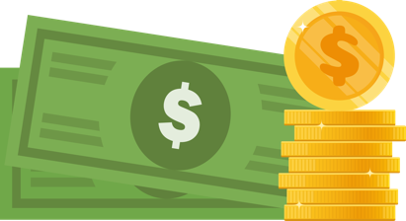
Hands on example:
Saving for a want
After 18 weeks — about 4 months — he hits his saving goal and has
$201 for his new set of wheels.
Notes:
VOICEOVER FOR THIS SLIDE:
Thanks to that gift and his budget, he’s able to save the full amount in about four months. And then he’s able to buy that bike that he’s been wanting!

Slide 34

Hands on example:
Saving for a want
Nice work, Charlie!
Notes:
VOICEOVER FOR THIS SLIDE:
Nice work!
[Presenter: Pause for animation.]

Slide 35
What is interest?
Interest is a payment the bank gives you for keeping your savings with them (usually in a savings account).
It’s calculated as a percentage of the amount you have
in your account.
Compound interest is earned on both the original money you put in your savings account and the additional interest payments. Over time, this can really add up.
Notes:
VOICEOVER FOR THIS SLIDE:
OK, one thing that we mentioned before that we didn’t include in Charlie’s savings example: interest!
Interest is a payment the bank gives you for keeping your savings with them.
Interest is calculated as a percentage of the amount that you have in your account.
Interest can help your money grow in the bank without your having to do anything to it. That’s compound interest — when the amount in your savings account increases because of an interest payment, and then the next interest payment is based on the new amount in your account. Over time, that can make a big difference. Let’s look at an example.

Slide 36
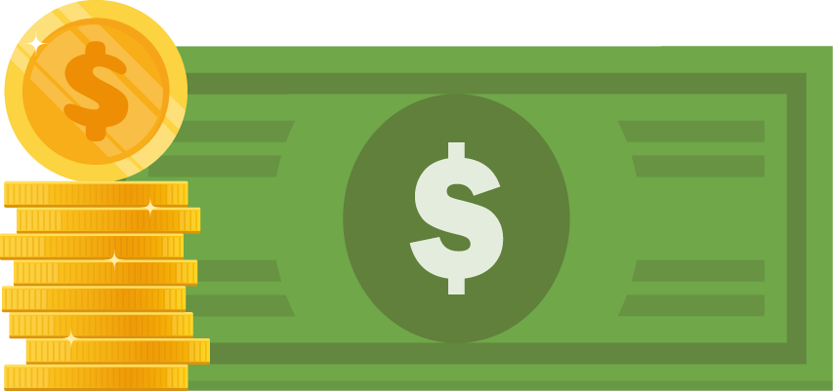
How compounding works
5% interest rate
Let’s say you put $100
in a bank account with a
5% annual interest rate.
Year 1
$100
Notes:
VOICEOVER FOR THIS SLIDE:
So here we’re going to look at savings with interest.
In this example, we’ll say you have $100 in a savings account that’s earning 5% interest. That’s a high interest rate for a savings account, but we’ll use it to show how compounding works.

Slide 37
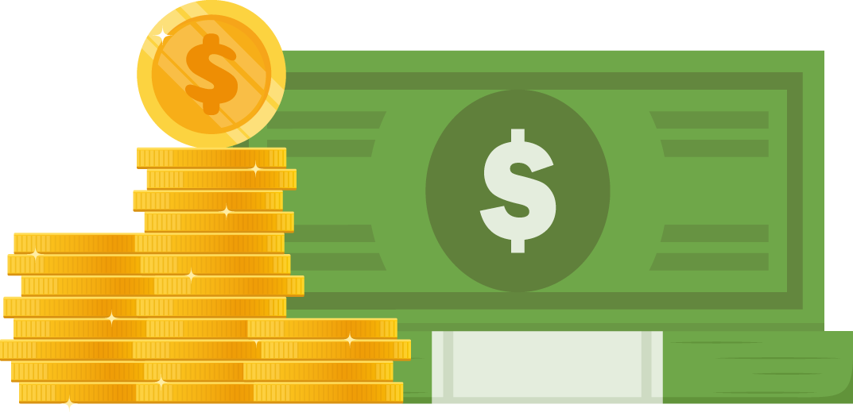
How compounding works
5% interest rate
Your $100 is earning interest each month. Plus, all the interest you’ve previously earned is earning interest. That’s compound interest.
Year 5
$127.63
Notes:
VOICEOVER FOR THIS SLIDE:
Every month and every year, that money is earning more money — just a small amount to start, but it keeps growing over time.
As the total amount in the account grows, the next interest payment also grows. That’s compound interest.

Slide 38
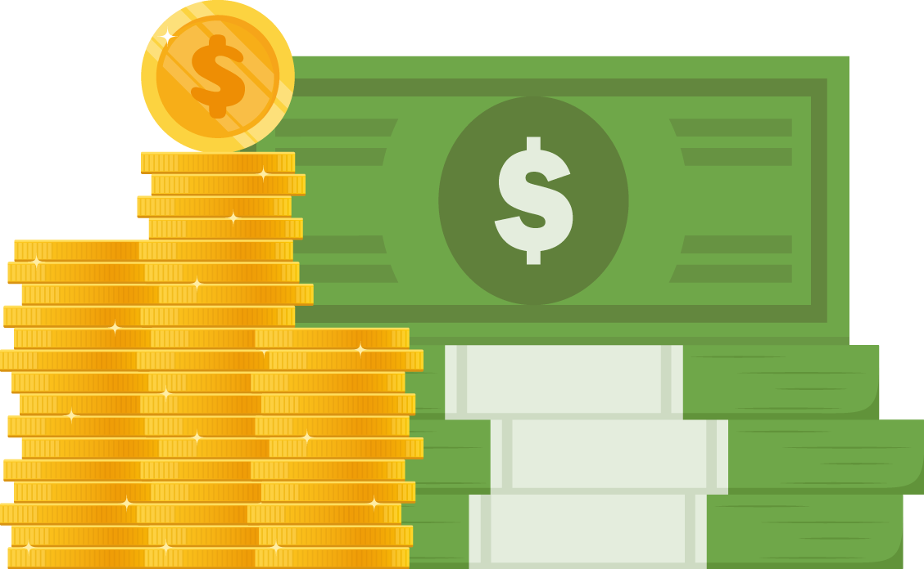
How compounding works
5% interest rate
Even if you never add more money, that $100 will become more than $160 over 10 years, all because of compound interest.
Year 10
$162.89
$62.89 interest earned
Notes:
VOICEOVER FOR THIS SLIDE:
And you can see that, even if you did nothing else, over 10 years that $100 turns into more than $160 — just because of compound interest!

Slide 39
Quiz time!
Question:
What’s one thing a budget can help you do?
Reach goals, keep you from spending too much,
help you save, or help you prepare for emergencies
Notes:
VOICEOVER FOR THIS SLIDE:
Now, let’s see what you’ve learned about spending and saving.
[Ask before revealing the answer]:
What do you think the answer is?
[Presenter: Click for answer.]

Slide 40
Quiz time!
True or false:
Savings accounts are for daily purchases.
False.
Checking accounts are for everyday spending money.
Notes:
VOICEOVER FOR THIS SLIDE:
[Ask before revealing the answer]:
What do you think the answer is?
[Presenter: Click for answer.]

Slide 41
Quiz time!
Fill in the blank:
When you spend more than you earn,
you go into .
debt
Notes:
VOICEOVER FOR THIS SLIDE:
[Ask before revealing the answer]:
What do you think the answer is?
[Presenter: Click for answer.]

Slide 42
Quiz time!
True or false:
Compound interest takes time to add up to great savings.
True.
Over time, compound interest on your savings can add up.
Notes:
VOICEOVER FOR THIS SLIDE:
[Ask before revealing the answer]:
What do you think the answer is?
[Presenter: Click for answer.]

Slide 43
Where to keep learning about finance
Hands on Banking
(Search online: Hands on Banking for Youth)
Consumer Financial Protection Bureau: Money as You Grow
(Search online: Money as You Grow)
FDIC Money Smart
(Search online: FDIC Money Smart)
Next Gen Personal Finance
(Search online: Next Gen Finance Games)
Notes:
VOICEOVER FOR THIS SLIDE:
Learning about money and increasing your knowledge about personal finances take time and effort but can pay off so much in the long run. It can help you improve your financial well-being over time and make your future brighter.
There are many free resources to help you — especially online. Talk to your parents or guardians about podcasts or websites that you might be able to look at or listen to so you can keep learning.
And of course, you can always ask a parent or guardian for their advice about spending and saving, too. They know a lot!
Any questions?

