Slide 1

Spending and saving
Learn about managing your money.
TIPS FOR
Students
Notes:
ATTENTION, SPEAKER!
Please do not change any of the content on the slides!
Please share in Presenter Mode/Slide Show Mode because there are animations and transitions to help emphasize points and help keep your audience engaged.
Practice your presentation in advance to make sure you know how the slide transitions work, especially for the quizzes.
Each slide includes voiceover notes to help you, but reviewing and practicing the entire presentation before sharing it with an audience will help you prepare. We suggest that you customize the voiceover notes to help you speak to your particular audience.
VOICEOVER FOR THIS SLIDE:
This presentation is all about the basics of spending and saving, which are the basic building blocks of learning how to manage your money.
Because the truth is, understanding the basics of managing money can really set you up for success in the future. This isn’t just about not spending all the money you get. It’s about knowing where your money goes so you can make decisions that help you get ahead.
Of course, we’ll cover a lot of information in this presentation. But another key thing to think about is the role a bank could play in how you manage your spending and saving. Bank accounts like checking and savings accounts can really simplify the process of knowing where your money goes.
But before we go too deep into that subject, let’s talk about spending and saving.

Slide 2
What we’ll talk about
What is a budget?
Why you should spend less than you earn
Wants vs. needs
Saving for a big purchase
Interest — what it is and why it matters
Notes:
VOICEOVER FOR THIS SLIDE:
Here’s a quick look at some of the things we’ll be talking about today. We’ll start with some of the basics, which really starts with understanding what a budget is and how to create one.
We’ll talk about why it’s important to spend less than you earn.
We’ll discuss things like wants vs. needs, and what it takes to save for a big purchase.
We’ll also explain a bit about interest — both the good and the not-so-good about interest and how it can impact your ability to save.
And we’ll talk about where you can go to keep learning more about lots of money topics that can help you out in life.

Slide 3
Let’s talk about the money you earn
What do you usually do with money you earn?
Do you spend it right away?
How do you decide what to buy? And when do you hold back on buying?
Do you have any ongoing expenses, like your phone or a game subscription? How do you plan for those bills?
Notes:
VOICEOVER FOR THIS SLIDE:
You might earn money from doing odd jobs, having a part-time job, or even as a gift for a holiday or for your birthday. But regardless of how you earn money, part of being financially responsible means understanding what you do with that money — what you spend your money on and what you save your money for.
Let’s talk about how you’re currently spending and saving money. [Ask the questions on the slide.]
Do you think your money habits are good or bad, or have you never really thought about them before?
If there is no rhyme or reason for how you spend or save, it may be time to make a plan for your money. This can also help you learn to avoid overspending — something that 83% of people said they struggled with in a 2023 survey by NerdWallet.
Taking control of your money usually starts with creating a budget.
Stat source:
https://www.nerdwallet.com/article/finance/data-2023-budgeting-report

Slide 4

What is a budget?
A budget is a plan for your money.
A budget helps you answer these questions:
Where is my money going each month?
How can I spend less and save more?
How will I handle surprise costs?
How can saving help me?
Are budgets complicated?
No! A budget can be as simple as you need it to be — you can decide what you need!
Notes:
VOICEOVER FOR THIS SLIDE:
Put simply, a budget is a written plan that helps you decide how you’ll spend your money and gives you something to check your spending against — as well as a way to keep track of how you’re doing with staying in line with how you think your money should be spent.
A budget can help you see where your money goes each month. It can help you discover where you can save. And it can help you save for bigger expenses.
A budget can be a helpful tool, especially as you start to earn more and spend more. You can make your money go further and last longer by having a budget. You’ll know where every dollar is going, so you can spend on and save for things that are important to you.
The good news is that a budget can be as simple as you need it to be.

Slide 5
Why you should create a budget
A budget will:
Help you reach your money goals.
Keep you from spending too much.
Help you save for things you want.
Prepare you for unexpected expenses.
Notes:
VOICEOVER FOR THIS SLIDE:
There is a saying that a budget is telling your money where to go instead of wondering where it went.
It’s easy to keep spending money on things you want. But if you have a budget, you know how much you should spend, and you can enforce a limit.
Let’s say you love to watch movies and have a budget of $20 set aside for streaming movies each month. Once you hit that $20, you stop buying movies. If you don’t have a budget, you’ll likely keep clicking to purchase movies — and spend way more than $20. Then you may not have enough money to cover your next important purchase, like tickets to see a concert you really want to go to.
As you get older, it’s really important to make sure your spending is under control and that you have a healthy savings. This way, if something unexpected happens — like your car breaks down or you break a bone and have a medical bill — you can pay for it.

Slide 6
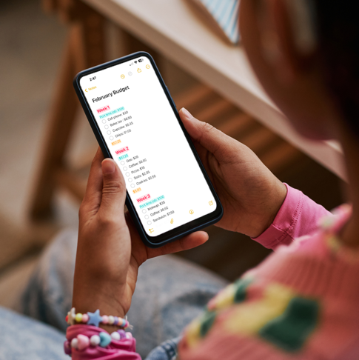
Let’s get a budget going!
Start by keeping track when you receive or spend money.
Make a note of every purchase you make for a month to see how much you spend.
How should I keep track?
Keep it simple to start: Keep track of your spending on paper or in a note on your phone.
Notes:
VOICEOVER FOR THIS SLIDE:
The first step in creating a budget is to keep track of how you’re already spending money.
That way, you realistically know what you need to spend on certain things in a certain timeframe — either weekly or monthly.
Start by writing down when you receive money and when you spend money.
Write down how much you receive and then how much you spend with each purchase.
At the end of the month, you can look back and see where your money went, which can then help you plan for where your money might go in the next month.

Slide 7




Let’s get a budget going!
Use that information to help plan next month’s budget.
Your goal should be to have money left over each month for savings.
Example of tracking some
family expenses:
Mortgage $2,000
Utilities and internet $260
Groceries and meals out $400
Gas and car payment $375
Total $3,035
Notes:
VOICEOVER FOR THIS SLIDE:
What would it take to create a budget? It can start with something as simple as a list like the one here — one that just highlights how you’re dividing up your money each month.
Your goal is to not spend everything, but to try to have some left for longer-term savings at the end of each month so you can build that savings account over time.
At the end of the month, you can look back and see where your money went, which can then help you plan for where your money might go in the next month.
[Ask:]
What do you think is part of your family’s monthly budget?
If you were creating a budget, what expenses would you add to this list?

Slide 8
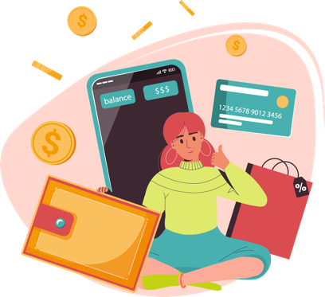

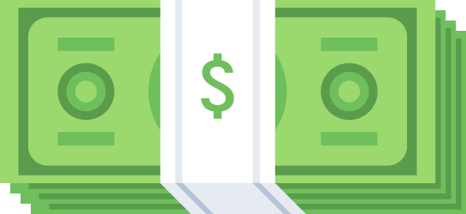
Hands on example:
Building a budget
Margo is 17 years old and wants to start a budget.
Notes:
VOICEOVER FOR THIS SLIDE:
Let’s go through an example of building a budget with Margo, who is 17 years old and wants to start a budget in order to improve her financial knowledge.

Slide 9


Hands on example:
Building a budget
She earns about $200 a week through her
job as a cashier.
Notes:
[Presenter: Share the info that’s on the slide.]

Slide 10


Hands on example:
Building a budget
She creates a plan so that 20% of each paycheck goes directly to
savings, 50% goes to her checking account for ongoing expenses (gas, cellphone bill, etc.), and 30% is left for unplanned fun with friends.
Notes:
[Presenter: Share the info that’s on the slide.]

Slide 11

Hands on example:
Building a budget
That means she’s saving $40 every week, covers her expenses,
and still has $60 to spend on fun with her friends!
Notes:
[Presenter: Share the info that’s on the slide.]

Slide 12

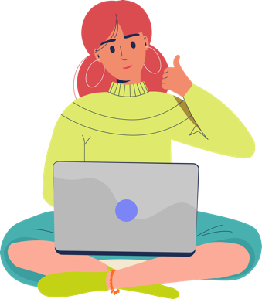

Hands on example:
Building a budget
Even better, by keeping track of her spending, she knows exactly
where each dollar she earns is going. Great job, Margo!
Notes:
[Presenter: Share the info that’s on the slide.]
VOICEOVER FOR THIS SLIDE:
Another good thing about Margo’s plan: While she’s mapping out in advance where she wants her money to go, it also gives her something to measure against at the end of the month.
Did her spending go as planned? She can track and make adjustments over time so her budget gets more and more accurate — which also will help her see where she might be able to cut back to save more if she needs to.
Because remember …
[Advance to the next slide.]

Slide 13

Your goal: Don’t spend it all!
Less spending means more saving.
When you spend more than you earn, you go into debt.
Notes:
VOICEOVER FOR THIS SLIDE:
… less spending means more saving — and your goal is to try to spend less than you earn.
Saving money will allow you to worry less (you will be able to cover unexpected expenses and hit money goals, as we talked about) and give you financial freedom as you get older. Living paycheck to paycheck — with no savings — can be stressful!
It can also lead to debt. Debt occurs when you borrow money — maybe you spent $100 on new clothes with a credit card, but you only have $80 in your account to pay your credit card bill.
In this case, you borrowed money from the credit card company, and now you have to pay it back — with interest.
Instead of just owing $20 the next month, you owe $20 plus the interest on the credit card, which is typically around 24% a year. So on your next bill, you’d owe $20.40. That number keeps growing each month, until you completely pay off your credit card bill.

Slide 14
Let’s talk!
Have you ever spent money on something
and regretted it later?
Notes:
VOICEOVER FOR THIS SLIDE:
[Ask:]
Have you ever spent money on something and regretted it later?
[Presenter: Consider sharing a story about a time when this happened to you.]

Slide 15
5 questions to ask yourself before you buy something
Will I use it? How often?
Did I want this before I walked into the store or saw it in an ad?
Where will I keep it?
Do I already have something like this at home?
Do I really need this?
Notes:
VOICEOVER FOR THIS SLIDE:
It can be really hard not to buy something we really want — something you unexpectedly see and think is just awesome.
But those kinds of impulse purchases, which happen when you make a sudden decision to buy something, can really hurt your ability to save. The thing is, we all face these kinds of struggles where we’re wowed by something in the moment and just want to buy it.
Here’s the thing: To defend against needless spending and to make sure you really need and can use the item that’s calling your name, it can help to ask yourself a few questions.
Will I use it, and how often? Be realistic. Is this really a useful thing that you’re going to use on a regular basis? Or are you going to tire of it quickly?
Did you even know about this item before you saw an ad for it or saw it on display in a store? If not, it might not be a need — otherwise you would have been looking for it.
Do you have a place to keep it or is it just going to clutter your home?
Do you already have something like this? If so, why aren’t you using that thing?
Do you really need it? This can really be the deciding factor. Sometimes it can help to force yourself to wait a few days before deciding on a big purchase. If it doesn’t feel as important or attractive in a few days, maybe you don’t need to get it.
Running through these questions can help you think through the purchase and hold back if you need to.
[Ask:]
What other questions could you ask yourself if you’re not sure about buying something?

Slide 16



Hands on example:
Need vs. want
Peyton sees an Instagram ad for a very cool pair of sunglasses that she wants for her spring break vacation.
Notes:
VOICEOVER FOR THIS SLIDE:
Let’s go through another hands on example — this one helps to show how you can sometimes determine wants vs. needs if you can just give things a little time.
[Presenter: Share the info that’s on the slide.]

Slide 17


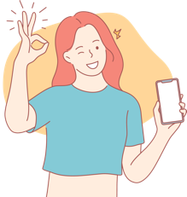
Hands on example:
Need vs. want
She puts the sunglasses in her online shopping cart but doesn’t click purchase — she wants to make sure she really wants them first.
Notes:
[Presenter: Share the info that’s on the slide.]

Slide 18

Hands on example:
Need vs. want
Five days go by, and she completely forgets about the sunglasses until she sees the ad again on Instagram. So she empties her cart.
Notes:
[Presenter: Share the info that’s on the slide.]

Slide 19
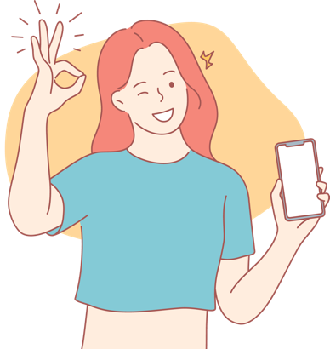
Hands on example:
Need vs. want
Waiting a few days helped Peyton avoid a needless impulse purchase. Great job, Peyton!
Notes:
[Presenter: Share the info that’s on the slide.]
[Pause for animation.]
VOICEOVER FOR THIS SLIDE:
The good thing about determining if something is a want or a need is that it’s like any other skill: The more you practice, the better you will get at figuring out wants vs. needs, and the better you’ll be able to avoid impulse purchases.

Slide 20


Needs vs. wants
Needs: Things you need to have for a safe, healthy, stable life.
Food
Water
Shelter
Clothing
Transportation
Medicine
Notes:
VOICEOVER FOR THIS SLIDE:
As you get older and take on more responsibilities, it will get more and more important for you to be able to differentiate between wants and needs.
Remember, needs are necessary for survival, so you need to spend money on them.
Needs could be food, water, shelter, clothing, and medicine.
[Ask:]
What else would you add to this list of needs?

Slide 21


Needs vs. wants
Wants: Things that are nice to have, but you could get by without them.
Electronics
Fancy cars
Vacations
Trendy clothes or accessories
Entertainment (music, streaming services, etc.)
Notes:
VOICEOVER FOR THIS SLIDE:
So what are wants?
They’re things that would be nice to have, but they aren’t necessary for survival. You could definitely get by without them.
Wants could be electronics, video games, fancy cars, or vacations.
[Ask:]
What else would you add to this list of possible wants?
Do you think it’s OK to purchase things like this? When would that be OK?

Slide 22
Quiz time!
Want or need?
The lunch you bring to school
A morning coffee shop latte
Need.
All basic meals are a need.
Want.
Although delicious,
it’s not necessary.
Notes:
VOICEOVER FOR THIS SLIDE:
OK, let’s put some of this into practice and see how well you can spot wants vs. needs.
Let’s start with this one. Which one is the want, and which is the need?
[Presenter: Click for answer.]

Slide 23
Quiz time!
Want or need?
The shoes you wear to school most days
A smartwatch
Need.
You need clothing to protect
your body.
Want.
You don’t need a smartwatch
to get by.
Notes:
VOICEOVER FOR THIS SLIDE:
And how about this one? Which one is the want, and which is the need?
[Presenter: Click for answer.]

Slide 24
Quiz time!
Want or need?
Your family’s annual trip to
the beach
A place to live while your house
is under construction
Want.
It’s awesome family time, but vacations are a bonus.
Need.
Shelter, or a home, is
always a need.
Notes:
VOICEOVER FOR THIS SLIDE:
Last one! Which one is the want, and which is the need?
[Presenter: Click for answer.]

Slide 25
Let’s talk!
What’s a money goal you have right now?
Notes:
VOICEOVER FOR THIS SLIDE:
OK, let’s talk a little about money goals. What’s a money goal you have right now?
[Presenter: Consider sharing a money goal that you have right now to get the conversation started.]
Besides preventing you from overspending, having a budget helps you reach money goals like these. Everyone has goals for their money — even if you’ve never thought too much about them.
Money goals can be a lot of things, like:
Buying a new phone.
Paying for a date.
Buying a car.
Paying for college.
When you’re a little older: saving for retirement!

Slide 26
And another question
What’s a money goal you think
you’ll have in the future?
Notes:
VOICEOVER FOR THIS SLIDE:
So let’s keep this conversation going. What’s a money goal you think you’ll have in the future, even if you don’t have it right now?
[Presenter: Consider sharing a money goal that you think you might have in the future — maybe retirement or buying a home.]
Whether you’re saving for a car, college, or a big trip in a couple of years, having a budget can help you meet those big saving goals by helping you keep your spending in check.

Slide 27
Tips for saving for a big purchase
Start early.
Set your goal and milestones.
Determine your budget.
Avoid impulse purchases.
Set up checking and savings accounts.
Make saving automatic.
Notes:
VOICEOVER FOR THIS SLIDE:
Whether you’re saving for a car or for college, there are a few tried-and-true ways to efficiently save.
Start early. Sometimes it can take years to save for things — like a car or college. It may seem silly to start saving for college already, but the earlier you begin, the more time your balance will have to grow.
Set your goals and milestones. Big goals can feel daunting, but if you set and celebrate milestones along the way, it can give you the motivation you need to keep going. For instance, you could try to save $500 for a car over summer break. Then set another milestone to save another $500 by winter break.
Determine your budget. Again, having a budget controls your spending so it doesn’t eat into savings.
Avoid impulse purchases. Make it a habit to avoid buying things you didn’t plan to buy — this is where the wait-a-week rule discussed earlier can really help out. If you want it in a week, it will still be there.
Set up a checking and savings accounts. Dividing your money will help you resist spending it all.
Automate your savings. This can be done in your bank account app. Set up an automatic transfer to move money from checking to savings after each paycheck so you don’t even have to think about moving money into savings.

Slide 28

How to make saving automatic
Use the tools your bank provides to simplify saving.
Use direct deposit to deposit paychecks into your checking account.
Set automatic transfers from checking to savings accounts.
Why save automatically?
If you automatically move money to your savings account, you’ll be less tempted to spend it.
Notes:
VOICEOVER FOR THIS SLIDE:
If you have a job, even if it’s part time, ask your employer about direct deposit. This lets you get your paycheck deposited directly into your checking account. Then there’s no way you will lose or spend the money as it sits in your wallet.
Once that is set up, you can also schedule automatic transfers or deposits so part of your paycheck goes directly to your savings account without your needing to do anything else.
Automating your savings can have big benefits. One, it gives you consistent growth. If you’re automatically saving $100 each month, you know you’ll have $1,200 at the end of the year — no guessing about how much you may be able to save each month.
Two, it helps you avoid the temptation to spend. If the money isn’t in your checking account, you’ll be less tempted to spend it.
And three, it can help you meet your saving goals. Automating saving allows you to save a specific amount so you can plan for and hit goals by a specific date.

Slide 29
How to get the most from a savings account
Earning interest is the main benefit of savings accounts.
Interest is a payment for keeping your money with the bank. It’s calculated as a percentage of the amount you have in your bank account.
Compound interest is earned on both the original money you put in the bank and the money that has been added through interest. Over time, this can really add up.
Notes:
VOICEOVER FOR THIS SLIDE:
Most bank savings accounts pay interest on the amount that you hold in the account — it’s one of the primary benefits of having a savings account.
What is interest? This is basically a payment that the bank gives you for keeping your money with the bank. The amount you’re paid is based on a percentage of the amount that you have in your bank account.
Most of these payments are based on an APR — an annual percentage rate. The higher the APR, the more your savings can earn for you.
What’s even better? Compound interest. This is money that’s earned both on the original amount in your account as well as on the interest you have been paid. Over time, this can add up and really grow the amount that you have saved. It’s also why it’s worthwhile to shop around for a high APR for your savings — the higher the interest payment, the faster your money can grow.
Here’s an example of how compounding works. [Presenter: Go to next slide.]

Slide 30
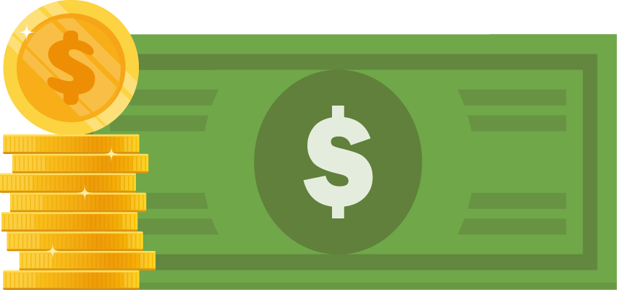
How compounding works
5% interest rate
Will saves the money from
his summer job.
At the end of summer, he has $1,000 in a savings account.
But his savings account is earning 5% interest.
Year 1
$1,000
Notes:
VOICEOVER FOR THIS SLIDE:
Let’s talk about Will and his money. Will does a pretty good job of budgeting over the summer and ends up with $1,000 in savings.
At the end of the summer, he opens a savings account that earns 5% interest and stashes that $1,000 in there.
Five percent is a high interest rate, but we’ll use that number so we can see what happens.

Slide 31
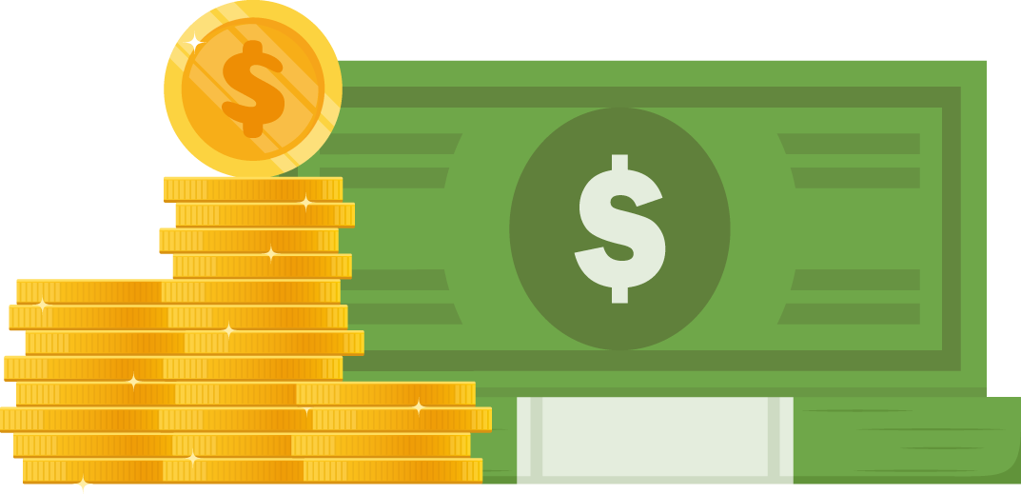
How compounding works
5% interest rate
Even if Will never adds more money, that $1,000 will become about $1,276 over five years, all because of interest.
Year 5
$1,276.28
Notes:
VOICEOVER FOR THIS SLIDE:
Will uses his savings account for long-term savings and leaves that $1,000 in the account for 10 years.
Here’s the thing: Because of the interest he’s earning, that $1,000 grows to about $1,276 in five years. You can see over time how the interest amount adds up, and each year the interest payment is a little more because it’s based on the total amount in the savings account.

Slide 32
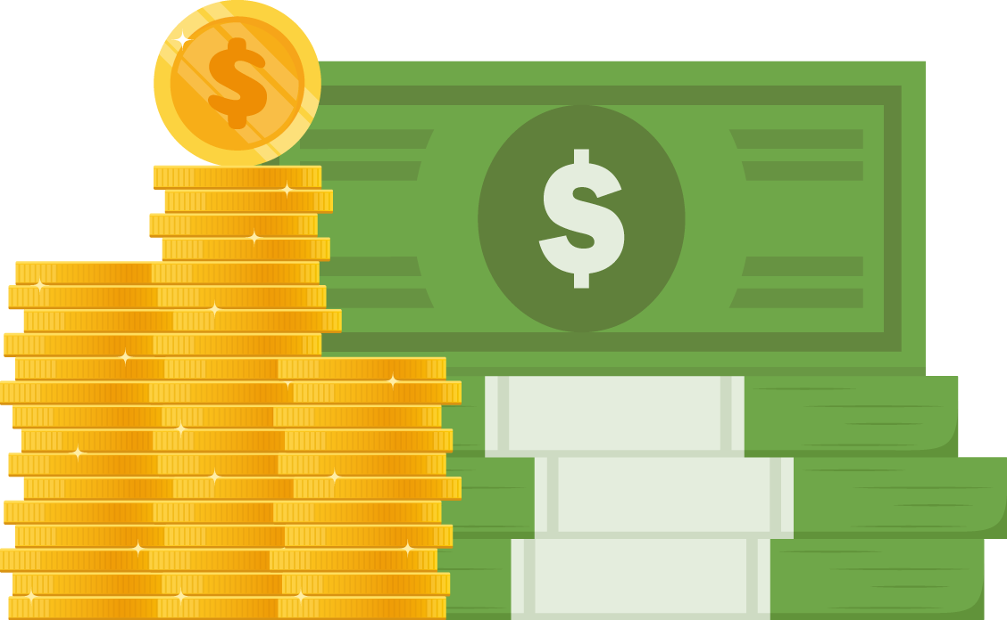
How compounding works
5% interest rate
He earns an interest payment each month, plus all the interest he’s previously earned is earning interest.
That’s compound interest.
In 10 years? He’ll have
almost $1,629.
Year 10
$1,628.89
$628.89 interest earned
Notes:
VOICEOVER FOR THIS SLIDE:
And in 10 years, he has $1,629.89.
That’s basically how compounding works — each interest payment means you have a new total amount in your savings account, and the next interest payment is based on that amount.
Over time, that amount can increase significantly.

Slide 33
Quiz time!
Question:
What’s one thing a budget can help you do?
Reach goals, keep you from spending too much,
help you save, or help you prepare for emergencies
Notes:
VOICEOVER FOR THIS SLIDE:
OK, it’s time to get into our final quiz! I have five questions for you. Here’s number one.
[Ask before revealing the answer]:
What do you think the answer is?
[Presenter: Click for answer.]

Slide 34
Quiz time!
Fill in the blank:
When you spend more than you earn,
you go into .
debt
Notes:
VOICEOVER FOR THIS SLIDE:
[Ask before revealing the answer]:
What do you think the answer is?
[Presenter: Click for answer.]

Slide 35
Quiz time!
True or false:
Automatic transfers can deposit your paycheck each month.
False.
Direct deposit puts your paycheck earnings into your account.
Notes:
VOICEOVER FOR THIS SLIDE:
[Ask before revealing the answer]:
What do you think the answer is?
[Presenter: Click for answer.]

Slide 36
Quiz time!
Question:
The money in your savings account can grow thanks to the power of what?
Compound interest.
Notes:
VOICEOVER FOR THIS SLIDE:
[Ask before revealing the answer]:
What do you think the answer is?
[Presenter: Click for answer.]

Slide 37
Quiz time!
True or false:
Compound interest takes time to add up to great savings.
True.
Over time, compound interest on your savings can add up.
Notes:
VOICEOVER FOR THIS SLIDE:
OK, last question!
[Ask before revealing the answer]:
What do you think the answer is?
[Presenter: Click for answer.]

Slide 38
Where to keep learning about finance
Hands on Banking
(Search online: Hands on Banking for Youth)
Bank On affordable bank accounts
(Search online: Bank On finance)
FDIC Money Smart
(Search online: FDIC Money Smart)
National Credit Union Administration learning tools
(Search online: National Credit Union Administration learning tools)
Notes:
VOICEOVER FOR THIS SLIDE:
Learning about money and increasing your knowledge about personal finances take time and effort but can pay off so much in the long run. It can help you improve your financial well-being over time and make your future brighter.
There are many free resources to help you — especially online. Consider subscribing to a financial education newsletter or podcast, or bookmarking a website.
If you have a relationship with a bank, you can also reach out to them to see if they can connect you with experts or other resources who can help educate you.
Any questions?

