Slide 1

Spending and saving
Learn about managing your money.
TIPS FOR
Adults
Notes:
ATTENTION SPEAKER!
Please do not change any of the content on the slides!
Please share in Presenter Mode/Slide Show Mode because there are animations and transitions to help emphasize points and help keep your audience engaged.
Practice your presentation in advance to make sure you know how the slide transitions work, especially for the quizzes.
Each slide includes voiceover notes to help you, but reviewing and practicing the entire presentation before sharing it with an audience will help you prepare. We suggest that you customize the voiceover notes to help you speak to your particular audience.
VOICEOVER FOR THIS SLIDE:
This presentation is all about the basics of spending and saving, which are the building blocks of learning how to manage your money.
Because the truth is, understanding the basics of managing money can really set you up for success in the future. This isn’t just about not spending all the money you get. It’s about knowing where your money goes so you can make decisions that help you get ahead.
Of course, we’ll cover a lot of information in this presentation. But another key thing to think about is the role a bank could play in how you manage your spending and saving. Bank accounts like checking and savings accounts can really simplify the process of knowing where your money goes.
But before we go too deep into that subject, let’s talk about spending and saving.

Slide 2
What we’ll talk about
Why you need a budget
Spending less than you earn
Building an emergency fund
Saving for something big
The benefit of interest
Notes:
VOICEOVER FOR THIS SLIDE:
Here are some of the topics we’ll be talking about today. We’ll start with some of the basics, which really starts with understanding what a budget is and how to create one.
We’ll talk about why it’s important to spend less than you earn.
We’ll look at how an emergency fund can help you be prepared for unexpected expenses like car repairs or medical bills.
We’ll discuss things like strategies to help you save for a big purchase.
We’ll also explain a bit about compound interest and how it can impact your ability to save.
And we’ll talk about where you can go to keep learning more about managing your money to reach financial stability.

Slide 3

Let’s talk about your money
Do you know how much money you saved last month?
What about how much you spent?
Notes:
VOICEOVER FOR THIS SLIDE:
Payday can be really satisfying. You’ve worked hard for your money, and you’ve earned every penny. But part of being financially responsible means understanding what you do with that money — what you spend your money on and what you save your money for.
Let’s talk about how you’re currently spending and saving money.
Do you know how much money you saved last month?
What about how much you spent?
Do you have clear financial goals, like saving for a down payment on a house or buying a car? Do you have a plan to reach those goals?
If you reach the end of the month and wonder where all your money went, you’re not alone. About 83% of people say they struggle with overspending, according to a 2023 survey by NerdWallet.
Part of taking control of your money includes creating a budget. This can help you track how your spending compares to how much you’re earning and saving.
Stat source:
https://www.nerdwallet.com/article/finance/data-2023-budgeting-report

Slide 4
Let’s talk about your money
Controlling your spending and prioritizing saving is crucial as you go through life.
By spending and saving responsibly, you can achieve financial security, reduce stress, and hit important life goals over time.
Notes:
VOICEOVER FOR THIS SLIDE:
It’s important to understand that controlling your spending and prioritizing saving are crucial as you go through life. Your finances can affect every aspect of your life, from your physical and mental health to even your ability to get certain jobs.
People who struggle with debt or financial insecurity are more likely to experience anxiety, depression, and feelings of hopelessness. These feelings can actually make your financial situation worse, according to a 2024 study by the TIAA Institute. Among those facing mental health challenges, 93% said they felt like they spent more than usual, and 56% said they took out a loan they otherwise would not have.
By spending and saving responsibly, you can achieve financial security, reduce stress, and reach your goals, like saving for retirement.
Stat source:
https://www.tiaa.org/public/institute/about/news/tiaa-institute-report-finds-ties-between-financial-stress-and-mental-health

Slide 5
Can you cover an unexpected expense?
More than a quarter of Americans (28%) have less than $1,000 in savings.
Percentage
of Americans who can cover an unexpected $400 expense
63%
CAN
37%
CAN’T
Notes:
VOICEOVER FOR THIS SLIDE:
An unexpected expense like a medical bill or car repair could lead to financial hardship for many families. According to the Federal Reserve, in 2023 only 63% of American adults could cover an unexpected expense of $400 using cash, savings, or a credit card they paid off right away. The remaining 37% said they would have paid by borrowing or selling something, or they would have had to go without.
But the good news is that it’s never too late to develop good spending and saving habits, so you can cover an emergency expense, plus all the normal expenses — like car payments, rent, bills, etc. — that come your way.
Stat sources:
https://www.forbes.com/advisor/banking/savings/average-american-savings/
https://www.federalreserve.gov/publications/2023-economic-well-being-of-us-households-in-2022-expenses.htm

Slide 6

What is a budget?
A budget is a plan for your money.
A budget helps you answer these questions:
Where is my money going each month?
How can I spend less and save more?
How will I handle surprise costs?
How can saving help me?
Are budgets complicated?
No! A budget can be as simple as you need it to be — you can decide what you need!
Notes:
VOICEOVER FOR THIS SLIDE:
If you’re ready to take control of your spending and saving, creating a budget is a great place to start.
A budget is a written plan that helps you decide how you’ll spend your money. It can keep you focused and on track when it comes to spending and saving because you’ll know where every dollar is going, so you can be sure you’re spending on the things that are important to you.
And your budget doesn’t have to be complicated. Start by looking at how much money you earn every month compared to how much you’re spending. Where is that money going? Are there places you could spend less so you can save more? Are you prepared for unexpected expenses? How could managing your money so you have more savings help you enjoy the life you want to live?

Slide 7
What is a money goal?
Everyone has goals for their money.
Examples include:
Buying a car or a home.
Paying off debt.
Planning for a big event (like a wedding or vacation).
Saving for college.
Saving for retirement.
What financial goals do you have for the future?
Notes:
VOICEOVER FOR THIS SLIDE:
You may have never verbalized your financial goals, but chances are you have some in mind.
Many people are working toward goals like buying a car or a home, paying off debt, planning for a big event like a wedding or a once-in-a-lifetime vacation, or saving for college or retirement.
[Ask]:
Have you ever hit a money goal? How long did it take you?
What financial goals do you have for the future?

Slide 8

Why you need a budget
A budget will:
Help you reach your money goals.
Keep you from spending too much.
Help you save for things you want.
Help you manage debt.
Prepare you for emergencies or unexpected expenses.
Notes:
VOICEOVER FOR THIS SLIDE:
There is a saying that a budget is telling your money where to go instead of wondering where it went.
It’s easy to keep spending money on things you want. But if you have a budget, you know how much you should spend, and you can set a limit for yourself.
If you have $100 set aside for takeout each month and you hit that limit with a week left to go, then it may be time to open the pantry instead.
A budget can also help you manage debt by avoiding spending more than you have while also helping you save for things you want.
It’s important to make sure your spending is under control and that you have a healthy savings. This way, if something unexpected happens — like your car breaks down or you have a sudden medical bill — you can pay for it.

Slide 9

Let’s get a budget going!
Start by keeping track when you receive or spend money.
Make a note of every purchase you make for a month to see how much you spend.
How should I keep track?
Keep it simple to start: Keep track of your spending on paper or in a note on your phone.
Notes:
VOICEOVER FOR THIS SLIDE:
The first step in creating a budget is to keep track of how you’re already spending money.
That way, you realistically know what you need to spend on certain things. A good way to start budgeting is to keep track of your spending for a month, writing down when you receive money and when you spend money.
Make a list of your usual expenses, like rent, utilities, car payments, etc., and how much they were for the month.
Next, write down every purchase you make during that month to see how much you spend.
Once you see your spending laid out in black and white, you can have a better sense of where your money is going. For example, you might be surprised by the amount you’re spending on takeout each month or how much you’re paying for subscription services.

Slide 10

Let’s get a budget going!
Use that information to help
plan next month’s budget.
Your goal should be to have money left over each month for savings.
Notes:
VOICEOVER FOR THIS SLIDE:
Use this information to plan for next month. Are there places you might be able to cut back on your spending, maybe by packing your lunch one day instead of eating out or canceling your Netflix subscription if you haven’t signed on in months?
Your goal should be to create a budget you can stick to and that ensures that you have money left over each month for savings.
But don’t get overwhelmed. It’s OK if your monthly savings start small. As you get more used to budgeting and managing your money, you can increase the amount you save over time.

Slide 11



Hands on example:
Building a budget
The Barretts are a young family with three kids,
one in daycare and two in school.
Notes:
VOICEOVER FOR THIS SLIDE:
Let’s go through an example of building a budget with the Barretts, a family with three young children. They want to create a budget so they can start working toward goals like saving for a family vacation.

Slide 12
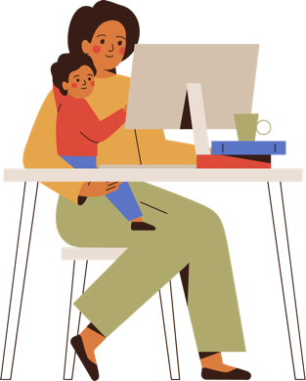


Hands on example:
Building a budget
Both parents work full-time jobs, and they’re contributing to retirement accounts through their employers.
Notes:
[Presenter: Share the info that’s on the slide.]

Slide 13


Hands on example:
Building a budget
They have two cars — one is paid off, and one is leased.
Mr. Barrett is still paying off his student loans.
Notes:
[Presenter: Share the info that’s on the slide.]

Slide 14

Hands on example:
Building a budget
They’ve created a thorough budget that reflects all their expenses
for the month, allocating some money toward an emergency fund.
Notes:
[Presenter: Share the info that’s on the slide.]

Slide 15


Hands on example:
Building a budget
By keeping track of their spending, they know exactly where each dollar
they earn is going and can save for fun extras like a family vacation.
Great job, Barretts!
Notes:
[Presenter: Share the info that’s on the slide.]
VOICEOVER FOR THIS SLIDE:
By budgeting for their regular expenses — like retirement savings, their car payment, and student loan payments — they can make sure they’ve got enough left over to contribute to their emergency fund and save for something fun, like a family vacation.
[Presenter: Pause for animation.]
When you know where each dollar you earn is going, it’s easier to prioritize your goals.

Slide 16
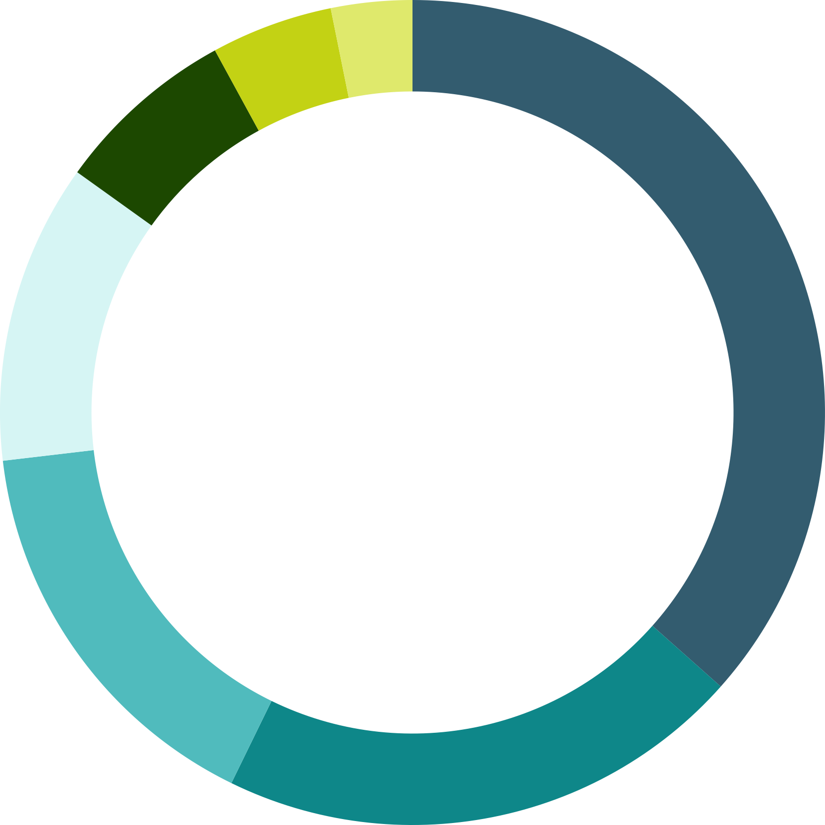
Hands on example:
Family budget
Example of tracking some family expenses:
Mortgage
Day care
Groceries
Car lease, gas, and insurance
Utilities
Other expenses
Student loan
$300
$200
$450
$2,300
$740
Total expenses
(for the month)
$6,290
$1,000
$1,300
Notes:
VOICEOVER FOR THIS SLIDE:
As an adult, you have a lot of financial responsibilities: rent or a mortgage, utilities, child care, groceries … it can all add up quickly.
Some of those costs stay the same every month, and some you can estimate based on previous months.
For example, let’s say these are your monthly expenses:
Mortgage is $2,300
Car lease, gas, and insurance are $740
Groceries are $1,000
Utilities like gas and electric add up to $450
Day care is $1,300
Student loan payment is $200
Other expenses, including a family gym membership, dining out, extracurricular activities for your kids, and contributing to your emergency savings
When you add it all up, your total expenses for the month are $6,290.

Slide 17
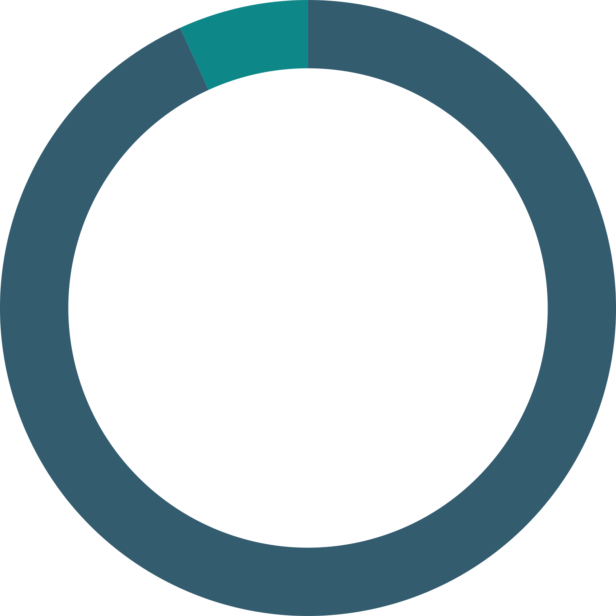
Hands on example:
Family budget
$460
LEFT OVER
If your family’s total income for the month (after taxes and retirement contributions are deducted from your paycheck) is $6,750, you have $460 left over for “extras.”
Total expenses for the month
What’s left over for saving or spending
Total income
(after tax)
$6,750
$6,290
TOTAL EXPENSES
Notes:
VOICEOVER FOR THIS SLIDE:
If your family’s total income for the month (after taxes and retirement contributions are deducted from your paycheck) is $6,750, you have $460 left over for “extras.”
When you budget with your financial goals in mind, you can decide the best way to use that leftover money, such as making “fun” purchases, like new clothes, or saving it for a specific purpose, like a vacation.

Slide 18
Your goal:
Don’t spend it all!
Less spending means more saving.
When you spend more than you earn,
you go into debt.
Debt can negatively impact your ability to get a car loan or mortgage.
Notes:
VOICEOVER FOR THIS SLIDE:
Your goal every month is to have money left over after all your essential expenses are covered. By spending less, you can save more, which will allow you to worry less (you will be able to cover unexpected expenses and hit money goals, as we talked about) and give you financial freedom. Living paycheck to paycheck — with no savings — can be stressful.
Having debt will impact your credit score, which is important when it comes to buying a car or home. If you’re overextended, you might be seen as a riskier borrower, so lenders may not want to give you a loan.
Debt from car loans, student loans, or mortgages isn’t a bad thing, but overall, you want to aim to be debt-free.

Slide 19
Let’s talk!
Have you ever spent money on something
and regretted it later?
Notes:
VOICEOVER FOR THIS SLIDE:
[Ask:]
Have you ever spent money on something and regretted it later?

Slide 20
5 questions to ask yourself before you buy something
Will I use it? How often?
Did I want this before I walked into the store
or saw it in an ad?
Where will I keep it?
Do I already have something like this at home?
Do I really need this?
Notes:
VOICEOVER FOR THIS SLIDE:
Running through these questions can help you think through a purchase and hold back if you need to. What other questions could you ask yourself if you’re on the fence about buying something?
You could also try to follow the five-day rule: If you’re thinking about making a purchase, wait five days to see if you’re still thinking about or needing the item you were going to buy. This is a great way to curb impulse purchases and can also be useful when shopping online. Leave the item in your virtual cart for a few days, and if you forget to come back and check out, you likely don’t need it and can save the money.

Slide 21


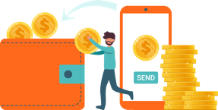
Hands on example:
Values-based budgeting
Katie and Matt love to travel; they’re always planning their next trip, and visiting new places brings them great joy.
Notes:
VOICEOVER FOR THIS SLIDE:
Budgeting is not just about cutting back on expenses and saving for a rainy day.
It’s also about aligning your spending with what you care about so you feel good about your spending and about taking control of your finances.
As an example, let’s look at Katie and Matt. They like to travel and are always looking ahead to their next trip.

Slide 22



Hands on example:
Values-based budgeting
They cover their monthly bills and save for retirement, but they’ve started to adjust some expenses to align with their desire to travel.
Notes:
VOICEOVER FOR THIS SLIDE:
They make sure to pay their monthly bills and save for retirement each month, but they know that they also want to be able to afford to travel. So they’ve started to adjust some of their spending, like cutting back on expenses, so they can save for that goal.

Slide 23
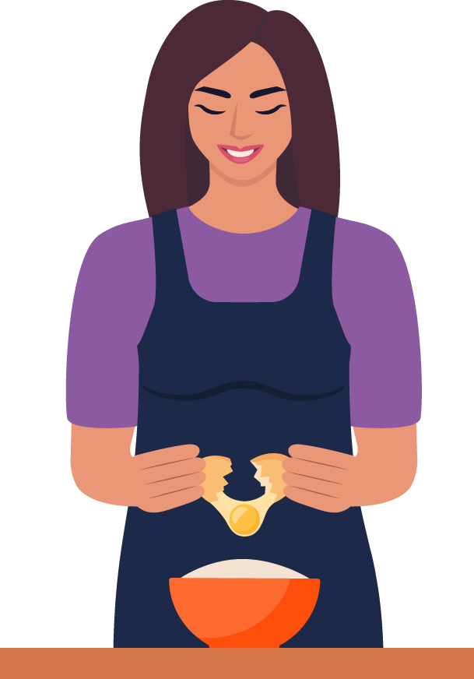

Hands on example:
Values-based budgeting
They moved to a studio apartment to save on rent. They cook meals
at home to save their “dining out” money for when they’re traveling.
Notes:
[Presenter: Share the info that’s on the slide.]

Slide 24

Hands on example:
Values-based budgeting
They’re confident in their budget, and it gives them the
freedom to pick up and travel.
Notes:
VOICEOVER FOR THIS SLIDE:
[Presenter: Pause for animation.]
By budgeting for the things they value and want to prioritize, they can live the lifestyle they want without having to worry about their finances.

Slide 25


What is an emergency fund?
It’s money you set aside for unexpected expenses.
How to create one? Start however
you can and build over time.
First, set of goal of $1,000.
Then keep adding until you have enough to cover three to six months’ living expenses, or more.
Notes:
VOICEOVER FOR THIS SLIDE:
To help ease financial stress, an emergency fund should be part of any budget.
That way, you can allocate money for your emergency savings each month so you’re prepared for the unexpected, like home repairs, medical bills, or loss of income. If you were to lose your job, would you be able to pay your bills while you looked for a new one?
A good rule of thumb is to have enough money saved to cover three to six months of living expenses. Multiply your monthly budget by three or six months and aim for that total.
Sometimes, that number can feel overwhelming. But it’s OK to start small. Set a smaller goal, like $1,000, and work toward that. Then keep adding to your emergency fund until you’ve reached your bigger goal.

Slide 26
Tips for saving for a big purchase
Set your goal and milestones.
Determine your budget.
Avoid impulse purchases.
Set up checking and savings accounts.
Make saving automatic.
Use investment vehicles (like a 401(k) or 529 plan).
Notes:
VOICEOVER FOR THIS SLIDE:
Whether you’re trying to save for emergencies or for another financial goal, there are a few tried-and-true ways to efficiently save.
Set your goal and milestones. Big goals can feel daunting, but if you set and celebrate milestones along the way, it can give you the motivation you need to keep going. For instance, you could try and save $500 for a car over three months. Then set another milestone to save another $500 over another three months.
Determine your budget. Again, having a budget controls your spending so it doesn’t eat into your savings.
Avoid impulse purchases. Make it a habit to avoid buying things you didn’t plan to buy — this is where the wait-a-week rule that we discussed earlier can really help. If you want the item in a week, it will still be there.
Set up checking and savings accounts. Dividing your money will help you resist spending it all. Keep the money you want to save in your savings account so you aren’t tempted to spend it, and use your checking account to keep money you know you need for your bills and other expenses.
Automate your savings. This can be done in your bank account app. Set up an automatic transfer to move money from checking to savings after each paycheck so you don’t even have to think about saving.
Use investment vehicles. Many times, these accounts have tax benefits, so you can park your money there and watch it grow over time.

Slide 27

How to make saving automatic
Use the tools your bank provides to simplify saving.
Use direct deposit to deposit paychecks into your checking account.
Set automatic transfers from checking to savings accounts.
Why save automatically?
If you automatically move money to your savings account, you’ll be less tempted to spend it.
Notes:
VOICEOVER FOR THIS SLIDE:
Automating your savings is an easy way to make sure you’re saving — you don’t even have to think about it!
If your employer offers it, get your paycheck deposited directly into your checking account. Then there’s no way you will lose or spend the money as it sits in your wallet. Your employer might even provide the ability to split your direct deposit, so you can send a certain amount from each paycheck to your savings account and the rest to your checking account, for example.
If that isn’t offered by your employer, you can use your bank’s tools to set up an automatic transfer right after each paycheck is deposited to move a set amount from your checking account to your savings account.
Automating your savings can have big benefits. One, it gives you consistent growth. If you’re automatically saving $100 each month, you know you’ll have $1,200 at the end of the year — no guessing about how much you may be able to save each month.
Two, it helps you avoid the temptation to spend. If the money isn’t in your checking account, you’ll be less tempted to spend it.
And three, it can help you meet your saving goals. Automating saving allows you to save a specific amount so you can plan for and hit goals by a specific date.

Slide 28
How to get the most from a savings account
Earning interest is the main benefit of savings accounts.
Interest is a payment for keeping your money with the bank. It’s calculated as a percentage of the amount you have in your bank account.
Compound interest is earned on both the original money you put in the bank and the money that has been added through interest. Over time, this can really add up.
Notes:
VOICEOVER FOR THIS SLIDE:
A savings account can also help your money work for you by earning interest.
Think of interest as free money — it’s money the bank gives you for keeping your money in an account at the bank. It’s calculated as a percentage of the amount you have in your bank account.
There are two types of interest: Simple interest is how much you earn monthly on the original amount deposited in your account. So if you open a savings account with $200, your interest each month will be based on that $200, no matter how much your balance has grown over time.
But compound interest is earned on both the original amount you deposited when opening the account and the money you earn in interest over time. In other words, it’s interest on interest. If you open the account with $200, the first year you’ll get interest on that $200. The second year, you’ll earn interest on the initial $200 plus the interest you earned on it previously.
While interest isn’t necessarily the fastest way to build your savings, it will steadily add a little bit to your balance every month, and that can add up over time.

Slide 29
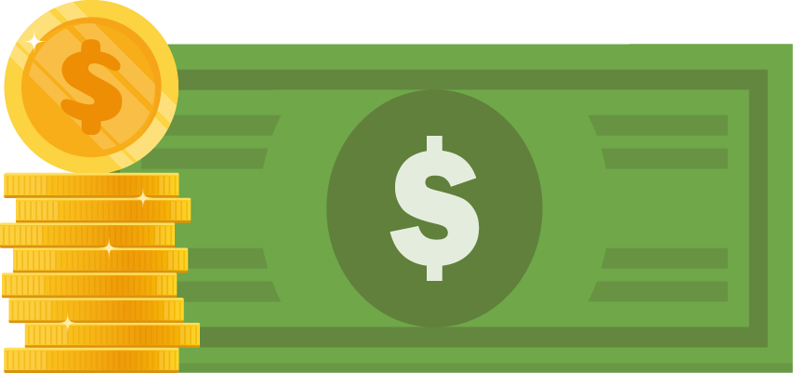
How compounding works
5% interest rate
Lucas gets a $5,000 signing bonus at his new job, and he decides to save that money as an emergency fund for the next few years.
He puts the money in a high-yield savings account with a 5% interest rate.
Year 1
$5,000
Notes:
VOICEOVER FOR THIS SLIDE:
Let’s talk about Lucas and his money. When Lucas gets a new job, his new employer gives him $5,000 as a signing bonus.
He decides he wants to use that money to create an emergency fund.
To make his money work even harder for him, he decides to open a high-yield savings account, which pays higher interest than a traditional savings account. His new savings account has a 5% interest rate.

Slide 30
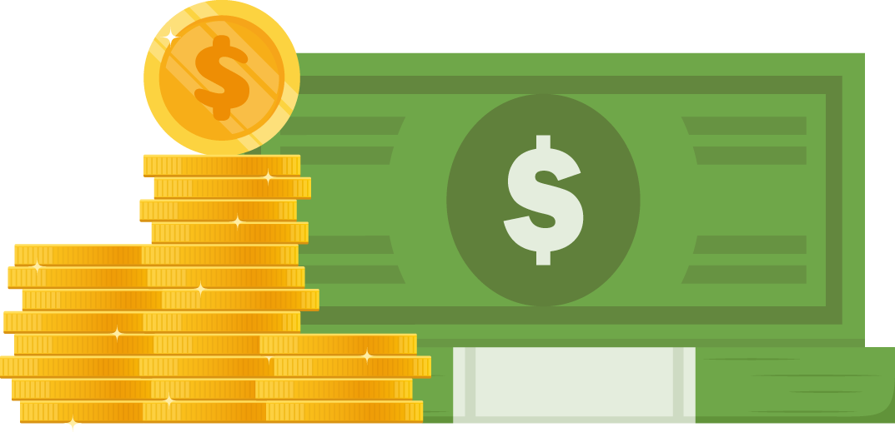
How compounding works
5% interest rate
Interest is basically money that the bank pays you for saving your money with them.
Lucas earns an interest payment each month, plus all the interest he’s previously earned is also earning interest. That’s compound interest.
Year 5
$6,381
Notes:
VOICEOVER FOR THIS SLIDE:
Lucas earns interest on that $5,000 each month. He also earns interest on the previous interest he earned.
So that means for the first year, he earns $250 in interest. In the second year, he earns 5% on $5,250 — the total amount of money in the savings account after one year of accruing interest.
Each year, he’ll continue to earn interest on the interest he’s already earned — you can see over time how the interest amount adds up, and each time it’s a little more because it’s based on the total amount in the savings account. That’s how compounding interest works.

Slide 31
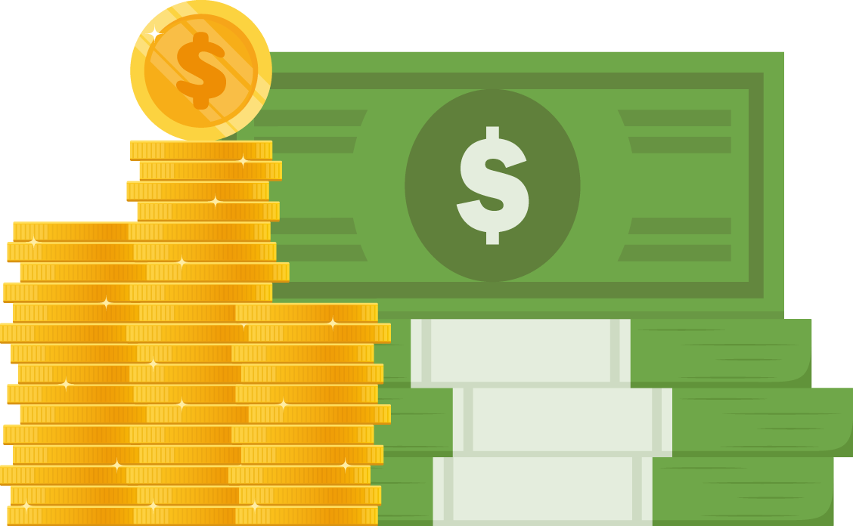
How compounding works
5% interest rate
Over the next 10 years, Lucas’ $5,000 turns into over $8,000 thanks to those interest payments — without his adding a penny more.
Year 10
$8,144.47
$2,387 interest earned
Notes:
VOICEOVER FOR THIS SLIDE:
After 10 years, his balance has grown from $5,000 to $8,144.47 because of the interest he’s earning. He’s building his savings without having to do a thing or save any additional money on his own.

Slide 32
Quiz time!
Question:
What’s one thing a budget can help you do?
Reach goals, keep you from spending too much, help you save,
or help you prepare for emergencies
Notes:
VOICEOVER FOR THIS SLIDE:
OK, let’s go over what we learned and see how well you understand budgets, spending, and saving. Here’s the first question.
[Ask before revealing the answer]:
What do you think the answer is?
[Presenter: Click for answer.]

Slide 33
Quiz time!
True or false:
To start, an emergency fund should cover
five years of expenses.
False.
Aim for $1,000 to start. Then work toward saving enough
to cover three to six months of expenses.
Notes:
VOICEOVER FOR THIS SLIDE:
[Ask before revealing the answer]:
What do you think the answer is?
[Presenter: Click for answer.]

Slide 34
Quiz time!
True or false:
The key to saving with compound
interest is time.
True.
The more time your money has in an account, the more time it has to grow.
Notes:
VOICEOVER FOR THIS SLIDE:
OK, last question!
[Ask before revealing the answer]:
What do you think the answer is?
[Presenter: Click for answer.]

Slide 35
Where to keep learning about finance
Hands on Banking
(Search online: Hands on Banking)
AICPA Financial Literacy Resources
(Search online: Financial Literacy Resources)
FDIC Consumer Resource Center
(Search online: FDIC Consumer Resource Center)
Bank On accounts
(Search online: Bank On certified accounts)
National Credit Union Administration
(Search online: My Credit Union Education)
Notes:
VOICEOVER FOR THIS SLIDE:
Take a photo of this slide for later!
Learning about money and growing your knowledge when it comes to personal finances takes time and effort but can pay off so much in the long run. It can help you improve your financial well-being over time, ease stress, and help you enjoy the life you want to live.
There are many free resources to help you, especially online. Consider subscribing to a financial education newsletter or podcast, or bookmarking a website.
If you have a relationship with a bank, you can also reach out to them to see if they can connect you with experts or other resources to educate you.
Any questions?

