Slide 1

What banks can do for you
Here’s what to know about banks.
TIPS FOR
Students
Notes:
ATTENTION SPEAKER!
Please use Presentation Mode / Slide Show Mode when sharing because there are animations and transitions that help emphasize specific points and keep your audience engaged.
Please do not change any of the content on the slides!
Each slide includes voiceover notes to help you, but reviewing and practicing the entire presentation before sharing it with an audience will help you prepare. We suggest that you customize the voiceover notes to help you speak to your particular audience.
VOICEOVER FOR THIS SLIDE:
This presentation is all about what banks can do for you.
Sometimes, people might wonder if banks are really helpful and if you really need a bank. But having a good relationship with a bank can be an important part of taking care of your money, which can impact a lot of different parts of your life.
Banks can be helpful and offer a lot of tools so you can reach your goals, whether that’s buying a car, buying a home, or saving money for that thing you really want.
So let’s dive into what you should know about banks.

Slide 2
What we’ll talk about
What a bank is
Basic banking terms
Why you need a bank
What it means to pay by card or phone
What banking questions to ask your parents or guardians
Opening a bank account
How to learn more about money
Notes:
VOICEOVER FOR THIS SLIDE:
Now here’s just a quick look at some of the things we’ll be talking about today. We’ll start with some of the basics, just explaining what a bank is and what banks do.
We’ll talk about earning money and how to put it in the bank.
We’ll talk about how you can do a lot with your phone these days, like depositing checks or paying for things.
We’ll also talk about what you need to do to open your first bank account.
And we’ll talk about ways to keep learning more about banks and other money topics that can help you out in life.

Slide 3
Where does money come from?
Money can come from a few places:
A job or having your own business
An allowance
Investing
Gifts
Notes:
VOICEOVER FOR THIS SLIDE:
ASK:
Where do you get money from? Where do your parents or guardians get money from?
Money comes from work. You may see your parents going to work, and that’s to earn money to pay for things like groceries, to pay bills, and more. But kids can also earn money, through an allowance, maybe for doing chores around the house, or through a job like babysitting or cutting the lawn for neighbors.
Money comes from money. There are ways that you can save money where that money can earn money without you doing any additional work. This is called interest. For example, with a certain type of savings account, you might put $100 in the account and then over time be paid more money in interest in that account. So you might have $100 now that becomes $110 later. Over time, it can really add up. We’ll talk more about interest later.
Money comes from other people. Sometimes people may give you money as a gift, like for your birthday or at a holiday, or if you reach a big milestone. And you may choose to give your money to others who need it, like giving it to church or charity.

Slide 4

Where can you keep your money?
As you earn more money, you need a place to keep it safe
and to keep track of it.
That’s where banks come in.
Notes:
VOICEOVER FOR THIS SLIDE:
As you start to get money, you will want a place where you can keep it safe. And while something like a piggy bank can hold your money and keep it close by, you will eventually want to keep your money someplace where it’s easy to use as well as save, manage, and track.
That’s where banks come in.
ASK:
Who has been to a bank before?
If you remember going to a bank, did you or your parents do anything specific there that you could tell us about?

Slide 5

What is a bank?
Banks:
Can keep your money safe.
Can protect your money through
government insurance.
Let you keep track of your money.
Let you add money and
take away money as needed.
Notes:
VOICEOVER FOR THIS SLIDE:
Let’s start here: Banks (and credit unions) are licensed institutions, which means that they meet a lot of federal requirements in order to qualify as a bank. Not just anyone can call themselves a bank or credit union.
One of the main purposes of a bank is to keep your money safe. Imagine if you kept all your money as paper dollar bills and coins, and something happened to your house — like flooding, a fire, or burglary. You could easily lose all of your money. But if you keep your money in the bank, you’d still have it, even in one of those worst-case scenarios.
Banks are also insured by the federal government, which means that if they go out of business somehow — which is very rare — the government will pay out what the bank owes you. The government insures the money you’ve deposited, up to a certain amount.
Banks also make it much easier to keep track of your money. You can see all of your money in one place without having to count up your cash every time. And you can easily look at your accounts anytime through the bank’s app or website.
With a bank account, you can also add money to your account at any time — this is called depositing money. And when you need money for something, you can always take it out — this is called withdrawing your money.
Banks make money by charging customers for their services, just like any other kind of business. People pay for the services because they value them. (But it’s a good idea to look for low prices for those services.)
In addition to the banks you see in your town, there are a couple of other types of financial institutions that offer these services. Credit unions are similar to banks, but they are not-for-profit organizations that typically serve a specific area or group (like workers in a specific industry). And online-only banks offer banking services but don’t have physical branches that you can visit. All of these are licensed institutions like banks.

Slide 6

What’s the point of banks?
Banks give you:
Safe, easy access to your money via debit cards.
A place to save and earn interest.
Loans and credit cards for building
credit history and hitting bigger goals.
What’s a debit card?
It’s a payment card linked to your checking account that you use to make purchases.
Notes:
VOICEOVER FOR THIS SLIDE:
So, what’s the point of banks? They can provide many benefits, including giving you things like safe, easy access to your money via debit cards. So with a checking account, you get one of the safest ways to store your money. And you also get a debit card, which is one of the safest ways to pay for purchases in everyday life.
Banks also provide a better place to save your money, because not only are your savings safer there — but you can also earn interest on the money you keep in a savings account. Interest is basically a payment you receive — it’s like getting paid just for keeping your money with the bank.
When you get older, you’ll also probably need to use loans and maybe even credit cards at some point in your life. Credit tools like these that banks offer are how many people do things like buying a car or a home. These tools let you borrow money that you pay back over time.
ASK:
Does anyone have a bank account? What about a debit card?

Slide 7
Basic banking terms
When you want to keep your money in a bank,
you open an account in your name.
You deposit money in your account when you add to it.
You withdraw money from your account when you want
to spend it.
Notes:
VOICEOVER FOR THIS SLIDE:
Let’s talk about a few of these basic banking terms.
Account: An account is what you have at a bank — it’s what you put your money in. You basically own that account, and the bank is just holding it for you. Usually, this is either a checking account or a savings account.
Deposit: To deposit something means that you put something away somewhere. So when you deposit money in a bank account, you’re adding to your account — putting that money there for later or so you can spend it using your debit card or transfer it to pay others.
Withdraw: Withdrawing means you take something out or away. So when you withdraw money, it usually means you’re withdrawing cash out of your account — and the amount you have in the account decreases.
ASK:
So if you’re adding money to an account, what are you doing? (Depositing.)
And when you’re taking money out of an account, what are you doing? (Withdrawing.)

Slide 8

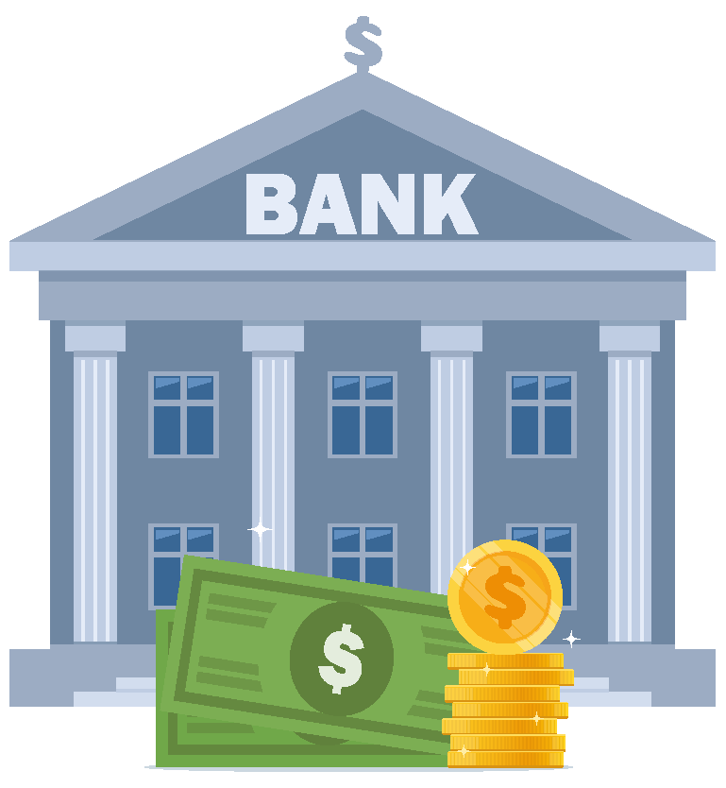
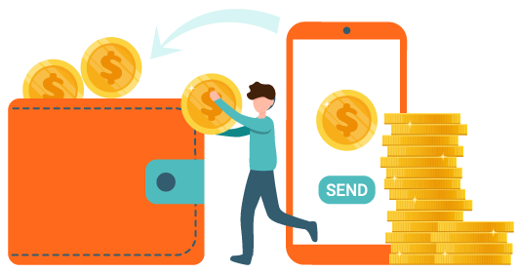
Hands on example:
Using your bank account
Grandma gives you $50 for your birthday. (Score!)
Notes:
(Use the onscreen text to tell the story of depositing money in a bank, where it can be safe and accessible.)
VOICEOVER FOR THIS SLIDE:
Let’s take a look at a hands on example — this demonstrates a basic way you can use a bank or checking account.
Let’s say you get $50 when grandma gives you some money for your birthday.

Slide 9

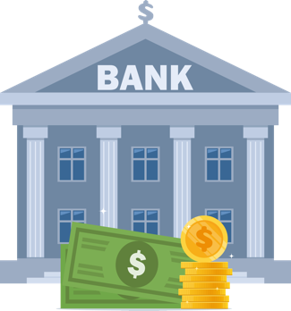
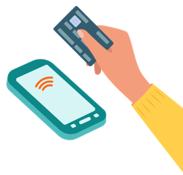
Hands on example:
Using your bank account
Instead of storing the money in your room, where your sister
might find it, you deposit it in your bank account.
Notes:
(Read the onscreen text to tell the story of depositing money in a bank, where it can be safe and accessible.)

Slide 10
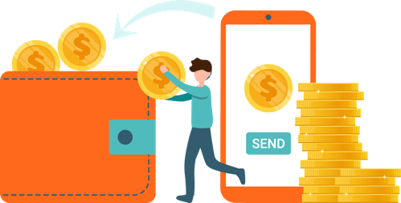

Hands on example:
Using your bank account
When you want to buy a new game, you can withdraw
some of that money to pay for it.
Notes:
(Read the onscreen text to tell the story of depositing money in a bank, where it can be safe and accessible.)

Slide 11
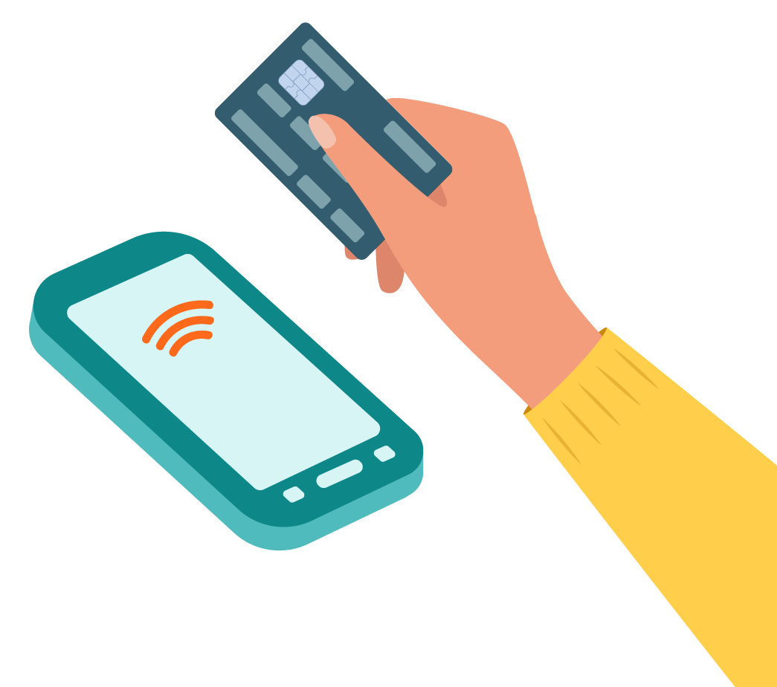
Hands on example:
Using your bank account
Or you can use the debit card
that’s connected to your account.
Notes:
(Read the onscreen text to tell the story of depositing money in a bank, where it can be safe and accessible.)

Slide 12


Hands on example:
Using your bank account
Either way, you kept your money safe
until you were ready to use it. Good job!
Notes:
(Read the onscreen text to tell the story of depositing money in a bank, where it can be safe and accessible.)
VOICEOVER FOR THIS SLIDE:
That’s an example of how bank accounts can be a safe place to keep your money — and it’s still easy to get your money when you need or want to spend it on something.
PAUSE FOR ANIMATION.
ASK:
Any questions about this?

Slide 13
Quiz time!
True or false:
You only need a bank account if you have lots of money.
False!
A bank account can be helpful in managing
almost any amount of money.
Notes:
VOICEOVER FOR THIS SLIDE:
ASK:
So here’s a question for you: Is it true that you only need a bank account if you have a lot of money?
NOTE: CLICK FOR ANSWER.
What do you think the answer is? What makes you say that?
Well, the answer is typically “no.” Bank accounts can be helpful even if you don’t have lots of money.
Checking and savings accounts can be great ways to keep any amount of money safe.

Slide 14
Do I really need to go to a bank?
Not very often, that’s for sure!
You can use a bank’s app or website to:
See how much money is in your account(s).
Deposit checks.
Pay bills (when you’re older!).
Send money to other people.
Move money from one account to another.
Notes:
VOICEOVER FOR THIS SLIDE:
Having a bank account doesn’t mean you have to go to a bank. You can do lots of banking either online or using a smartphone.
Here’s why: Bank accounts are not physical things like cars or your shoes. They are tools and information that you can access from almost anywhere.
For example, you can log on to your account through the bank app on your smartphone or through the bank’s website and see how much money you have, and you can also manage it and make payments from there.
Here are a few examples of what you can do from your bank’s app or website.

Slide 15
What you should know about paying with cards
Credit card
The card company is loaning you money that you pay back later, plus extra if the loan is not paid in full on time.
Debit card
This card is linked to your checking account, so you can only spend what is in your account. It’s like using cash.
Prepaid card
This type of card is not linked to a bank! You add money to it, and then you can use what’s on the card. One example: a gift card.
Notes:
VOICEOVER FOR THIS SLIDE:
While they all look (and swipe) the same, debit cards, credit cards, and prepaid cards all work a little differently. And it’s important to know the difference, as some could end up costing you more money!
Credit cards provide a line of credit. What does that mean? When you use a credit card, you’re basically borrowing money that you need to pay back later. Credit cards charge interest on the money you use unless it’s paid back within the grace period. That means you pay an extra amount on top of the money you owe.
Debit cards are linked to your bank account and are limited by how much money is in the account. It’s kind of like using cash.
A prepaid card, like a gift card, is not linked to a bank account. Instead, you put money into the card account, sometimes called loading money onto the card, before you can spend it.
ASK:
Which of these cards could end up costing you more money?

Slide 16

Phones can help pay for things, too … kind of
You can add your debit card
to a digital wallet on your phone.
You can download and
use your bank’s app.
You can download a payment app
like Venmo or Cash App, link it to
your bank account, and make
payments with it.
Notes:
VOICEOVER FOR THIS SLIDE:
You’ve probably seen people use their smartphones to pay for things at most stores or restaurants. They can do this because they have a bank or payment app or a digital wallet set up on their phone so that they can make payments.
These apps or wallets are usually connected to a credit or debit card or to a bank account.
You can use your bank’s app to make payments or manage money (as long as you have the app installed on your phone).
You can add your debit card to your phone’s digital wallet to make paying easier. (The money still comes from your account, though!)
You can connect your account to a payment app like Venmo or Cash App to make payments (though the money still comes from your account for these payments, too). These are just two examples. There are other payment apps out there as well.

Slide 17

Phones can help pay for things, too … kind of
Digital wallets, bank apps, and payment apps can all help you:
Send and receive money.
Pay bills.
Pay for items and services
online or in person.
Notes:
VOICEOVER FOR THIS SLIDE:
All these options — digital wallets, bank apps, and payments apps — can make it easier for you to send and receive money from a bank account; pay bills with a bank account; and pay for things online or at a store, restaurant, or other types of businesses, just using your phone.

Slide 18

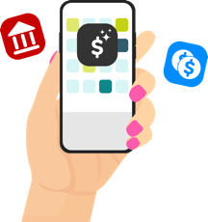
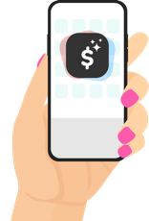
Hands on example:
Paying with apps
Emma, Claire, and Taylor want to buy ice cream
but don’t have cash or debit cards.
Notes:
(Use the story onscreen as a way to show how bank and payment apps can make sending and receiving money easy.)
VOICEOVER FOR THIS SLIDE:
Let’s look at another hands on example.
Imagine Emma, Claire, and Taylor are out at the shopping center, and they want to buy ice cream. BUT — they don’t have cash or a debit card with them.

Slide 19


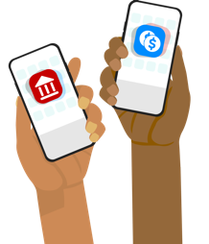
Hands on example:
Paying with apps
But they each have a smartphone
with different payment apps.
Notes:
(Read the onscreen text to show how bank and payment apps can make sending and receiving money easy.)

Slide 20


Hands on example:
Paying with apps
Emma uses Apple Pay, built into her iPhone,
to pay for their ice cream.
Notes:
(Read the onscreen text to show how bank and payment apps can make sending and receiving money easy.)

Slide 21
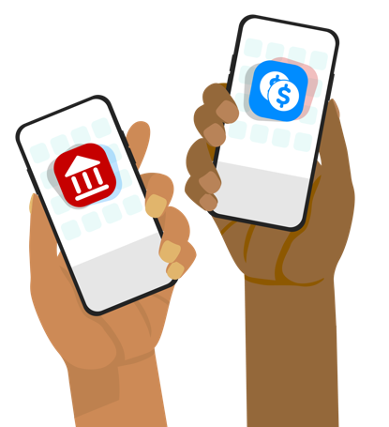
Hands on example:
Paying with apps
Claire uses her bank’s app to pay Emma back, while
Taylor opens up the Venmo app to do that.
Notes:
(Read the onscreen text to show how bank and payment apps can make sending and receiving money easy.)

Slide 22

Hands on example:
Paying with apps
All settled!
Notes:
(Read the onscreen text to show how bank and payment apps can make sending and receiving money easy.)
PAUSE FOR ANIMATION.
ASK:
Any questions about this? Does it make sense how it works?

Slide 23
Quiz time!
True or false:
A credit card is basically the same as a debit card.
False!
Notes:
VOICEOVER FOR THIS SLIDE:
ASK:
So, true or false: A credit card is basically the same as a debit card.
What do you think the answer is? What makes you say that?
CLICK TO REVEAL ANSWER.
Remember: A credit card and a debit card look the same but function differently.
A credit card allows you to make purchases by basically lending money that you pay back later (with possible interest fees).
A debit card allows you to make purchases using funds that are already in your bank account. It’s like using cash.

Slide 24
What to remember about cards
A credit card and a debit card look the same
but function differently.
A credit card helps you make purchases
by lending you money that you pay back later
(along with any interest fees).
A debit card helps you make purchases using
funds that are already in your bank account.
It’s like using cash.
Notes:
VOICEOVER FOR THIS SLIDE:
I know we talked about this earlier, but it really is important to know the difference between credit cards and debit cards.
Remember, when you use a credit card, you’re basically borrowing money that you need to pay back later. Credit cards charge interest on the money the cardholder borrows unless it's paid back within the grace period. So using a credit card can cost you more money.
Debit cards are linked to your bank account and are limited by how much money is in the account. It’s kind of like using cash. If you spend more than what’s in your account, you could get charged an extra fee by your bank.

Slide 25
Talking about money with parents or guardians
The adults in your life know a lot about money
— ask them about it!
Many people don’t want to share how much they
earn or spend …
but you can still talk to your parents or
guardians about how they hope you will handle
your money.
Notes:
VOICEOVER FOR THIS SLIDE:
When it comes to learning about money, you can learn a lot from your parents or guardians. Really! They know a lot. You just need to ask.
A lot of people aren’t comfortable talking about how much they earn, but you can still ask about tips or advice they might have for you.
Let them know that you want to learn about good money management and want their advice.
It can help to ask a few questions — maybe starting with what’s on your mind, like how you can start earning money or saving for something you want. You could also ask them about what they would like for you to do with your money.

Slide 26
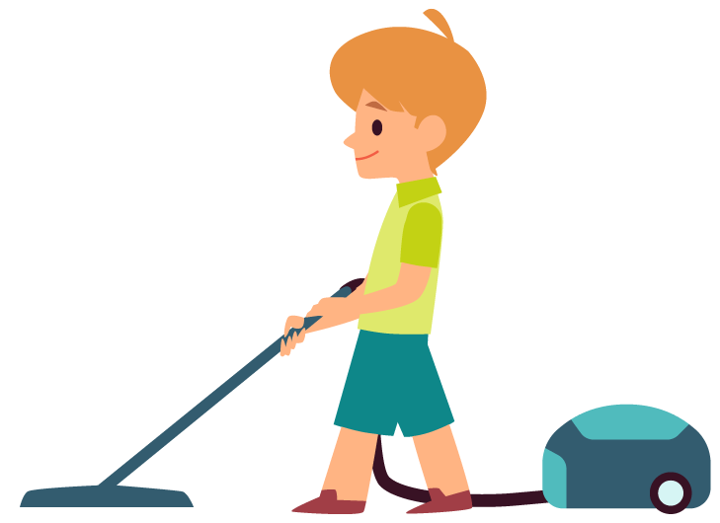


Hands on example:
Questions to ask parents or guardians
How can I earn money?
Notes:
VOICEOVER FOR THIS SLIDE:
Here are some sample questions to consider asking your parents or guardians.
Not everyone likes to talk about how much money they earn or how much they have saved, but they will likely be willing to talk about their goals and their hopes for you!

Slide 27



Hands on example:
Questions to ask parents or guardians
What should I save for?
Notes:
(Read the onscreen text to share possible questions for parents or guardians.)

Slide 28


Hands on example:
Questions to ask parents or guardians
What’s the most important thing you want me
to know about money?
Notes:
(Read the onscreen text to share possible questions for parents or guardians.)
PAUSE FOR ANIMATION.

Slide 29

How to open your first account
1
Talk to a parent or guardian.
A parent’s or guardian’s name will likely have
to be on the account if you’re under 18.
Your parent or guardian can help you figure out what information you might need.
2
Research options.
3
Compare the terms.
4
Sign up together.
Notes:
VOICEOVER FOR THIS SLIDE:
ASK:
Has anyone here opened a bank account before? What was that like for you?
If you haven’t done it before and are thinking you might want to, here are a few of the steps to opening an account.
You’re going to want to talk to your parents or guardians about it. If you’re under 18, they will most likely need to have their name on your account, too.
Your parents or guardians can also help you figure out what kind of information you’re going to need to have on hand when you open the account, like an ID or your address.

Slide 30
How to open your first account
1
Talk to a parent or guardian.
2
Research options.
You can search your parent’s or guardian’s bank website for “student and teen checking accounts.” Or do a simple online search for that phrase. Bank On is also a great way to find the right option for you.
3
Compare the terms.
4
Sign up together.
Notes:
VOICEOVER FOR THIS SLIDE:
You might want to open an account with a local bank, but it’s possible to open an account with an online-only bank, too. You and your parents or guardians will want to do some research so you can avoid any fees — sometimes there can be charges for some kinds of accounts.
Where can you research that info? Sites like Bank On (https://joinbankon.org/) are sources of information about trustworthy banks.
Talk with your parents or guardians about all the steps here to make sure your account is going to provide what you need.

Slide 31
How to open your first account
1
Talk to a parent or guardian.
2
Research options.
3
Compare the terms.
A good account for a kid is one that:
Does not charge a monthly service fee.
Allows you to log in to track spending and saving and use online banking tools.
Can help you learn about money!
4
Sign up together.
Notes:
VOICEOVER FOR THIS SLIDE:
Then you need to look at the details. Here are some things to make sure you look into.
A good first account is one that does not charge a service fee.
You will also want to consider an account that gives you access to some tools to track your spending and saving — these can be really helpful in learning money habits that will be important for you to have throughout your life.

Slide 32
How to open your first account
1
Talk to a parent or guardian.
2
Research options.
3
Compare the terms.
4
Sign up together.
Your parent or guardian can help you whether you’re opening a bank account online or in person.
Notes:
VOICEOVER FOR THIS SLIDE:
Once you’ve found the right bank for you, sign up! Your parents or guardians can help you do this and can also help you take the first steps in moving money into your account and understanding how it works.

Slide 33
Banks and you:
Final quiz time!
Name two places money can come from.
Possible answers: a job, an allowance, gifts,
investing, other people
Notes:
VOICEOVER FOR THIS SLIDE:
Now we’re on to our final quiz!
ASK BEFORE REVEALING THE ANSWER:
What do you think the answer is? What makes you say that?
CLICK TO REVEAL ANSWER.

Slide 34
Final quiz time!
True or false:
When you put money into the bank, you withdraw it.
False.
Putting money in is called making a deposit.
Notes:
ASK BEFORE REVEALING THE ANSWER:
What do you think the answer is? What makes you say that?
CLICK TO REVEAL ANSWER.

Slide 35
Final quiz time!
Fill in the blank.
Apple Pay, Venmo, and
Cash App are all apps.
payment
Notes:
ASK BEFORE REVEALING THE ANSWER:
What do you think the answer is? What makes you say that?
CLICK TO REVEAL ANSWER.

Slide 36
Final quiz time!
True or false:
When you pay with a debit card,
you’re using money from your checking account.
True!
Notes:
ASK BEFORE REVEALING THE ANSWER:
What do you think the answer is? What makes you say that?
CLICK TO REVEAL ANSWER.

Slide 37
Where to learn more about money
Hands on Banking
(Search online: Hands on Banking for Youth)
Consumer Financial Protection Bureau: Money as You Grow
(Search online: Money as You Grow)
FDIC Money Smart
(Search online: FDIC Money Smart)
Next Gen Personal Finance
(Search online: Next Gen Finance Games)
Notes:
VOICEOVER FOR THIS SLIDE:
If you’re interested in learning more about banks, there are lots of resources available online. The ones listed here are a few trusted ones that we recommend checking out.
Of course, you can always talk to a parent or guardian about your banking questions, too.
Any questions before we wrap up?

