Slide 1

What banks can do for you
Here’s what to know about banks.
TIPS FOR
Students
Notes:
ATTENTION, SPEAKER!
Please use Presentation Mode/Slide Show Mode when sharing because there are animations and transitions that help emphasize specific points and keep your audience engaged.
Please do not change any of the content on the slides!
Each slide includes voiceover notes to help you, but reviewing and practicing the entire presentation before sharing with an audience will help you prepare. We suggest that you customize the voiceover notes to help you speak to your particular audience.
VOICEOVER FOR THIS SLIDE:
This presentation is all about what banks can do for you.
Sometimes, people might wonder if banks are really helpful and if you really need a bank. But having a good relationship with a bank can be an important part of taking care of your money — which can impact a lot of different parts of your life.
Banks can be helpful and offer a lot of tools so you can reach your goals, whether that’s buying a car, buying a home, or saving money for that thing you really want.
So let’s dive in to what you should know about banks.

Slide 2
What we’ll talk about
What a bank is
What banks can do for you
Earning money and putting it in the bank
Paying with cards and your phone
Opening your first accounts: What you need
Protecting against digital fraud
Where to learn more about finance
Notes:
SPEAKER NOTES:
VOICEOVER FOR THIS SLIDE:
Now here’s just a quick look at some of the things we’ll be talking about today. We’ll start with some of the basics, just explaining what a bank is and some of the things that banks can do for you.
We’ll talk about earning money and how to put it in the bank.
We’ll talk about how you can do a lot with your phone these days, like depositing checks or paying for things.
We’ll also talk about what you need to do to open your first bank account.
And we’ll talk about ways to keep your money and banking information safe — and where you can go to keep learning more about banks and other money topics that can help you out in life.

Slide 3
What is a bank?
Banks are licensed institutions that:
Keep your money safe.
Protect your money through government insurance.
Help you keep track of your money.
Let you add (deposit) money and take away
(withdraw) money as needed.
Notes:
SPEAKER NOTES:
VOICEOVER FOR THIS SLIDE:
Let’s start here: Banks (and credit unions) are all licensed institutions, which means that not just any company or organization can call themselves a bank. You have to go through a lot of federal regulations to be able to qualify as a bank.
One of the main points of a bank is keeping your money safe. Imagine if you kept all your money as paper dollar bills and coins, and something happened to your house — like flooding, a fire, or burglary. You could easily lose all of your money and savings. But if you keep your money in the bank, you’d still have it in one of those worst-case scenarios. It would be a whole lot less stressful and make it way easier for you to cover your expenses.
Banks are also insured by the federal government, which means that if they go out of business somehow — which is very rare — the government will pay out what the bank owes you. The government insures the money you’ve deposited, up to $250,000 per account ownership category. You can learn more about how that works at fdic.gov.
Banks also make it much easier to keep track of your money and finances. You can see all of your money in one place without having to count up your cash every time. And you can easily look at your accounts anytime through the bank’s app or website.
With a bank account, you can also add money to your account at any time — this is called depositing money. And when you need money for something, you can always take it out — this is called withdrawing your money.
Banks make money by charging customers for their services, just like any other kind of business. People pay for the services because they value them. (But it’s a good idea to look for low prices for those services.)
In addition to the banks you see in your town, there are a couple of other types of financial institutions that offer these services. Credit unions are similar to banks, but they are not-for-profit organizations that typically serve a specific geographic area or group (like workers in a specific industry). And online-only banks offer banking services but don’t have physical branches that you can visit. All of these are licensed institutions like banks.

Slide 4

What’s the point of banks?
Banks give you:
Safe, easy access to your money via
debit cards.
A place to save money and earn interest.
Loans and credit cards for building
credit history and hitting bigger goals.
Guidance and support for achieving financial goals.
What’s a debit card?
This type of card lets you pay for items with money from your checking account.
Notes:
SPEAKER NOTES:
ASK: Does anyone here happen to already have a bank account? Or maybe a debit card?
If so, that’s a great first step to take.
Do you want to share about your experience with your bank account so far?
VOICEOVER FOR THIS SLIDE:
Let’s talk a little more about the point of banks.
Economic events like recessions and other financial crises have caused some people to mistrust banks. In fact, a 2023 study found that about 50% of people were worried about the safety of their money in banks. But remember: Banks are backed by the government and are the safest place to store your money, build credit, and save for the future.
One of the easiest ways to access or spend your money from your bank account is using a debit card. When you get a debit card, it’s linked to your bank account. So when you buy or pay for something with your debit card, it instantly takes money directly from your bank account.
By depositing your money in a savings account and keeping it there, you can also earn interest — this means the bank actually pays you just for keeping your money with them. It’s a win-win.
Banks also offer lots of services and tools to help you manage your money, save, and build credit that can help with future big purchases. They can also help you do things like pay bills.
SOURCE LINK:
https://news.gallup.com/poll/505439/half-worry-money-safety-banks.aspx

Slide 5
Basic banking terms
Account: You open an account in your name when you want to keep your money in a bank.
Deposit: You deposit money into your account when you want to add to it.
Withdraw: You withdraw money from your account when you want to spend it.
Notes:
VOICEOVER FOR THIS SLIDE:
Let’s talk about a few of these basic banking terms.
Account: An account is what you have at a bank — it’s what you put your money in. You basically own that account, and the bank is just holding it for you. Usually this is either a checking account or a savings account — we’ll talk about those two different types of accounts a little more later.
Deposit: To deposit something means that you put something away somewhere. So when you deposit money in a bank account, you’re adding to your account — putting that money there for later, or so you can spend it using your debit card or transfer it to pay others.
Withdraw: Withdrawing means you take something out or away. So when you withdraw money, it usually means you’re withdrawing cash out of your account — and the amount you have in the account decreases.
SPEAKER NOTES:
ASK: So if you’re adding money to an account, what are you doing? (Depositing)
And when you’re taking money out of an account, what are you doing? (Withdrawing)

Slide 6

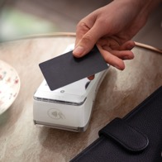
Checking vs. savings
Checking account
Used for everyday spending/purchases
Linked to a debit card (which looks like a credit card)
Using a debit card withdraws money from your checking account
Notes:
VOICEOVER FOR THIS SLIDE:
There are two main types of accounts that those new to banking should know about.
The first we’ll talk about is a checking account — which is typically used to store your spending money.
This money is typically easier to access than the money you have in a savings account.
You can easily use or spend the money you have in a checking account using your debit card. You can also typically pay bills directly from a checking account.

Slide 7


Checking vs. savings
Savings account
Not used for daily spending
Where you deposit money to keep it safe for the future
Where you can keep adding money until you need to use it for a big purchase
Earns interest
Notes:
VOICEOVER FOR THIS SLIDE:
Savings accounts work a little differently. Like the name suggests, these types of accounts are typically used for savings for future needs — not for your everyday spending. They don’t come with a debit card.
One of the biggest benefits of a savings account is that most savings accounts earn interest.
Interest is basically a payment for keeping your savings with the bank. The amount of interest you receive is calculated as a percentage of the amount that you have in your account.
For example, if you have a 3% interest rate on a savings account with $1,000 in it — they’ll pay you 3% of $1,000 ($30) over the course of a year just for having that money in the savings account.

Slide 8


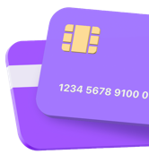
Hands on example:
Keeping money safe
You earn $100 by babysitting your neighbors’ kids.
Notes:
(Use on-screen text to tell the story of depositing money in a bank, where it can be safe and accessible.)
VOICEOVER FOR THIS SLIDE:
Let’s take a look at a hands-on example — this demonstrates a basic way you can use a bank or checking account.
Let’s say you earn $100 by babysitting your neighbors’ kids.

Slide 9

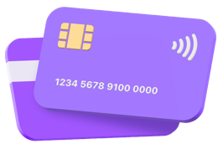

Hands on example:
Keeping money safe
Instead of storing it in your room,
where your sister could find it …
Notes:
(Read on-screen text to tell the story of depositing money in a bank, where it can be safe and accessible.)

Slide 10
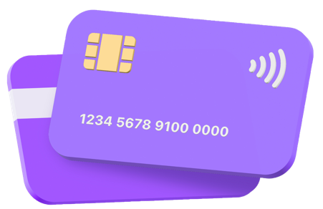


Hands on example:
Keeping money safe
… you deposit it in your checking account.
Notes:
(Read on-screen text to tell the story of depositing money in a bank, where it can be safe and accessible.)

Slide 11



Hands on example:
Keeping money safe
A few months later, when you want to buy new headphones, you can withdraw some of that money to pay for them.
Notes:
(Read on-screen text to tell the story of depositing money in a bank, where it can be safe and accessible.)
NOTE: PAUSE FOR FINAL ANIMATION
VOICEOVER FOR THIS SLIDE:
That’s an example of how bank accounts can be a safe place to keep your money — and it’s still easy to get your money when you need or want to spend it on something.
Any questions about this?

Slide 12
Do I really need to go to a bank?
Not very often!
You can also use a bank’s app or website to:
See how much money is in your account.
Deposit checks.
Pay bills (when you’re older!).
Send money to other people.
Move money from one account to another.
Notes:
VOICEOVER FOR THIS SLIDE:
Banking doesn’t mean you have to go to a bank. You have lots of options these days for banking online or from a smartphone.
Bank accounts are not physical things. They are tools and information that you can access. For example, you can log on to your account through the bank app on your smartphone or through the bank’s website and see how much money you have, and you can also manage it and make payments from there.
Here are a few examples of what you can do from your bank’s app or website.

Slide 13
Question
Is it safe to use your smartphone
to pay for things?
Yes!
Notes:
VOICEOVER FOR THIS SLIDE:
ASK: So here’s a question for you: Is it safe in most cases to use your phone to pay for things?
What do you think the answer is? What makes you say that?
CLICK TO REVEAL ANSWER
Well, the answer is typically, yes.
Bank and payment apps are encrypted and secure to use on most payment platforms. At the same time, you should always make sure you’re sending money to people or places you know and trust. The ease of sending money with apps can also attract scammers, so it’s a good idea to be aware of common scams so you can avoid them.

Slide 14
You can use your smartphone to pay for things, too
You can add your debit card to a digital wallet on your phone to use it for payments.
You can download and use your bank’s app.
Or you can download a payment app such as Venmo or Cash App and link it to your banking account to make purchases and pay people.
Notes:
VOICEOVER FOR THIS SLIDE:
You often don’t even need cash to pay for things at most stores or restaurants — especially if you have a smartphone and you’ve connected your debit card or checking account to it.
You can use your bank’s app to make payments or manage money (as long as you have it installed on your phone).
You can add your debit card to your phone’s digital wallet to make paying easier (the money still comes from your account, though!).
You can connect your account to a payment app like Venmo or Cash App to make payments (though the money still comes from your account for these payments, too). These are sometimes called “peer-to-peer payment apps” because they let you send money to and receive money from people you know.
Question: What are some other payment apps you know about? (PayPal, Apple Cash/Apple Pay, Google Pay, etc.)

Slide 15
You can use your smartphone to pay for things, too
All these options can help you:
Send and receive money.
Pay bills.
Purchase items or services online or in person.
Notes:
VOICEOVER FOR THIS SLIDE:
All these options — digital wallets, bank apps, and payment apps — can make it easier for you to send and receive money from a bank account, pay bills with a bank account, and pay for things online or at a store, restaurant, or other type of business.

Slide 16

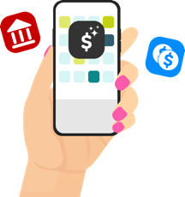
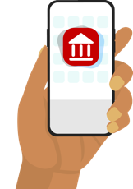
Hands on example:
Paying with apps
Emma, Claire, and Taylor want to buy ice cream
but don’t have cash or debit cards.
Notes:
[Use the story on-screen as a way to show how bank and payment apps can make sending and receiving money easy.]
VOICEOVER FOR THIS SLIDE:
Let’s look at another hands-on example.
Imagine Emma, Claire, and Taylor are out at a shopping center, and they want to buy ice cream … BUT they don’t have cash or a debit card with them.

Slide 17


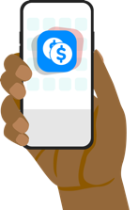
Hands on example:
Paying with apps
But they each have smartphones
with different payment apps.
Notes:
(Read the on-screen text to show how bank and payment apps can make sending and receiving money easy.)

Slide 18


Hands on example:
Paying with apps
Emma uses Apple Pay, built into her iPhone,
to pay for their ice cream.
Notes:
(Read the on-screen text to show how bank and payment apps can make sending and receiving money easy.)

Slide 19
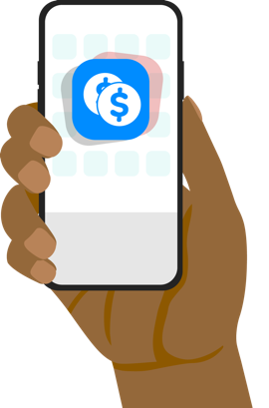
Hands on example:
Paying with apps
Claire uses her bank’s app to pay Emma back …
Notes:
(Read the on-screen text to show how bank and payment apps can make sending and receiving money easy.)

Slide 20

Hands on example:
Paying with apps
All settled!
Notes:
(Read the on-screen text to show how bank and payment apps can make sending and receiving money easy.)
PAUSE FOR CONFETTI ANIMATION
Any questions about this? Does it make sense how it works?

Slide 21


Other ways banks can help you
Earning interest
Interest is money a bank pays you in exchange for keeping your money in a savings account.
Keeping your savings in an account where you earn interest helps you stay financially healthy.
Notes:
VOICEOVER FOR THIS SLIDE:
So banks can be a partner throughout life as you need to manage more money or address financial needs.
Let’s look at some of the other ways banks can help you.
We’ve already talked about this first one a little.
You can earn interest on top of the money you already have by keeping the money you don’t need right away in a savings account.
Typically, the interest they pay you is reflected as a small percentage of your total balance.
The more money you have in savings, the more you can earn in interest. This can help you save toward your goals and stay financially healthy.

Slide 22


Other ways banks can help you
Borrowing for big things
Personal loans, car loans, mortgages (house loans) — most banks offer all of these, where you borrow money and pay it back over time.
Although you earn interest on savings accounts, you pay interest on loans.
Notes:
ASK: What are some things that banks can help you buy?
VOICEOVER FOR THIS SLIDE:
Banks are one of the best ways you can access money for those bigger things you need in life — like a car loan so you have a vehicle that can get you to school or work … a mortgage so you can buy a house … or a personal loan so you can start a business.

Slide 23


Other ways banks can help you
Building credit
Many banks offer credit cards as a way to borrow money to pay for things. This can be a good way to build credit history, but you’ll be charged a fee (interest) if you don’t pay it off each month.
Notes:
VOICEOVER FOR THIS SLIDE:
Many banks also offer credit cards. Credit cards are one way to pay for things, but when you swipe a credit card, you’re actually borrowing money from the bank — it’s like a short-term loan. And much like a loan, you will be charged interest if the amount is not paid back in full each month.
So you should be careful about spending more than you can afford to pay back in a short amount of time. There might also be other costs, like an annual fee, so it’s important to find out all the details of any credit card.
Using a credit card responsibly also builds your credit history over time — which can help you do things like getting some of those bigger loans we just talked about.

Slide 24

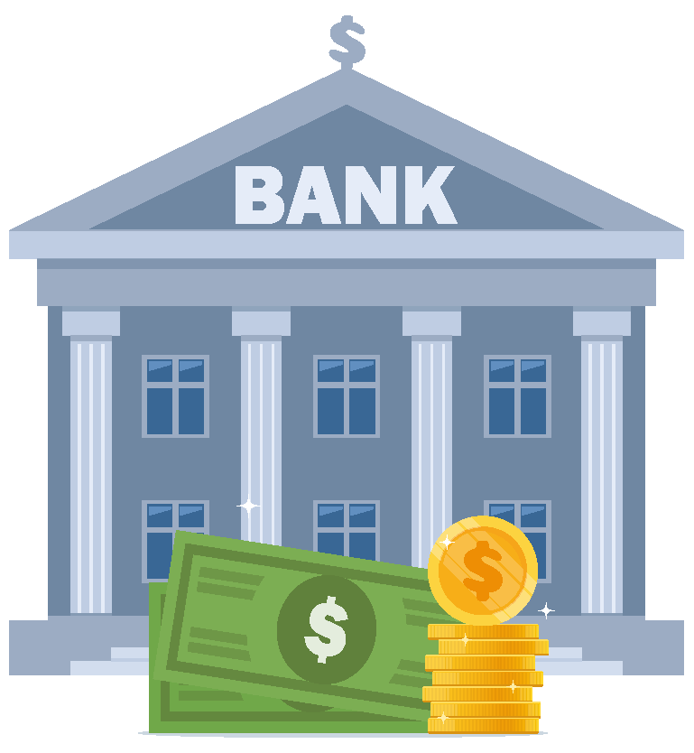

Hands on example:
Exploring interest
The truth is, interest payments can mean money you earn
or a cost you pay, depending on the situation.
Notes:
[Use on-screen text to tell the story of how interest payments can be money you earn or a cost you pay.]
VOICEOVER FOR THIS SLIDE:
Let’s take a look at a hands-on example — this one talks about two ways that interest can work.
In one situation, it’s money you earn. In another, it’s a cost you pay.

Slide 25
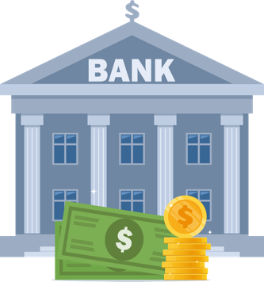

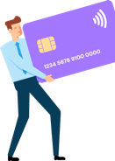

Hands on example:
Exploring interest
A savings account is an example of interest
working for you.
Notes:
[Use on-screen text to tell the story of how interest payments can be money you earn or a cost you pay.]

Slide 26
Hands on example:
Exploring interest
If you have $5,000 in a savings account with a 5% interest rate, after 10 years it will grow to more than $8,144.
Year | Interest earned | Total
Start | 0 | $5,000
5 | $1,381.41 | $6,381.41
10 | $3,144.47 | $8,144.47
Notes:
[Use on-screen text to tell the story of how interest payments can be money you earn or a cost you pay.]
VOICEOVER FOR THIS SLIDE — (Review on-screen text first.):
With 5% interest working for you, your savings can earn money over time.
It’s important to note that this is just an example. The interest rates available to you will vary.

Slide 27
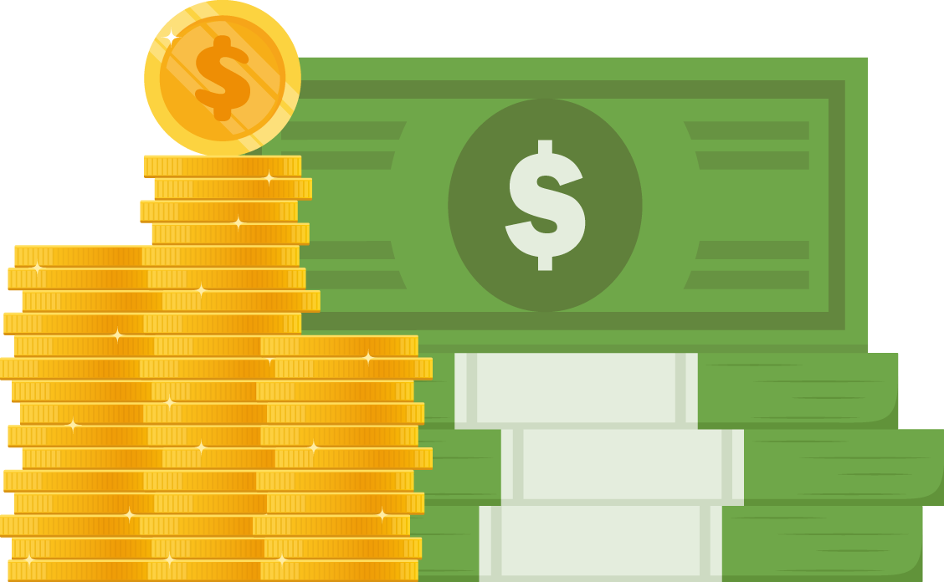
Hands on example:
Exploring interest
And if you were to add $100 a month over those 10 years, you’d end with $23,580, including $6,580 in interest!
10-year total
$23,580
Notes:
[Use on-screen text to tell the story of how interest payments can be money you earn or a cost you pay.]

Slide 28

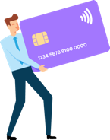
Hands on example:
Exploring interest
However, when you borrow money, interest
is a cost you might pay.
Notes:
[Use on-screen text to tell the story of how interest payments can be money you earn or a cost you pay.]

Slide 29
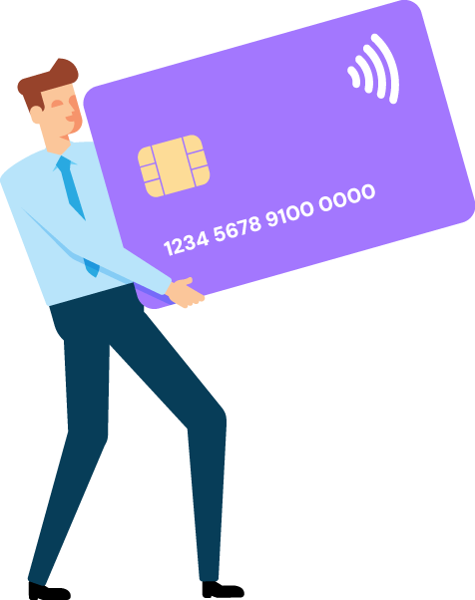
Hands on example:
Exploring interest
For example, interest is basically the cost of borrowing from a credit card company — it’s the money you pay
if you carry a balance after your billing period ends.
Notes:
[Use on-screen text to tell the story of how interest payments can be money you earn or a cost you pay.]

Slide 30

Hands on example:
Exploring interest
Let’s say you have a credit card bill of $5,000 and make only the minimum payments (around $100 to start).
If your interest rate is 18%, it will take 472 months (39 years!) to clear the debt.
Paid off in
39 years
Notes:
[Use on-screen text to tell the story of how interest payments can be money you earn or a cost you pay.]

Slide 31
Hands on example:
Exploring interest
On top of that, you will pay $13,396 in interest — almost three times your initial debt.
Even if you were to increase your payments to $250 per month, the debt would still take 24 months to pay and cost $989 in interest.
Extra fees due to interest
$13,396
Notes:
[Use on-screen text to tell the story of how interest payments can be money you earn or a cost you pay.]

Slide 32
Quiz time!
True or false:
A credit card is basically the same as a debit card.
False!
Notes:
VOICEOVER FOR THIS SLIDE:
ASK: So, true or false: A credit card is basically the same as a debit card.
What do you think the answer is? What makes you say that?
CLICK TO REVEAL ANSWER
Remember: A debit card uses money directly from your checking account. But a credit card uses the bank’s money — and you have to pay it back.

Slide 33
Not all cards are the same
Debit card
This card is linked to your checking account, so you can only spend what is in your account. It’s like using cash.
Prepaid card
This is not linked to a bank. You add money to it and then use what’s on the card. Examples: gift cards or SNAP benefits on an EBT card.
Credit card
With this card, the company basically loans you money that you pay back later (with interest if not paid back in full on time).
Notes:
VOICEOVER FOR THIS SLIDE:
While they all look (and swipe) the same, debit cards, credit cards, and prepaid cards function differently. And it’s important to know the difference, as some could end up costing you more money!
Debit cards are linked to the user’s bank account and are limited by how much money is in the account.
Credit cards provide you with a line of credit to borrow against as needed and pay back later. Credit cards charge interest on the money the cardholder borrows unless it’s paid back within the grace period. There might also be other costs, like an annual fee.
A prepaid card is not linked to a bank or credit union account. Instead, you put money into the card account, sometimes called loading money onto the card, before you can spend it.
ASK: Which of these cards could end up costing you more money?

Slide 34
It’s easy to manage money with a bank
Most employers can deposit paychecks right into your checking account (this is called direct deposit).
You can also deposit checks with your phone
using your bank’s app.
Use checking and savings accounts to organize
and earn interest on your money.
Notes:
ASK: How do you think a bank can make it easier to manage your money?
VOICEOVER FOR THIS SLIDE:
As you start earning money, it’s helpful to manage it through a bank.
Direct deposit can make it easy for your employer to deposit your money — it goes into your account automatically.
You can also deposit checks in person or by using your bank’s app on your phone. You often only need to sign the check and include pictures of the front and back of the check (taken through the app).
You can use your checking and savings accounts for budgeting — keep money in your checking account for immediate expenses, and use your savings account for long-term plans.

Slide 35


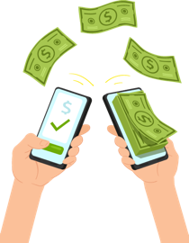
Hands on example:
Saving more
Here’s how you could save $3,600 from working a summer job.
Notes:
[Use on-screen text to tell the story of budgeting/saving money.]
VOICEOVER FOR THIS SLIDE:
Here’s another hands-on example that shows how you could earn $3,600 by working over the course of a summer and divide it between your checking account — aka, your spending money — and your savings account — aka, your money for future goals or needs.

Slide 36


Hands on example:
Saving more
Let’s say you work 6 hours per day as a camp counselor
and make $15 an hour. That’s $450 a week.
Notes:
[Use on-screen text to tell the story of budgeting/saving money.]

Slide 37
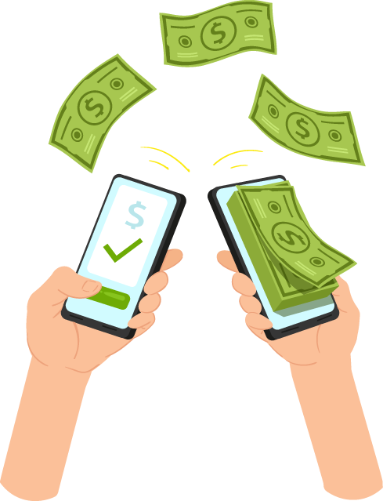
Hands on example:
Saving more
You can set up an automatic transfer to move some of each paycheck into savings — let’s say $150 each week.
Notes:
[Use on-screen text to tell the story of budgeting/saving money.]

Slide 38
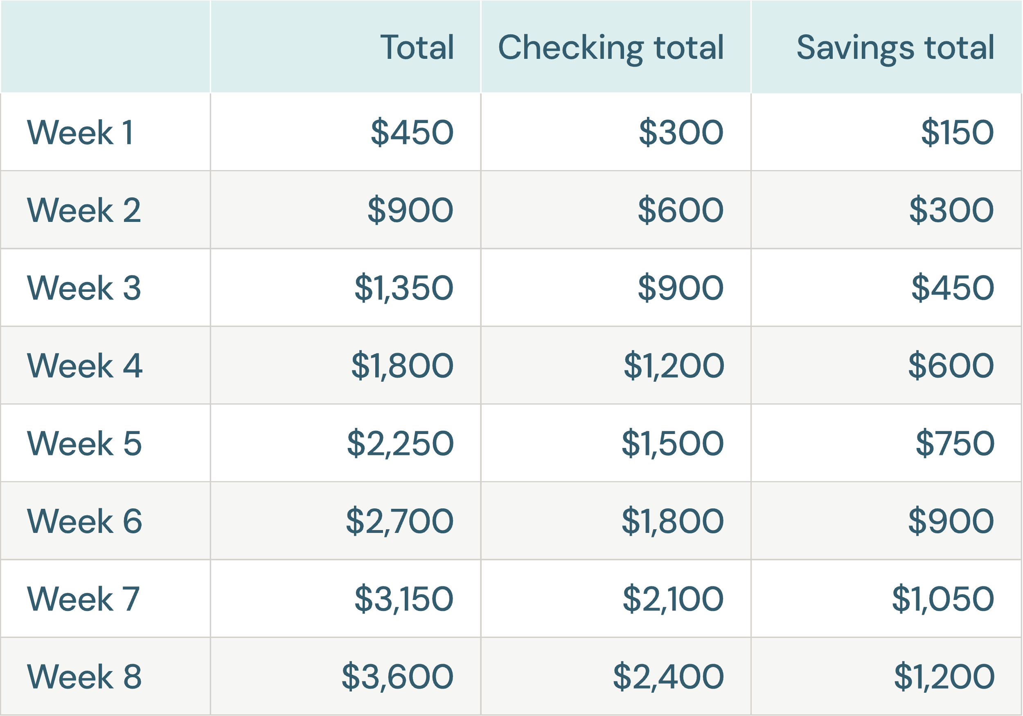
Hands on example:
Saving more
At the end of the summer,
you’ll have:
$2,400 in your checking account for spending.
$1,200 in your savings account for future goals (like a car!).
Notes:
NOTE: PAUSE FOR FINAL ANIMATION

Slide 39

How to open your first account
1
Gather information.
A valid, government-issued photo ID
Basic info: birthday, Social Security number, or Taxpayer ID
Your current address
2
Talk with a parent or guardian.
3
Research local and online options.
4
Compare the terms.
Notes:
ASK: Who here has opened a bank account? What was that experience like for you?
VOICEOVER FOR THIS SLIDE:
If you’re interested in opening an account, know that there are a few steps involved. You might not need to do this in person, but you might want to visit your local bank to see what it’s like when you open an account and also ask any questions you might have.
Step 1, though, is to gather some basic information you’ll need — including a valid government ID, like a driver’s license, and your address and Social Security number or Taxpayer Identification Number. They’ll ask for these things at the bank or on the bank’s website when you apply to open an account. Your parent or guardian can help you get this info together.

Slide 40
How to open your first account
1
Gather information.
2
Talk with a parent or guardian.
Their name will likely have to be on the account if you’re under 18.
3
Research local and online options.
4
Compare the terms.
Notes:
ASK: Who here has opened a bank account? What was that experience like for you?
VOICEOVER FOR THIS SLIDE:
Step 2: Talk to a parent or guardian about your goals.
If you’re under 18, you’ll likely need a parent’s or guardian’s name or signature to be on the bank account with yours.
A parent or guardian may be able to help guide you through this process and gather the documents and information you need from Step 1.

Slide 41
How to open your first account
1
Gather information.
2
Talk with a parent or guardian.
3
Research local and online options.
You can search online for “student and teen checking accounts.”
Opening your account at your parents’ bank may be helpful.
Bank On (JoinBankOn.org) is a great way to find the right option for you.
4
Compare the terms.
Notes:
VOICEOVER FOR THIS SLIDE:
Step 3: Once you have the info you need and your parent or guardian are on board, you should do some research to see what your banking options are.
It’s possible to open an account with an online-only bank, too.
Try searching online for “student checking accounts” or “teen checking accounts.” Before you choose one, see what kind of fees they may charge you — if any. Some banks may require you to have a certain amount deposited to avoid a fee.
We like Bank On — or JoinBankOn.org — as a source for researching trustworthy banks.
Talk with your parent or guardian about all the steps here to make sure your account is going to provide what you need and not charge you unnecessary fees.

Slide 42
How to open your first account
1
Gather information.
2
Talk with a parent or guardian.
3
Research local and online options.
4
Compare the terms.
A good account for students:
Doesn’t charge monthly service fees.
Allows you to track your money and use online banking tools.
Can still be used even after you graduate.
Notes:
VOICEOVER FOR THIS SLIDE:
Step 4: Again, compare the account rules or terms from your favorite options before applying.
A student bank account shouldn’t charge you a monthly service fee and should make it easy for you to access and track your money and use online banking tools.

Slide 43
Protecting against fraud
Do your best to keep your information safe!
Choose strong and unique passwords with special characters (!, $, #, %).
Enable two-factor authentication.
Avoid public Wi-Fi.
Sign up for banking alerts.
Avoid phishing attempts.
Notes:
VOICEOVER FOR THIS SLIDE:
No matter if you opt for an online-only bank or a brick-and-mortar one, you need to keep your personal information safe when transacting online.
Choose strong and unique passwords. Use special characters, numbers, and a mix of uppercase and lowercase letters, or use a password manager to generate and store passwords.
Enable two-factor authentication. This is when you choose to get a text to enter a unique code when logging on.
Avoid public Wi-Fi (not always secure).
Sign up for banking alerts (for low/high balances, new transactions, failed login attempts, password changes, personal info changes).
Avoid phishing attempts. Phishing usually happens by emails or texts, and it’s someone’s attempt to get you to either click a bad link or share private information (like passwords). If you get a questionable message, scrutinize the senders’ emails, hover over links — but don’t click — to check where they actually go, and don’t provide personal info via email or text. Call the person or the bank back to check, but use a number you know (don’t click one that was provided in the possibly fake email or text!).

Slide 44
Quiz time!
True or false:
When you put money in the bank, it’s not protected by the government if the bank fails.
False!
Notes:
[Follow quiz prompts.]
VOICEOVER
CLICK TO REVEAL ANSWER
Also, as we talked about before, there is a limit to how much the government insures, and you can learn how it works on the FDIC’s website.

Slide 45
Quiz time!
True or false:
When you pay with a debit card, you’re using money from your checking account.
True!
Notes:
[Follow quiz prompts.]
CLICK TO REVEAL ANSWER

Slide 46
Quiz time!
Name two things you can do when you’re logged in to your bank account online.
Check the money in your account.
Deposit checks.
Send money to other people.
Move money between accounts.
Pay bills.
Notes:
[Follow quiz prompts.]
CLICK TO REVEAL ANSWER

Slide 47
Quiz time!
Fill in the blank.
Apple Pay, Venmo, and
Cash App are all apps.
payment
Notes:
[Follow quiz prompts.]
CLICK TO REVEAL ANSWER

Slide 48
Where to learn more about personal finances
Hands on Banking
(Search online: “Hands on Banking for youth”)
Consumer Financial Protection Bureau: Money as You Grow
(Search online: “Money as You Grow”)
FDIC Money Smart
(Search online: “FDIC Money Smart”)
National Credit Union Administration learning tools
(Search online: National Credit Union Administration learning tools)
Notes:
VOICEOVER FOR THIS SLIDE:
Now, we’re really just scratching the surface here. You’re encouraged to seek other resources to continue learning about money and personal finance topics.
Your parents may be a good resource — or a trusted family member or friend. But keep in mind that not everyone has good information to share.
These are a few websites that you can seek out for learning more. You can also search online for other websites, newsletters, or podcasts to keep learning.
Any questions before we wrap up?

