Slide 1

What banks can do for you
Here’s what to know about banks.
TIPS FOR
Adults
Notes:
ATTENTION SPEAKER!
Please do not change any of the content on the slides!
Please present in Presenter Mode / Slide Show Mode because there are animations and transitions to emphasize points and keep your audience engaged.
Each slide includes voiceover notes to help you, but reviewing and practicing the entire presentation before sharing with an audience will help you prepare. We suggest that you customize the voiceover notes to help you speak to your particular audience.
VOICEOVER FOR THIS SLIDE:
This presentation is all about what banks can do for you.
Sometimes, people can be skeptical about whether or not banks are truly helpful. But having a good relationship with a bank can be an important part of your financial well-being — which also affects your overall well-being.
Banks can be great resources that offer many tools to help you achieve your goals in life, whether that’s buying a car, buying a home for you and your family, or getting a loan to start a business.
So let’s get ready to learn about the benefits of banking.

Slide 2
What we’ll talk about
What a bank does
Whether you need to go to a bank
Paying with cards and smartphones
Managing monthly income and savings
Opening a new account: what you need
Protecting against digital fraud
Where to learn more about finance
Notes:
VOICEOVER FOR THIS SLIDE:
This is just a quick look at what we’ll be covering today …
We’ll start with some of the basics, just explaining what a bank is and what are some of the things that banks can do for you.
Do you actually need to go to a bank? We’ll talk about that, too.
We’ll talk about how you can do a lot with your phone these days, like depositing checks or paying for things, and that your bank is an important part of the process.
We’ll talk about what you need to do to open your first bank account.
And we’ll talk about ways to keep your money and banking information safe — and where you can go to keep learning more about banks and other money topics that can help you out in life.

Slide 3
What is a bank?
It’s a financial institution licensed by the government.
A bank provides a range of financial services:
Accounts for saving money and paying bills
Various loan types for larger purchases
Help in tracking and managing your money
A safe place to keep your money
Notes:
VOICEOVER FOR THIS SLIDE:
Let’s start here: Banks (and credit unions) are licensed institutions, which means that not just any company or organization can call themselves a bank. You have to go through a lot of federal regulations to be able to qualify as a bank.
One of the main points of a bank is keeping your money safe. Imagine if you kept all your money as paper dollar bills and coins, and something happened to your house — like flooding, a fire, or burglary. You could easily lose all of your money and savings. But if you keep your money in the bank, you’d still have it in one of those worst-case scenarios. It would be a whole lot less stressful and make it way easier for you to keep on living.
Bank accounts also make it easy to pay bills and save money. With a bank account, you can also add money to your account at any time — this is called depositing money. And when you need money for something, you can always take out it — this is called withdrawing your money.
Banks also make it much easier to keep track of your money and finances. You can see all of your money in one place without having to count up your cash every time. And you can easily look at your accounts anytime through the bank’s app or website.
Banks make money by charging customers for their services, just like any other kind of business, and people pay for the services because they value them. (But it’s a good idea to look for low-cost services that meet your needs.)
In addition to the banks you see in your town, there are a couple other types of financial institutions that offer these services. Credit unions are similar to banks, but they are not-for-profit organizations that typically serve a specific geographic area or group (like workers in a specific industry). And online-only banks offer banking services but don’t have physical branches that you can visit. All of these are licensed institutions like banks.

Slide 4

Benefits of banking:
Security
Banks are the safest place to store money and can help you reach your goals.
Banks can help protect against fraud.
Banks can provide FDIC insurance up to $250,000 per depositor.
Banks allow you to access your money whenever you need it
What’s FDIC insurance?
This coverage automatically protects your money in the rare event that your bank fails.
Notes:
VOICEOVER FOR THIS SLIDE:
Let’s talk a little more about the point of banks.
Economic events like recessions and other financial crises have caused some people to mistrust banks. In fact, a 2023 study found that about 50% of people were worried about the safety of their money in banks. But remember: Banks are backed by the government and are the safest place to store your money, build credit, and save for the future.
What do we mean by ”backed by the government”? Banks are insured by the Federal Deposit Insurance Corporation (FDIC), which means that if the bank goes out of business somehow — which is very rare — the government will pay what the bank owes you, up to $250,000 per account ownership category. You can learn more about how that works at fdic.gov.
By depositing your money in a savings account and keeping it there, you can also earn interest — this means the bank actually pays you just for keeping your money with them. It’s a win-win.
SOURCE LINK:
https://news.gallup.com/poll/505439/half-worry-money-safety-banks.aspx

Slide 5
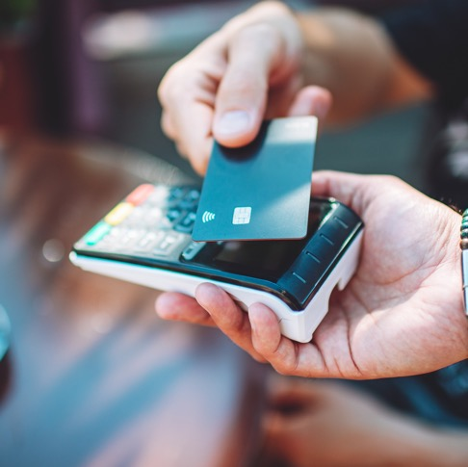
Benefits of banking:
Services
Banks can make transactions easier:
Checking and savings accounts
Debit cards
Building a credit history
What’s a debit card?
This type of card lets you pay for items with money from your checking account.
Notes:
VOICEOVER FOR THIS SLIDE:
Banks really do make it easier to manage money and pay bills. You can set up a checking account for bill payment, and a savings account for longer-term growth of the money you have available.
One of the easiest ways to access or spend your money from your bank account is using a debit card. When you get a debit card, it’s linked to your bank account — usually to your checking account. So when you buy or pay for something with your debit card, it instantly takes money directly from your account.

Slide 6

Benefits of banking:
Services
Banks can also help with larger purchases:
An auto loan to buy a vehicle
A personal loan to start a business
A mortgage to buy a home
Student loans to pay for college

Slide 7
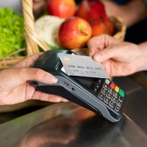

Types of bank accounts
Checking accounts
Used for everyday spending and purchases
Linked to a debit card (which looks like a credit card)
Is the account that money is withdrawn
from when using a debit card
Notes:
VOICEOVER FOR THIS SLIDE:
Let’s quickly go over the two main two types of bank accounts people use for depositing and managing their money.
Checking accounts are used for everyday purchases.
Checking accounts are linked to a debit card. When you use a debit card to pay for things, it uses the money in your checking account.

Slide 8


Types of bank accounts
Saving accounts
Not used for daily purchases
Typically used for longer-term savings
A place where you can keep adding money for future purchases or emergencies
Earn interest and can benefit from compounding
What is interest?
Interest is money earned by a savings account based on a percentage of the amount in the account.
Notes:
VOICEOVER FOR THIS SLIDE:
Savings accounts are not used for daily spending, and are typically where you deposit money for the future or emergencies. Some people may even call their savings account their “emergency fund” or “rainy day fund.”
You can keep adding to it, until you need to use it. Savings accounts earn interest and can benefit from compounding interest. Has anyone heard of compounding interest before? (Can wait for class response.)
We’ll go into an example of this next. But the idea is that the bank is paying you for keeping your money in a savings account with them … by paying you interest, they’re helping your savings balance grow — and as that savings account balance gets bigger, you get bigger and bigger interest payments. Compounding is basically speaking to this idea that your money can grow by a lot over time because of these interest payments.

Slide 9



Hands on example:
What’s compounding?
Maria receives a $20,000 inheritance. She puts it in
a savings account that pays a 4% interest rate.
Notes:
VOICEOVER FOR THIS SLIDE:
This is a very basic example of how compounding and saving can work.
Let’s imagine Maria receives a $20,000 inheritance. She decides to put it in a savings account that pays a 4% interest rate.
That savings account will start paying her more than $65 per month, and as the balance grows, those monthly interest payments grow.
It’s important to note that this is just an example. The interest rates available to you will vary.

Slide 10

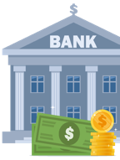


Hands on example:
What’s compounding?
Through the power of saving and compounding, after
5 years, there is more than $24,000 in the account.
Notes:
VOICEOVER FOR THIS SLIDE:
Through the power of saving and compounding, after 5 years, Maria now has more than $24,000.

Slide 11

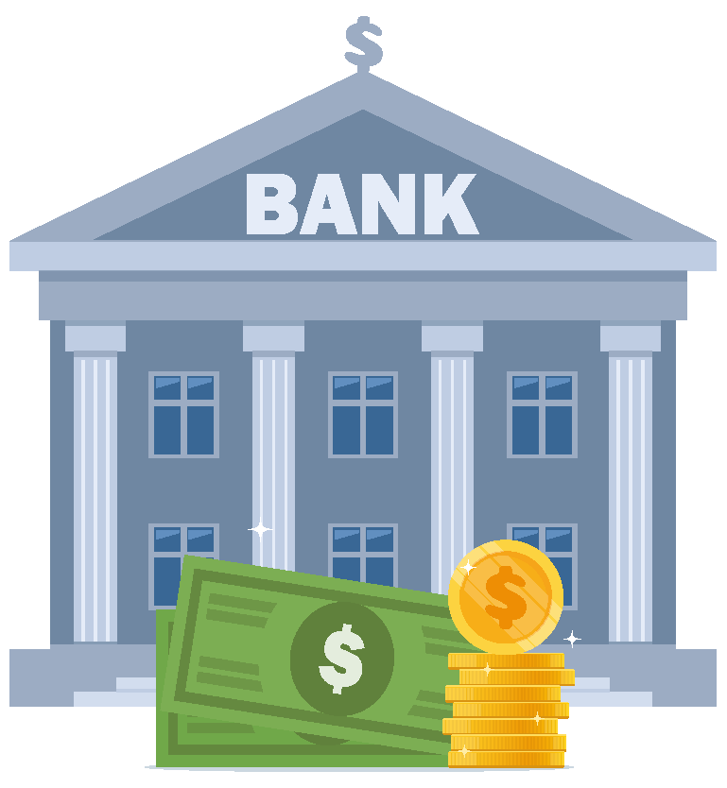


Hands on example:
What’s compounding?
Maria can use that money for a big purchase, or she can
continue saving and letting it grow.
Notes:
VOICEOVER FOR THIS SLIDE:
She can use that money to buy a car, a home, or continue saving and letting it grow.

Slide 12
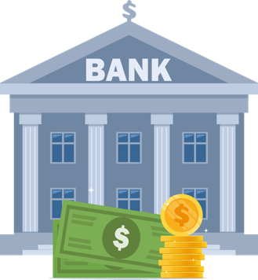


Hands on example:
What’s compounding?
If she continues to save for 5 more years,
she’ll have almost $30,000.
Notes:
VOICEOVER FOR THIS SLIDE:
In 5 more years, she’ll have almost $30,000.

Slide 13

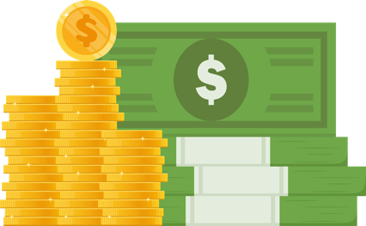

Hands on example:
What’s compounding?
In 30 years, she’ll have more than $66,000.
Notes:
VOICEOVER FOR THIS SLIDE:
PAUSE FOR ANIMATION
If she lets that initial $20,000 grow for 30 years, she’ll have over $66,000. That’s more than $46,000 in growth, thanks to compound interest!

Slide 14
Do I really need to go to a bank?
Not very often!
You can also use a bank’s app or website to:
View and monitor your accounts.
Deposit checks.
Pay bills.
Send money.
Transfer money.
Notes:
VOICEOVER FOR THIS SLIDE:
So, do you need to go to a bank location to use bank services? The answer is actually no. Almost everything that used to be done in-person at the bank can now be done online or through an app.
That means you can use a bank’s website or its app to access your money and accounts, sign up for new services, and more.
Here are some basic examples of what you can do:
– You can use a banking app or website to view or monitor your accounts — and you can even set up alerts to let you know about spending or balance changes.
– Most banking apps allow you to deposit checks just using your phone.
– You can pay bills from many banking apps or websites.
– You can use it to send money to other people, like family members or friends.
– You can also use it to move money to other accounts.
Ask: Do any of you have a banking app? If so, what do you typically log into it for? Or what are some of the things you can use the app to do, if you don’t mind sharing?

Slide 15
Quiz time!
True or false:
A credit card is basically the same
as a debit card.
False!
Notes:
Ask before revealing the answer: What do you think the answer is? What makes you say that?
CLICK TO REVEAL ANSWER

Slide 16
What to know about cards
Debit card
It is linked to your checking account; it’s like using cash. A debit card won’t help you build a credit history.
Prepaid card
It isn’t linked to a bank. You add money to it and then use what’s on the card. Examples: gift cards or SNAP benefits on an EBT card.
Credit card
Credit card companies basically loan you money that you pay back later (with interest if not paid in full on time). Credit cards can help you build a credit score and credit history.
Notes:
VOICEOVER FOR THIS SLIDE:
Now, let’s go over a few of the different types of cards.
While they all look — and swipe — the same, debit cards, credit cards, and prepaid cards function differently.
Debit cards are linked to the user's bank account and are limited by how much money is in the account.
A prepaid card is not linked to a bank or credit union account. Instead, you put money into the card account, sometimes called loading money onto the card, before you can spend it.
Credit cards provide you with a line of credit they can borrow against as needed and pay back later. In other words, when you swipe a credit card, you’re actually borrowing money from the bank—it’s like a short-term loan. And much like a loan, you will be charged interest if the amount is not paid back in full each month.
Credit cards charge interest on the money the cardholder borrows unless it's paid back within the grace period. Sometimes stores and retailers will offer extra discounts if you sign up for their particular credit card. Be extra cautious in those situations! Signing up might impact your credit score, and those cards sometimes have very high interest rates. There might also be other costs like an annual fee, so it’s important to find out all the details of any credit card before you sign up.
Again, you’ll notice that these different types of cards all look very similar — but they serve very different purposes.

Slide 17
What about payment apps?
Your bank’s app can do a lot of things.
But you might want to use a payment app, too.
Payment app examples:
Venmo
Cash App
Apple Pay
Notes:
VOICEOVER FOR THIS SLIDE:
Besides cash, there are a few ways to pay for things, especially if you have a smart phone that is tied to your debit card (checking account).
Along with using your bank’s app to pay bills, you have some other options through third-party payment apps.
Payment apps are usually a separate download from your banking app, though some can be integrated into your bank’s app.
Examples of payment apps include Venmo, Apple Pay, Cash App, and PayPal.

Slide 18

What about payment apps?
You can use payment apps to:
Send and receive money.
Pay for goods or services online
or in person.
Pay bills.
Notes:
VOICEOVER FOR THIS SLIDE:
You can also use a payment app to:
– Send and receive money
– Pay for goods or services online or in person
– Pay some of your bills
Payment apps connect to your bank account or are funded by money you move from your bank account.
These are sometimes called “peer-to-peer payment apps” because they let you send money to and receive money from people you know.

Slide 19
Digital wallets, explained
Digital wallets:
Safely store your payment details
(including credit or debit card info) on
your smartphone.
Allow you to complete transactions at checkout with your phone.
Notes:
VOICEOVER FOR THIS SLIDE:
Payment apps are one way to use your phone like a card or a wallet. But there are also things called “digital wallets.”
Digital wallets can safely store your payment details — like your card numbers — and can easily retrieve this information when you’re checking out while shopping online, or even in a physical store. If you ask the person at the register if they take Apple Pay, for example, they’ll probably say yes — and you can complete the transaction by tapping your phone on the card reader.

Slide 20
Digital wallets, explained
Digital wallet examples:
PayPal
Google Wallet
Samsung Wallet
Apple Wallet
Notes:
VOICEOVER FOR THIS SLIDE:
Some examples of digital wallets include PayPal, Google Wallet, Samsung Wallet, and Apple Wallet.
Each phone’s digital wallet system may be different. For example, if I double-tap one of the side buttons on my phone, it brings up my digital wallet, and then I’d just hold my phone near the scanner at the register to pay.

Slide 21



Hands on example:
Payment apps
Drew picks up lunch for his coworkers, Matt and Will.
He uses Apple Pay on his iPhone to pay at the restaurant.
Notes:
VOICEOVER FOR THIS SLIDE:
Time for another hands-on example!
Drew works with Matt and Will, and he offers to pick up lunch for them one day. He leaves his wallet in the office and uses Apple Pay, built into his iPhone, to tap and pay at the restaurant instead of using a card or cash.

Slide 22



Hands on example:
Payment apps
Back at the office, Matt and Will don’t have
cash to pay Drew back.
Notes:
VOICEOVER FOR THIS SLIDE:
Once he gets back to the office, he finds out that Matt and Will don’t have cash to pay him either.

Slide 23
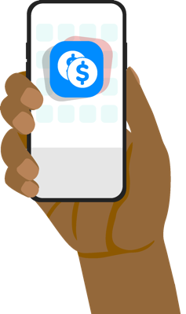

Hands on example:
Payment apps
But Matt and Will both have Venmo accounts,
so they pay Drew back using the app.
Notes:
VOICEOVER FOR THIS SLIDE:
But they do have payment apps! They both log in to Venmo and send money to Drew that way.

Slide 24


Hands on example:
Payment apps
All settled!
Notes:
VOICEOVER FOR THIS SLIDE:
All settled!
PAUSE FOR ANIMATION

Slide 25
Quiz time!
Question:
Is it safe to use your smartphone
to pay for things?
Yes!
Notes:
Ask before revealing the answer: What do you think the answer is? What makes you say that?
CLICK TO REVEAL ANSWER

Slide 26
Managing monthly income and savings
Benefits of using direct deposit:
Easy
Safe
Fast
Automatic (can help with savings, too!)
Notes:
VOICEOVER FOR THIS SLIDE:
Having bank accounts also makes it easier to manage your monthly income and savings.
With a bank account, your paycheck can often be sent to you via direct deposit. This is one of the safest and fastest ways to get paid with most jobs — it’s typically faster and easier than getting a paper check.

Slide 27
Managing monthly income and savings
Checking and savings account benefits:
Can help you organize your money
(spending vs. saving)
Can earn interest
Notes:
VOICEOVER FOR THIS SLIDE:
You can often set up direct deposit so that some of your pay goes to your checking account, while some automatically goes into your savings account, which can make budgeting easier.
Remember, everyday money (money for bills, rent or mortgage payments, money to pay off credit cards, etc.) should go into checking, while longer-term savings can go in a savings account where it can earn interest.

Slide 28



Hands on example:
Saving automatically
Julia wants to build her emergency fund while also
saving for her daughter’s college education.
Notes:
VOICEOVER FOR THIS SLIDE:
Here’s a hands-on example of the power of having a savings account and saving automatically:
Imagine Julia wants to build up her emergency fund while saving for her daughter’s college education.

Slide 29


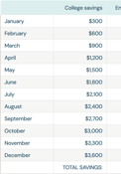
Hands on example:
Saving automatically
She sets up two savings accounts — one for the emergency fund and one for the college fund — and starts dividing her money between these two goals.
Notes:
VOICEOVER FOR THIS SLIDE:
Her savings accounts lets her divide her money for these two goals — she has an account dedicated to each goal.

Slide 30


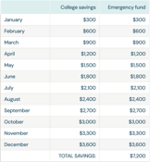
Hands on example:
Saving automatically
To make it easy, she sets up automatic transfers
from her monthly paycheck that put $300 into
each account each month.
Notes:
VOICEOVER FOR THIS SLIDE:
Julia sets up automatic transfers to put $600 from each monthly paycheck toward these goals — $300 in each account.

Slide 31
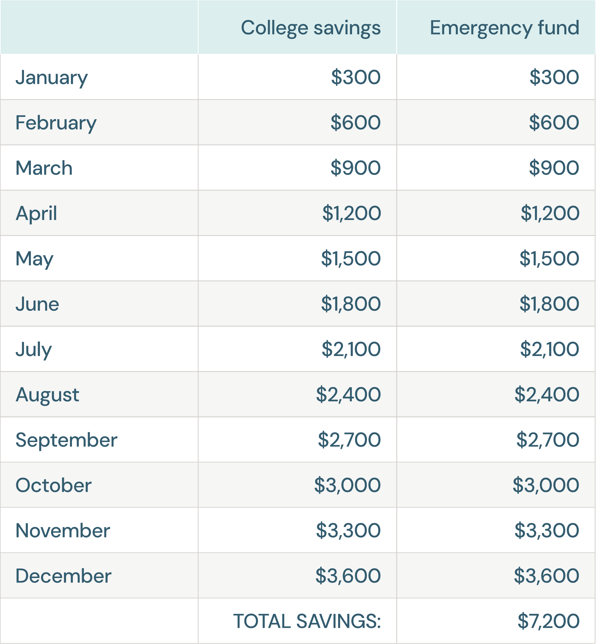
Hands on example:
Saving automatically
After one year, she has $3,600 saved for emergencies and $3,600 saved in her daughter’s college fund.
Notes:
PAUSE FOR ANIMATION

Slide 32

How to open a bank account
1
Research your options.
Go online and check out terms and rates depending on what type of account you need (checking or savings). Bank On (joinbankon.org) is a great tool for this research.
2
Gather documents.
3
Connect in person or online.
4
Open your account!
Notes:
VOICEOVER FOR THIS SLIDE:
Obviously, bank accounts don’t just open on their own. There are a few steps you need to take to open a bank account — none of them are hard, but it helps to know what’s expected.
First, you should research your options. This means researching local banks and online-only banks, and figuring out which offers the services you need. You should check out any special terms and interest rates for the accounts you need (checking or savings). BankOn (joinbankon.org) can help with this, as it lists banks with low fees — and that’s exactly what you want.

Slide 33
How to open a bank account
1
Research your options.
2
Gather documents.
To open an account, you’ll likely need:
A valid, government-issued photo ID
Basic info: birthday, Social Security number, or Taxpayer ID
Your current address
3
Connect in person or online.
4
Open your account!
Notes:
VOICEOVER FOR THIS SLIDE:
Next, you’ll need to get some documents together.
To open an account, you’ll likely need:
A valid, government-issued photo ID
Basic info: Birthday, Social Security Number or Taxpayer ID
Your current address
Take a look at the bank’s website to see if any additional information is needed.

Slide 34
How to open a bank account
1
Research your options.
2
Gather documents.
3
Connect in person or online.
Many accounts can be opened online, but if you need to physically deposit cash, you need to visit a branch or ATM.
4
Open your account!
Notes:
VOICEOVER FOR THIS SLIDE:
Speaking of … your next step is to either visit the bank in person or go to the bank’s website.
Many accounts can be opened online, but if you need to physically deposit cash, you may need to visit a branch or ATM.

Slide 35
How to open a bank account
1
Research your options.
2
Gather documents.
3
Connect in person or online.
4
Open your account!
Make sure it’s funded and that you have online access. If it’s a checking account, you may receive a debit card in the mail.
Notes:
VOICEOVER FOR THIS SLIDE:
Finally: Open your account!
Make sure it’s funded and you have online access. And, if it’s a checking account, you may receive a debit card in the mail.
That’s it — you’re ready to bank!

Slide 36
6 details to confirm when researching a bank
Service fees. Is there a monthly fee? Can you avoid it?
Penalties. What happens if you accidentally overspend?
Minimum balance. What is it?
Locations. Are there ATM or branch locations?
Services/benefits. Do they have online bill payments?
Interest. If you’re opening a savings account, what’s the interest rate?
Notes:
VOICEOVER FOR THIS SLIDE:
When it comes to banks, you have options. So it can be helpful to look at the details to make sure you’re getting the service you want without any unnecessary fees.
With that in mind, there are the six top details to confirm when researching a bank and what they can offer you.
Service fees. For example, is there a monthly fee for an account? If so, is it easy to avoid it? Many banks, for example, won’t charge you a service fee if you simply set up direct deposit from your paychecks to your bank account. If a bank says it will charge you for this service, look elsewhere.
Penalties. What happens if you overdraft—meaning you spend more than is in your account? If you’re worried that you may one day accidentally spend more money than you have in your account, you want to pay close attention to this. Overdraft fees can add up if you’re not careful. Some banks charge them, while some banks may not or may give you a grace period to make up the difference. Some banks may also forgive the first overdraft or two you have on your account.
Minimum balance. What is it? Some banks may require you to have a minimum amount in your account to open it or avoid fees. For some banks, they may not have a minimum required balance at all — or it may be $0. But other banks may require you to deposit and keep $50 as a minimum balance, $500 as a minimum balance, or more to keep the account open.
Locations. Does the bank have ATM or branch locations? How can you withdraw cash? For some, this may not be important — but keep this in mind if ATM access is important to you.
Other services or benefits. Do they have online bill pay? Are there other features that you’re particularly interested in? Be sure they’re offered!
Interest. If you’re opening a savings account, what’s the interest rate (also known as the annual percentage rate, or APR)? Some banks will offer you a much higher or lower interest rate on your savings account balances than others.

Slide 37


Online vs. in-person
Online-only (aka digital) banks
Pros:
Lower or fewer fees
Competitive interest rates
Cons:
Limited or no cash deposit options
No local branches for in-person help
Possibly no ATM access
Notes:
VOICEOVER FOR THIS SLIDE:
Also consider if in-person banking is important to you. There are many banks today that only operate online.
So while almost all banks today have online banking options — not all banks have storefronts or ATMs.
Different types of banks may offer different benefits. Keep some of these common pros and cons in mind while researching and considering your options.

Slide 38

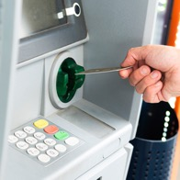
Online vs. in-person
Traditional banks with physical locations
Pros:
Easy access to ATMs
In-person services (notary, safety deposit boxes, cash deposits)
Relationship with your banker
Cons:
Possibly more or higher fees
Notes:
VOICEOVER FOR THIS SLIDE:
If in-person banking is important to you, make sure you consider these pros and cons. One of the bigger watch-outs is that banks with physical locations may charge higher fees as a way to maintain those facilities — it’s an expense that online-only banks just don’t have.
So that’s something you’re going to want to research before you decide which bank is right for you.

Slide 39
Protecting against digital fraud
Choose strong and unique passwords that include special characters (!, $, %, ^).
Enable two-factor authentication.
Avoid public Wi-Fi.
Sign up for banking alerts.
Avoid phishing scams.
Notes:
VOICEOVER FOR THIS SLIDE:
No matter if you opt for an online-only bank or a brick-and-mortar one, you need to keep your personal information safe when transacting online.
These basic guidelines can help protect you from fraud. For example:
Choose strong and unique passwords. Use special characters, numbers, and a mix of upper and lower case letters, Or use a password manager to generate passwords.
Enable two-factor authentication. This is when you choose to get a text to enter a unique code when logging on.
Avoid public Wi-Fi (not always secure)
Sign up for banking alerts (for low/high balances, new transactions, failed login attempts, password changes, personal info changes)
Avoid phishing attempts. Phishing usually happens by emails or texts, and it’s someone’s attempt to get you to either click a bad link or share private information (like passwords). If you get a questionable message, scrutinize the senders’ emails, hover over links — but don’t click — to check where they actually go, and don’t provide personal info via email or text. Call the person or the bank back to check, but use a number you know (don’t click one that was provided in the possibly fake email or text!)

Slide 40
Quiz Time!
True or False:
If your bank is FDIC insured, it means your money
in deposit accounts is protected if the bank somehow fails or goes out of business.
True!
Notes:
Ask before revealing the answer: What do you think the answer is? What makes you say that?
CLICK TO REVEAL ANSWER
Remember, thanks to FDIC insurance, the money in your deposit accounts, like checking and savings accounts, is insured up to $250,000.

Slide 41
Quiz Time!
Question:
What’s the difference between
debit and credit cards?
Debit cards use money from your checking account, while credit cards borrow against a line of credit, and you have to pay that money back.
Notes:
Ask before revealing the answer: What do you think the answer is?
CLICK TO REVEAL ANSWER

Slide 42
Quiz Time!
Fill in the blank.
payment
Venmo and Cash App are examples of apps.
Apple Wallet and Google Wallet are examples
of wallets.
digital
Notes:
Ask before revealing the answer: What do you think the answer is?
CLICK TO REVEAL ANSWER

Slide 43
Quiz Time!
Question:
The money in your savings account can grow
thanks to the power of what?
Compounding interest
Notes:
Ask before revealing the answer: What do you think the answer is?
CLICK TO REVEAL ANSWER

Slide 44
Where to learn more about personal finances
Hands on Banking
(Search online: Hands on Banking)
FDIC Consumer Resource Center
(Search online: FDIC Consumer Resource Center)
Bank On accounts
(Search online: Bank On certified accounts)
National Credit Union Administration
(Search online: My Credit Union Education)
Notes:
VOICEOVER FOR THIS SLIDE:
Take a photo of this slide for later!
Learning about money and growing your knowledge when it comes to personal finances takes time and effort — but can pay off so much in the long run. It can help you improve your financial well-being over time and make your future brighter.
There are many free resources to help you — especially online. Consider subscribing to a financial education newsletter or podcast, or bookmarking a website.
If you have a relationship with a bank, you can also reach out to them to see if they can connect you with experts or other resources to educate you.

